Slide 1
PHY 114 A General Physics II
11 AM-12:15 PM TR Olin 101
Plan for Lecture 7 (Chapter 27):
Electrical currents
Voltage and resistance
Electrical power

Slide 2
Remember to send in your chapter reading questions…

Slide 3
Evening exams
#3 and #4

Slide 5
i-clicker:
A. Would attend a review of Exam 1 at 5 PM today (Tuesday)
B. Would attend a review of Exam 1 at 5:15 PM Wednesday.

Slide 6
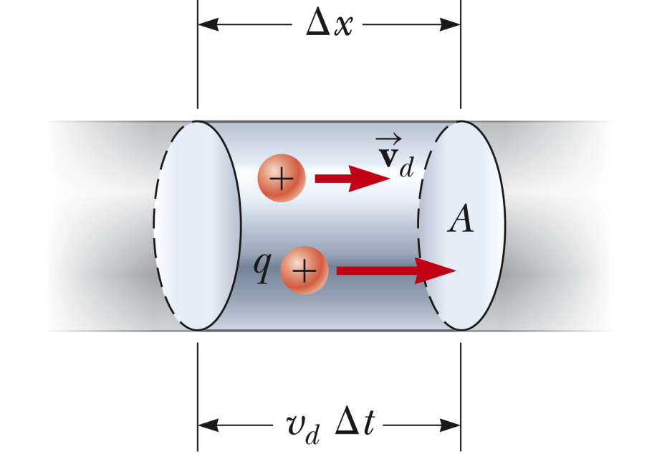
Up to now, we have been considering equilibrium configurations of charges -- electrostatics. Now we will consider steady-state motions of charges.
Electrical current
➔By convention +I denotes the direction of positive charge flow (or the opposite direction of negative charge flow).
drift velocity
# charges/volume

Slide 7
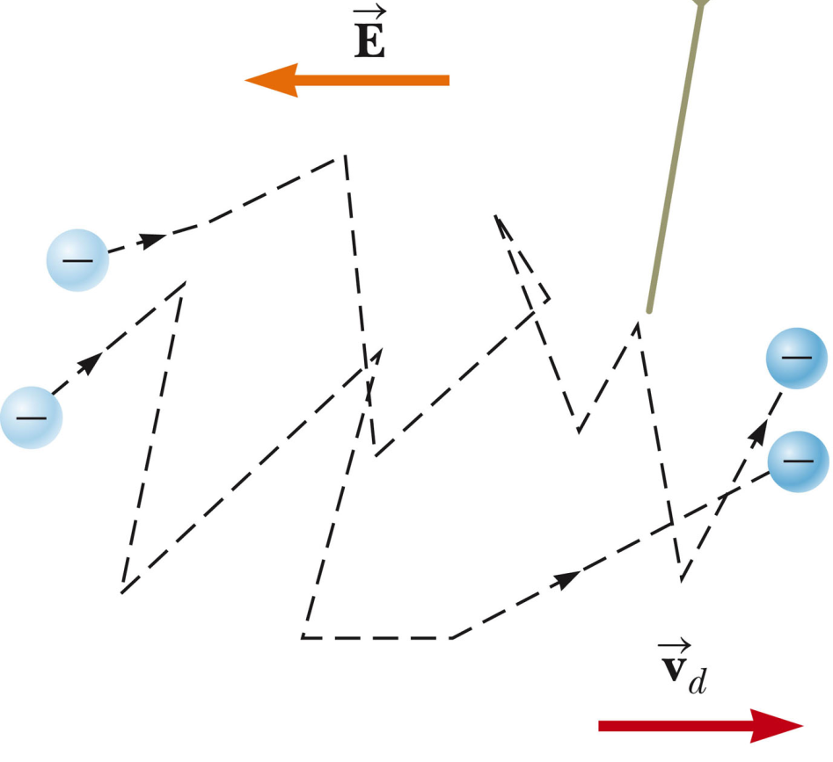
Representation of drift velocity of negative charge carrier in some material.
Why would this be a suitable model of the motion of a charge within an electric field?
Suppose you have an electron – charge q=-e and mass m_{e} initially at rest in the presence of electric field E. What is the velocity at time t:
v_{d}
-eEt/m_{e}

Slide 8
Model to describe drift velocity
term representing collisions on a time scale of τ

Slide 9
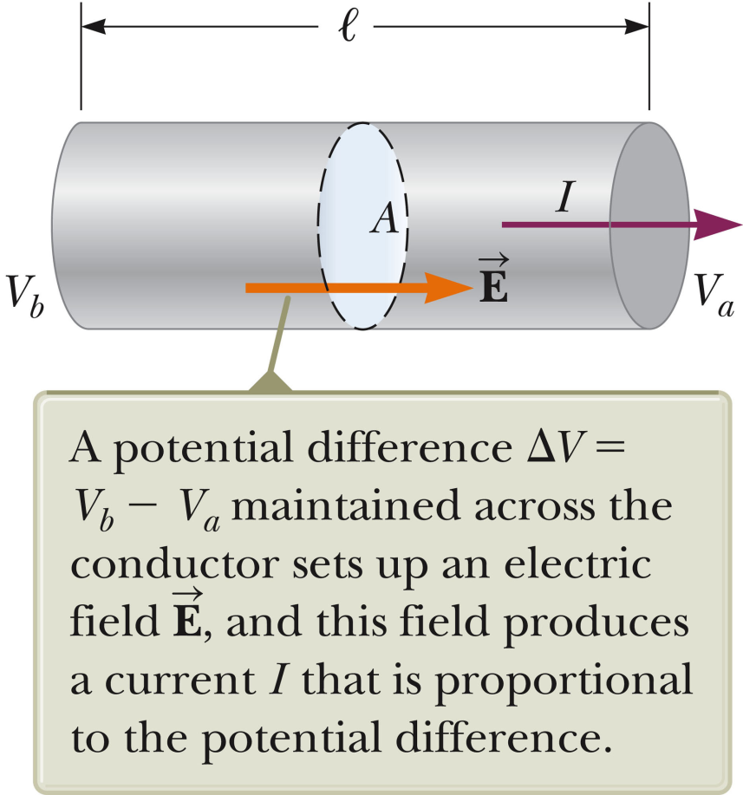
ΔV=E l

Slide 10
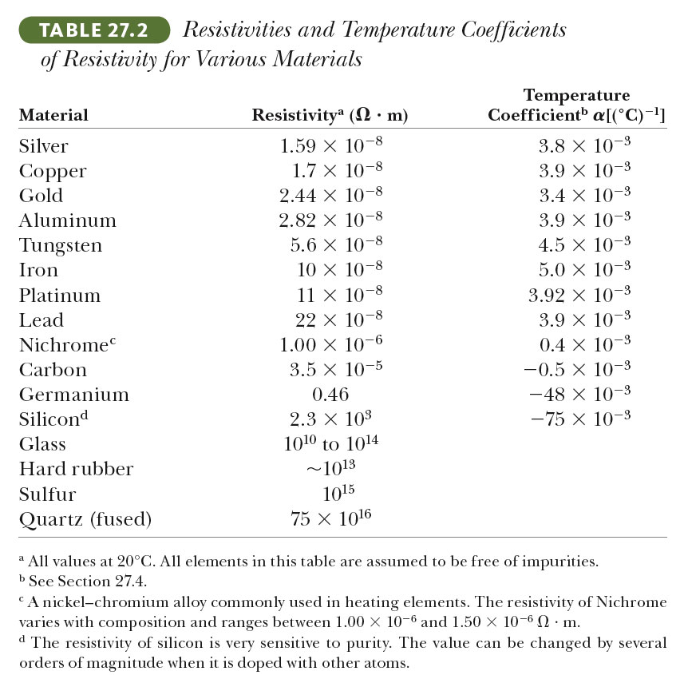
ρ

Slide 11
Example:
What is the resistance of a Al wire of diameter 1mm and length 1m?

Slide 12
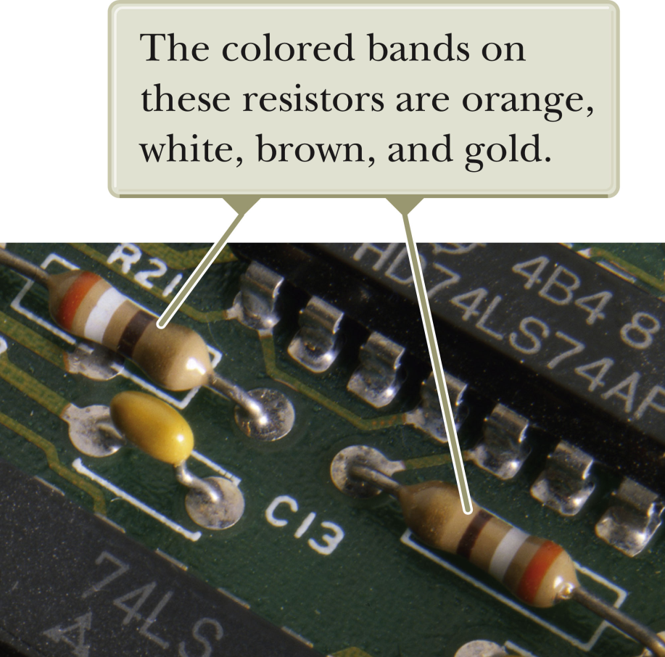
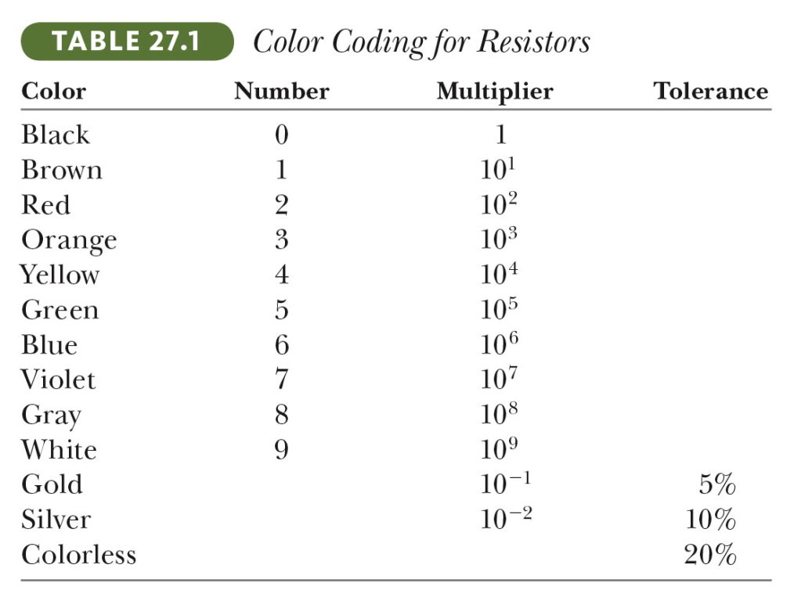
Practical resistors:

Slide 13
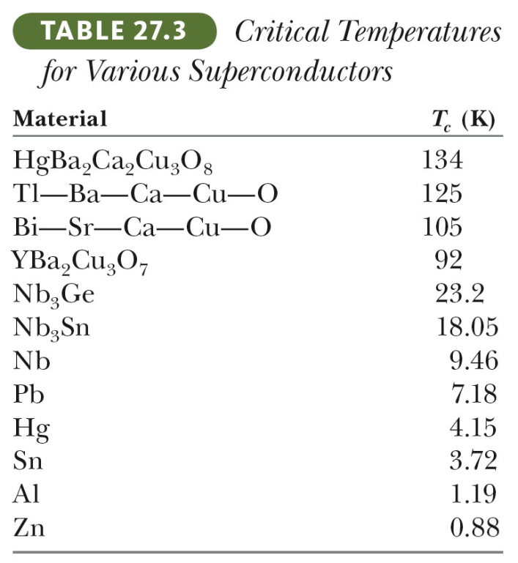
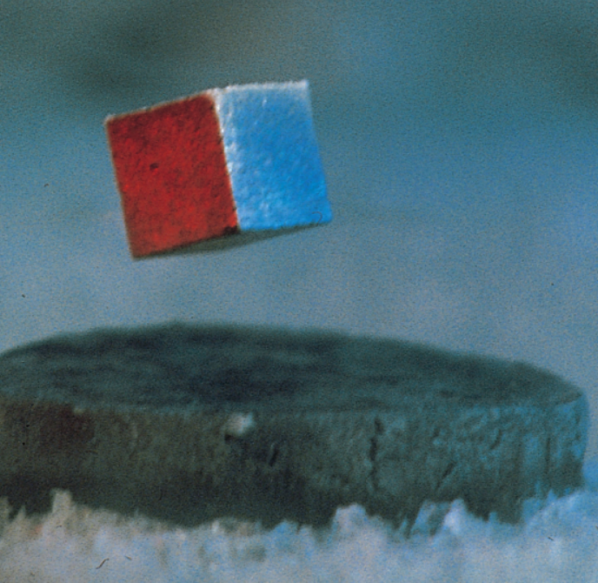
For superconducting materials:
term representing collisions on a time scale of τ ⎝ ∞
For superconducting materials ρ ➔ 0
Currents confined to surfaces; induced by magnetic fields

Slide 14
Energy associated with currents and voltage
Electric potential energy for charge Q in voltage ΔV
Rate of change of electric potential energy:

Slide 15
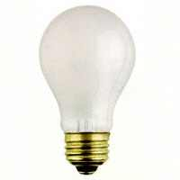
Consider a 60 W light bulb, connected to a 120 V voltage source.
What is the current passing through the wire in the bulb?
(A) 0.5 A (B) 1.0 A (C) 2.0 A (D) 240 A
What is the resistance of the wire in the bulb?
(A) 0.5 Ω (B) 1.0 Ω (C) 2.0 Ω (D) 240 Ω

Slide 16
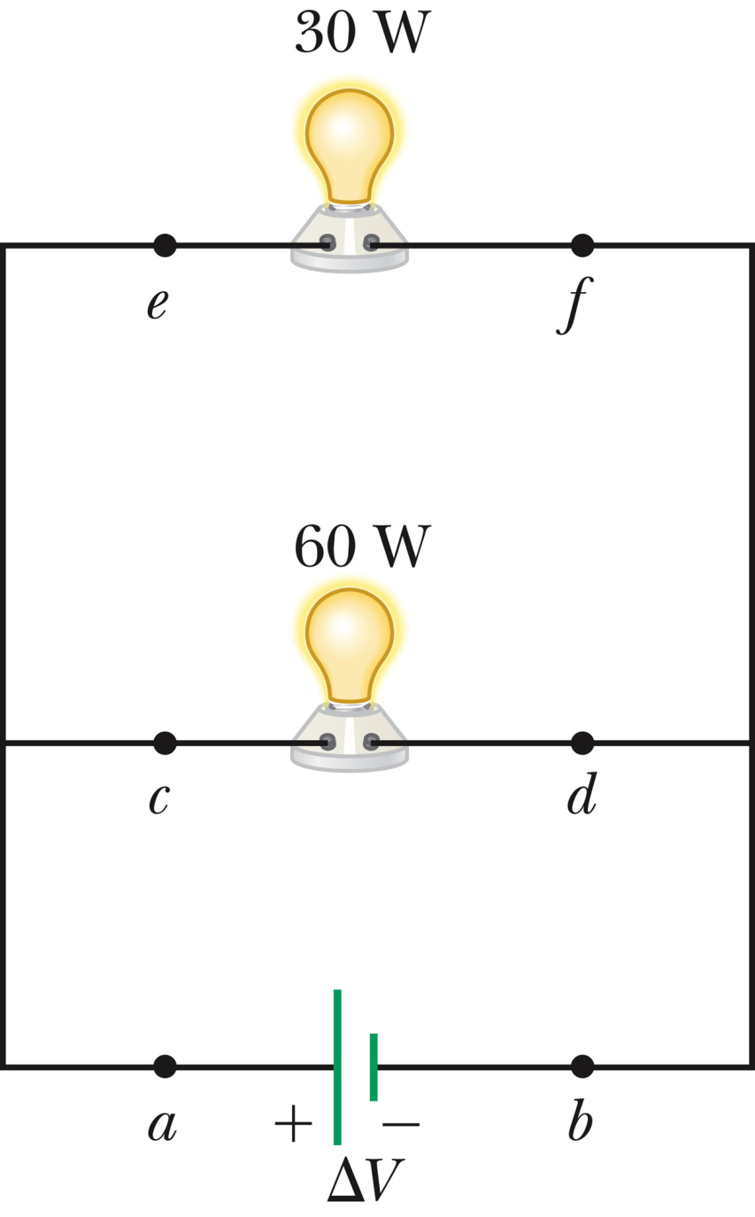
Which is true:
I₁ > I₂
I₁ < I₂
I₁ = I₂
I₁, R₁ , ΔV₁
Which is true:
R₁ > R₂
R₁ < R₂
R₁ = R₂
I₂, R₂, ΔV₂
Which is true:
ΔV₁ > ΔV₂
ΔV₁ < ΔV₂
ΔV₁ = ΔV₂

Slide 17
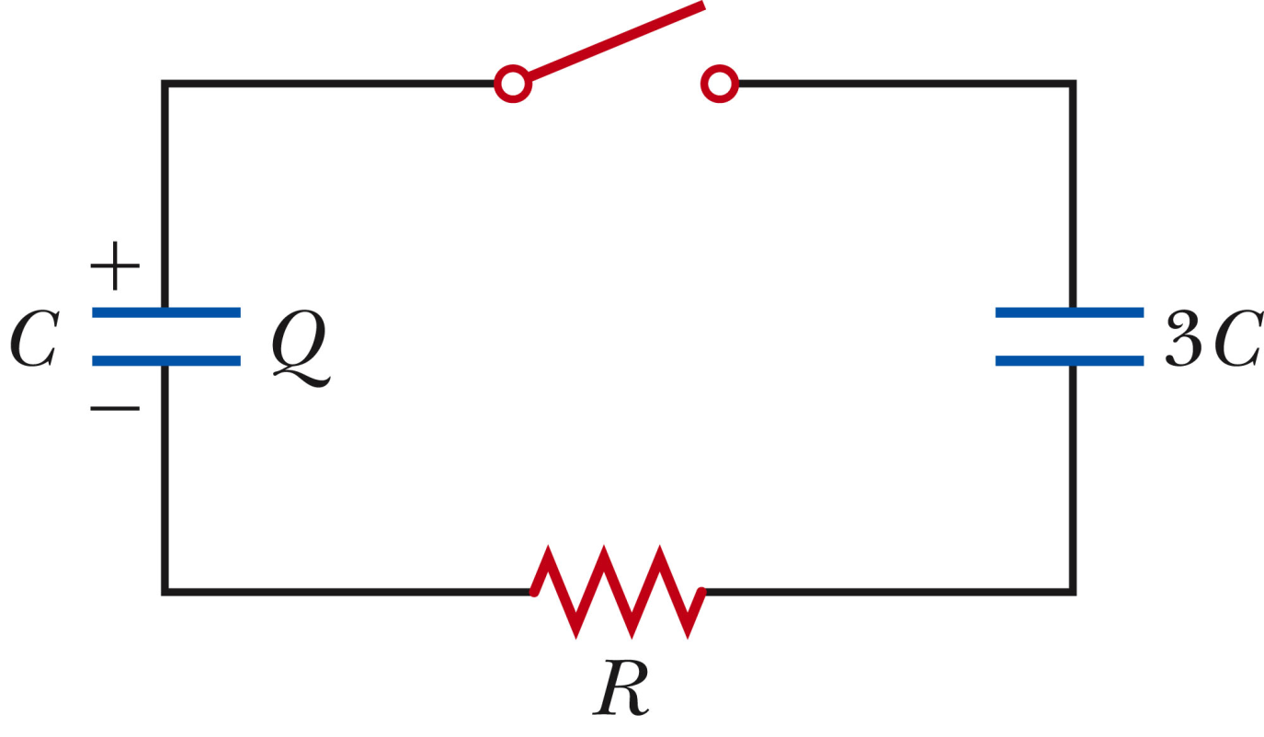
Initially, the switch is open and the left capacitor is charged.
Q=0
Now the switch is closed.
R has no effect.
R has an effect on the initial Q’.
R has an effect on the final Q’.
Q’
Q’

