Slide 1
PHY 114 A General Physics II
11 AM-12:15 PM TR Olin 101
Plan for Lecture 8 (Chapter 28):
Direct-current circuits
Voltage and resistor circuits
Kirchhoff’s rules

Slide 2
Remember to send in your chapter reading questions…

Slide 3
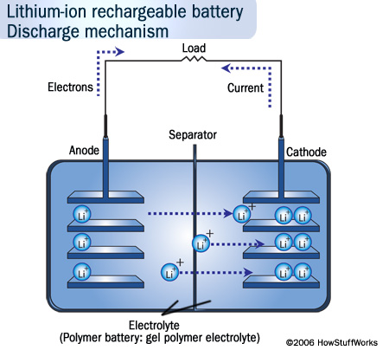
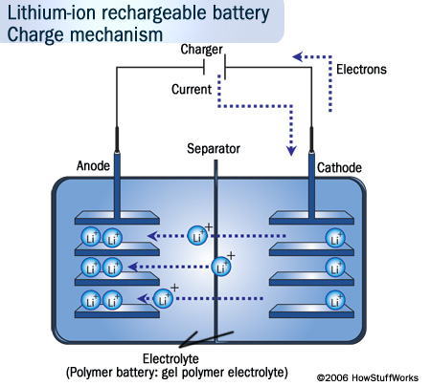
Comment on Direct current versus Alternating current
http://www.pbs.org/wgbh/amex/edison/sfeature/acdc.html
Example – Li ion rechargeable battery
http://electronics.howstuffworks.com/everyday-tech/lithium-ion-battery1.htm

Slide 4
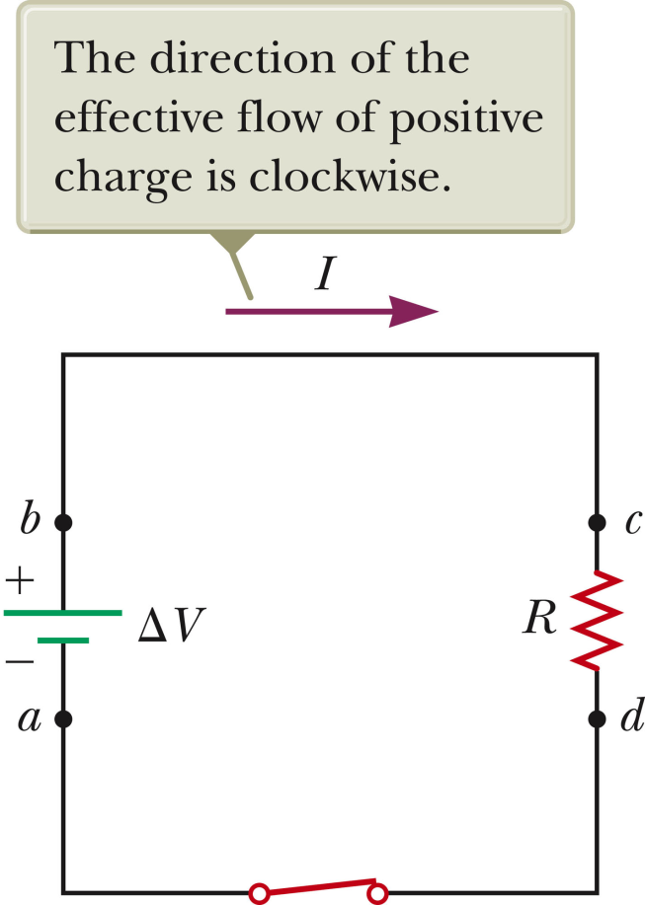
Switch open, no current flowing, battery storing energy
Switch closed, current flowing, battery discharging
I

Slide 5
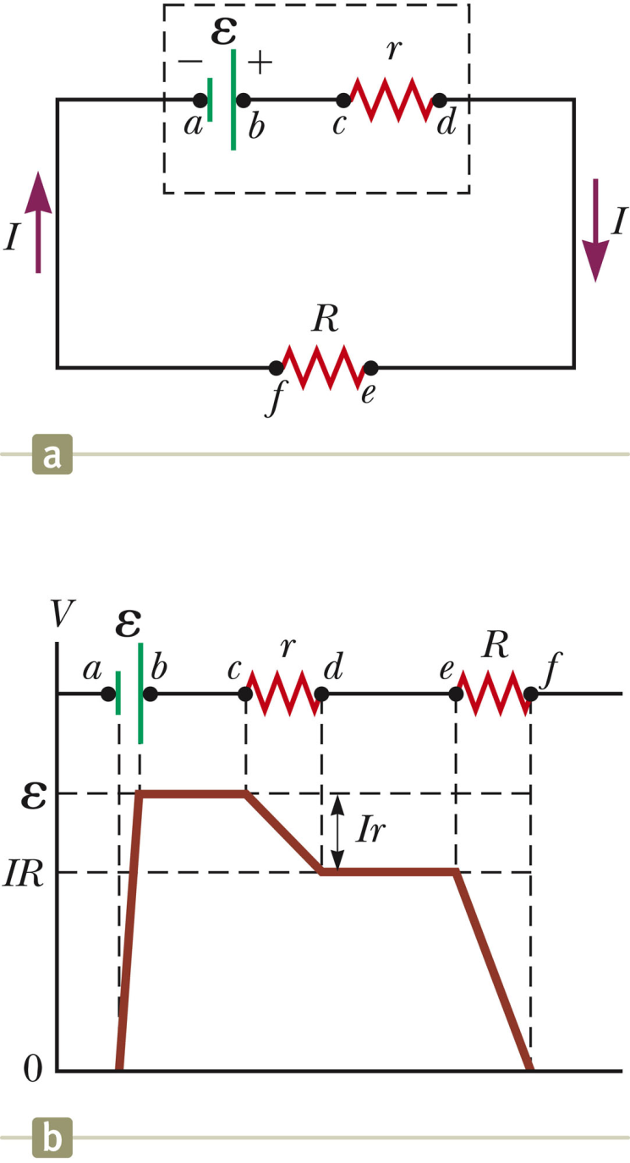
Equivalent circuit for E
ΔV
E=12V, r=0.1Ω, R=9.9Ω; what is ΔV?
ΔV=E
ΔV<E
ΔV>E

Slide 6
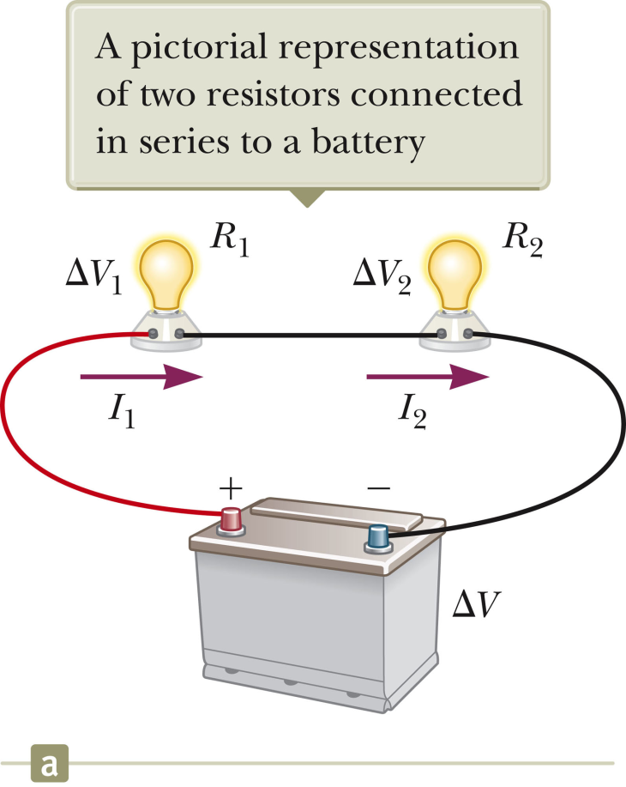
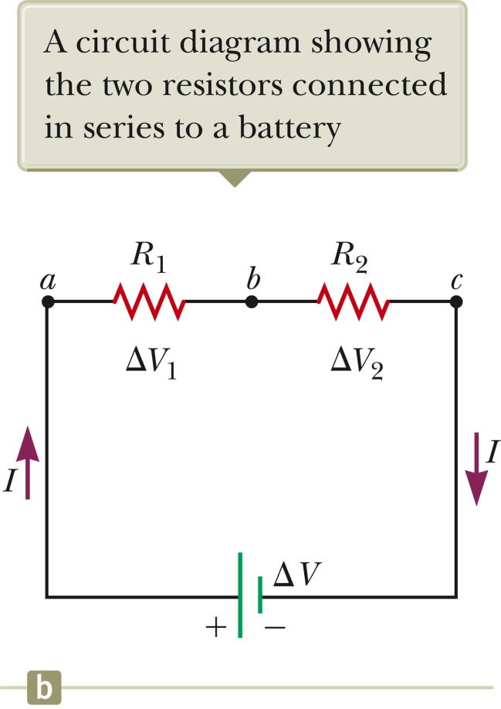
Resistors in series:

Slide 7
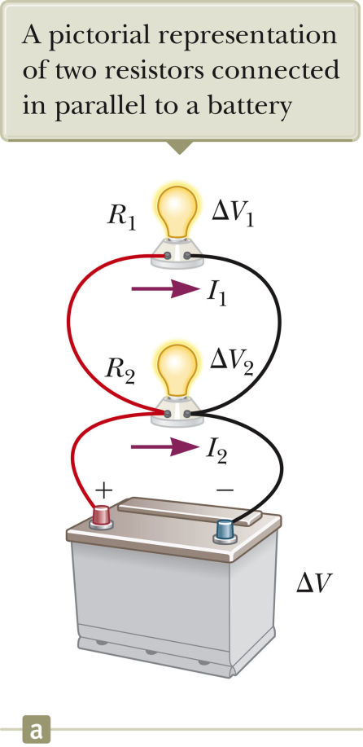
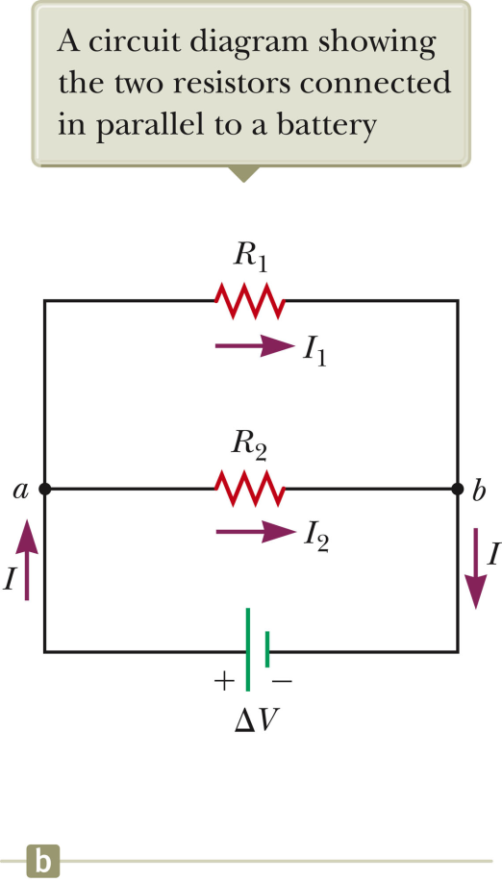
Resistors in parallel

Slide 8
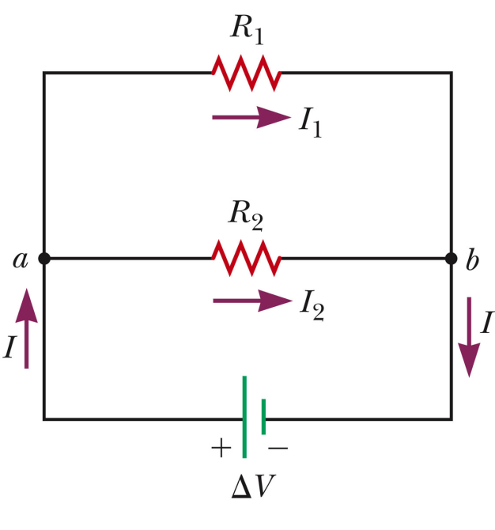
Examples: R₁=1Ω, R₂=100Ω, ΔV=100V

Slide 9
Circuit analysis – Kirchhoff’s rules
Conservation of charge (current) at a junction:

Slide 10
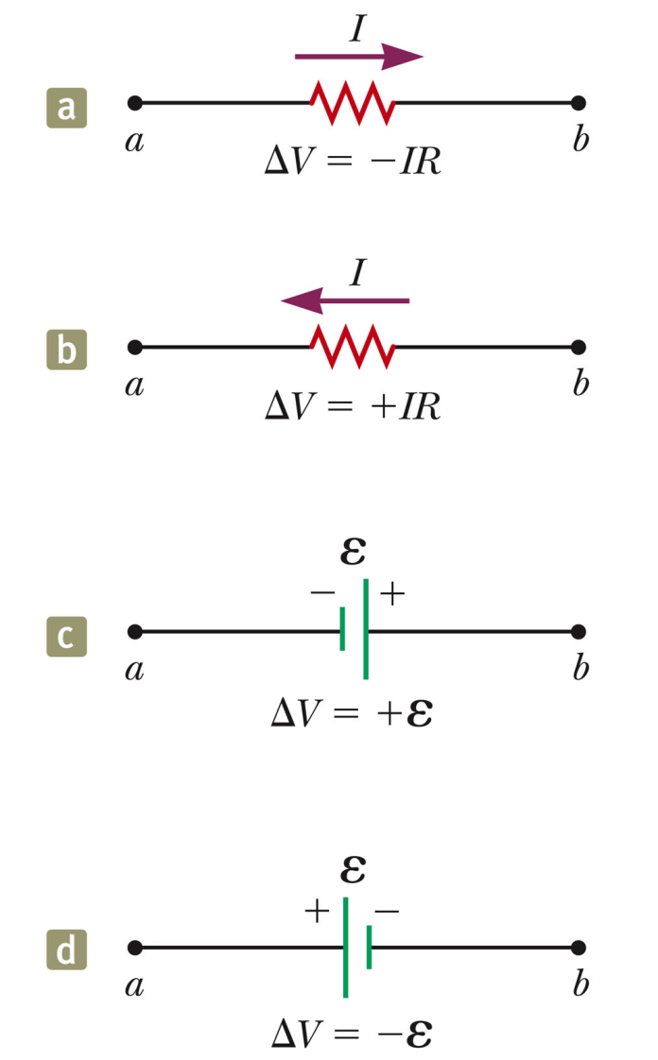
Circuit analysis – Kirchhoff’s rules
Conservation of potential around a closed circuit:
Sign conventions:ΔV=V_{b}-V_{a}
ΔV₁
ΔV₂
ΔV₃

Slide 11
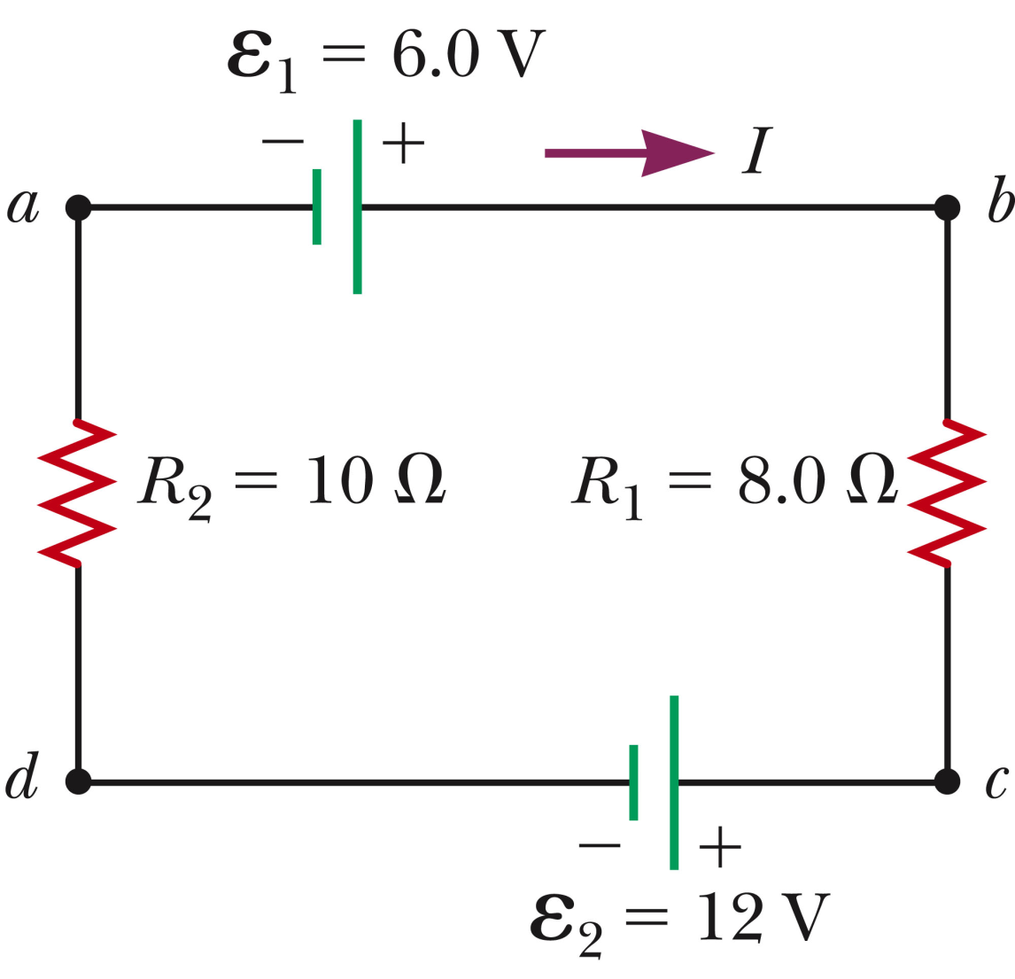
Example:
I<0 means:
The circuit is wrong (cannot exist or will blow up).
The current flows opposite the arrow.

Slide 12
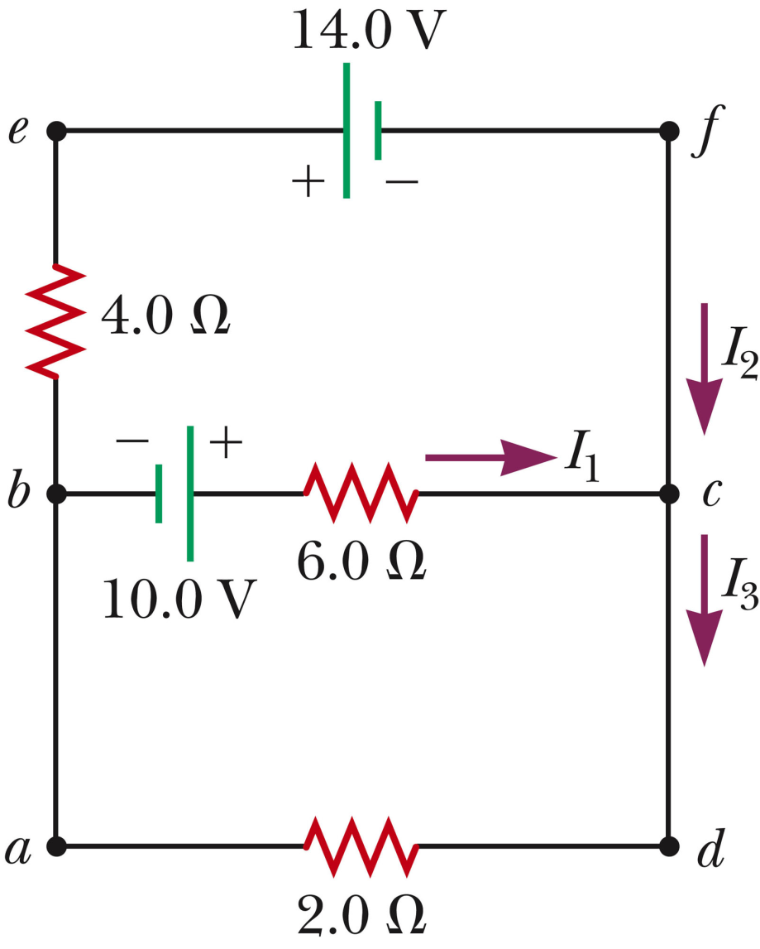
Example:
I₂
I₃

Slide 13
How to measure current
I
I
A
R₁
Inside ammeter:
I
I
R₂

Slide 14
R₁
I
R₂
➔Current that drives measurement device.

Slide 15
What if the ammeter were connected in parallel to the wire? (Assume that the wire resistance is R_{w}=0.001Ω.)
A
The measurement would be identical to series result.
The measurement would be less than the series result.
The measurement would be greater than the series result.

Slide 16
How to measure voltage
V
I
I
R_{eq}
Total equivalent circuit:
R_{V}
I
I
R_{eq}

Slide 17
Total equivalent circuit: Suppose I=10A, R_{eq}=10Ω, R_{V}=100Ω
R_{V}
I
I
R_{eq}

Slide 18
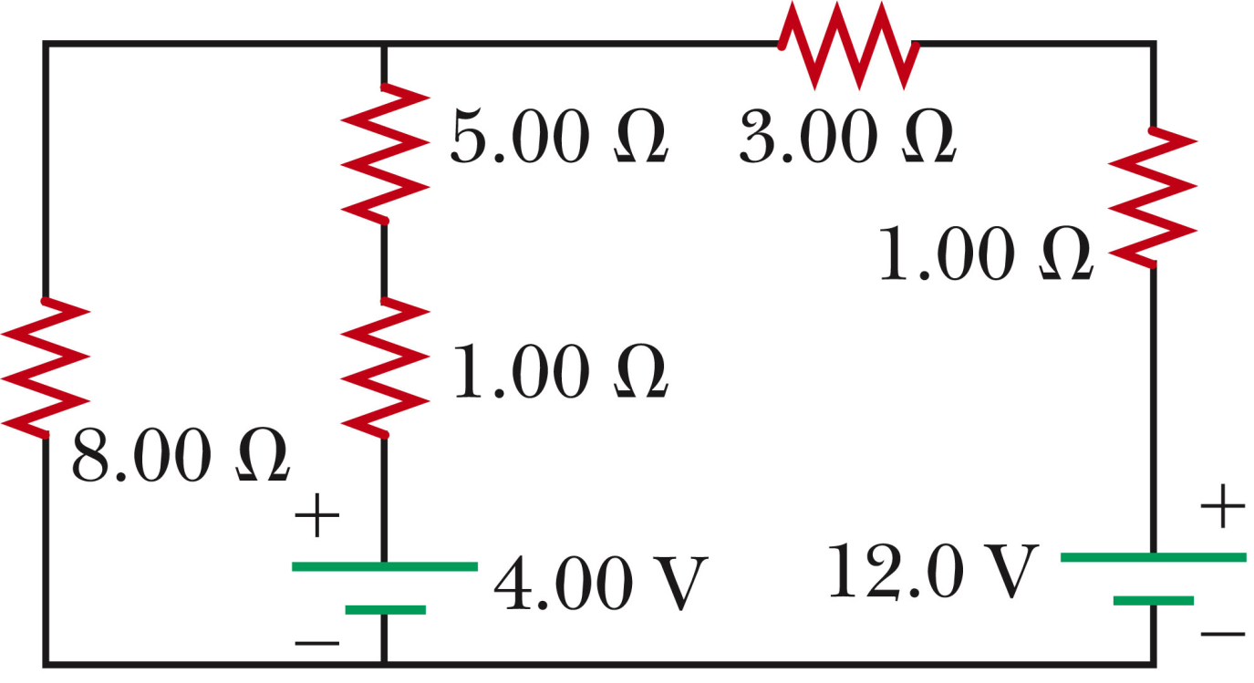
I₃
I₃
I₂
I₁
3 unknowns ➔ need 3 equations

