Slide 1
PHY 114 A General Physics II
11 AM-12:15 PM TR Olin 101
Plan for Lecture 9 (Chapter 28):
Direct-current circuits continued
Voltage, resistor, and capacitor circuits

Slide 2
Remember to send in your chapter reading questions…

Slide 3
Professor George Holzwarth (gholz@wfu.edu)
will administer the exam on 2/28/2012 and will lecture on magnetic fields, electric motors, etc. on 3/1/2012.

Slide 4
Circuit diagram:
Example project from web page http://www.kpsec.freeuk.com/projects/dummy.htm

Slide 5
From webassign:
I
I₁

Slide 6
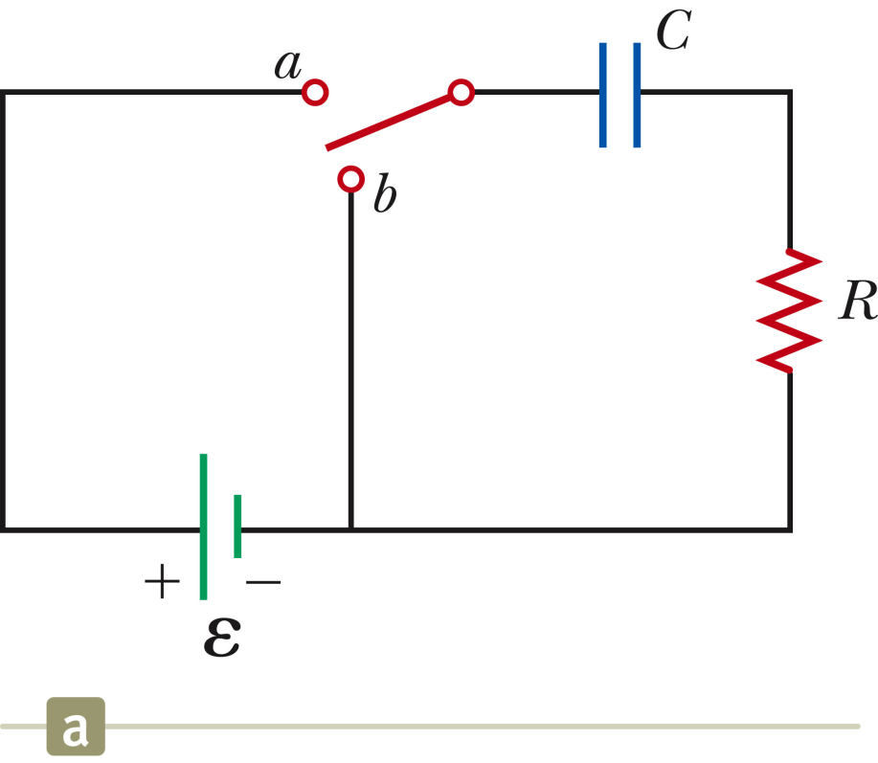
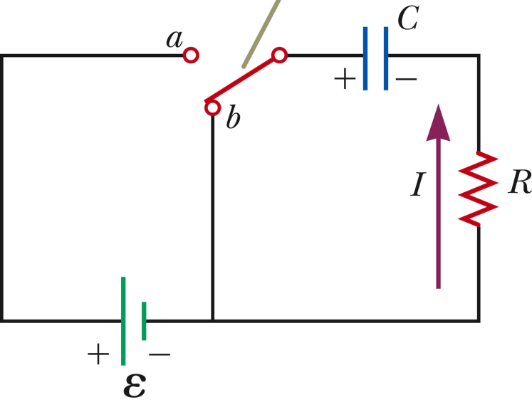
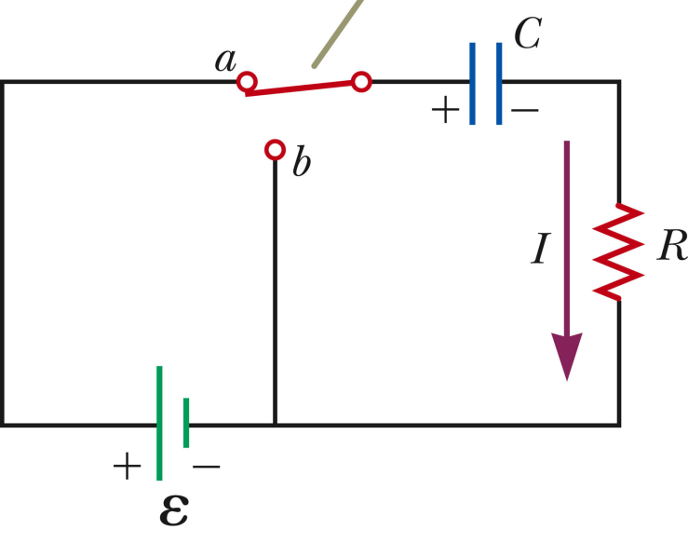
Circuits involving Voltage, Capacitance, and Resistance
Open switch ➔ no charge or current
Switch closed ➔ RC circuit
Switch closed ➔ VCR circuit

Slide 7
+Q
-Q
C
I

Slide 8
What are the units of RC?
Seconds
Cycles per second
Meters
Coulombs
Volts

Slide 9
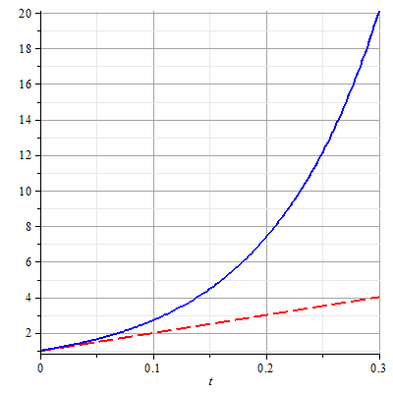

Slide 10
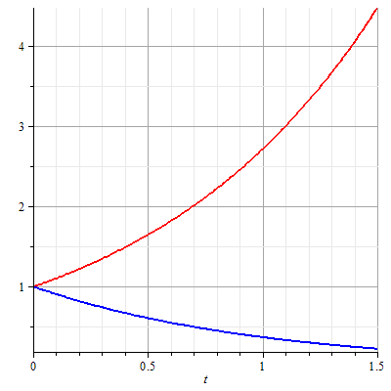

Slide 11
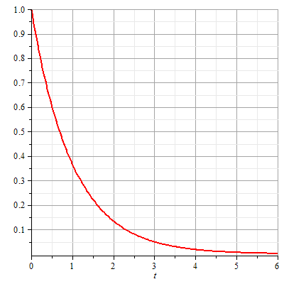
+Q
-Q
C
I
e⁻¹=0.37
e⁻²=0.14
e⁻³=0.05

Slide 12
Charging capacitor:
Switch closed at t=0; Q(t=0)=0

Slide 13
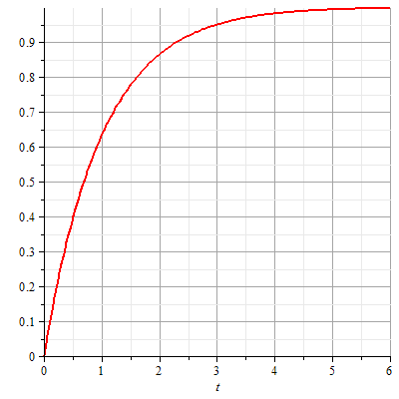
Charging capacitor:
Switch closed at t=0; Q(t=0)=0

Slide 14
Discharging capacitor
When switch closed Q(t_{c})=CE

Slide 15
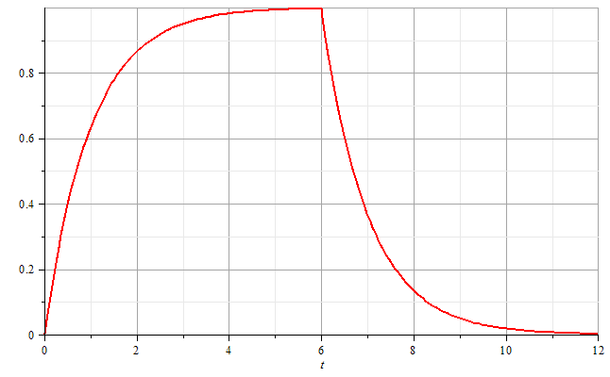
a
b
→t

Slide 16
a
b
→t

Slide 17
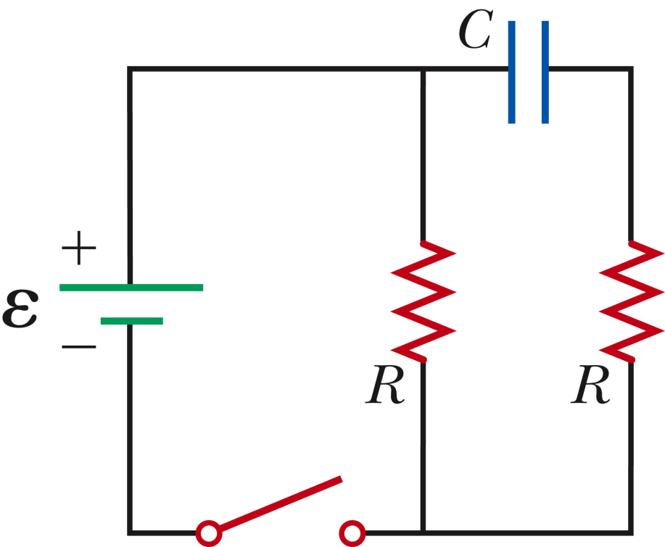
What is the current I flowing through the battery just when the switch is closed?
0
E/2R
E/R
2E/R
Example 28.5 :
Assume the capacitor is initially uncharged.
I
What is the current I flowing through the battery after the switch has been closed for a long time?
0
E/2R
E/R
2E/R

Slide 18
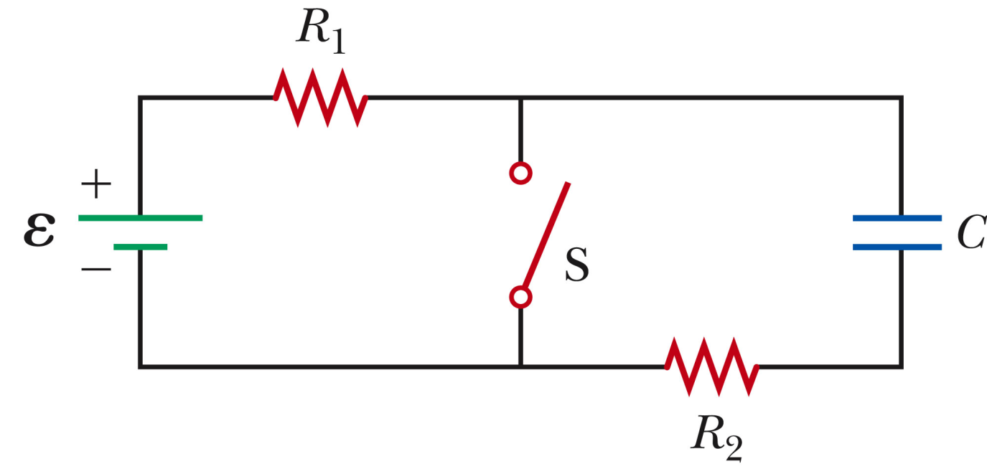
When switch is open:
+Q
I
I
-Q

Slide 19
When switch is closed (reset t=0):
+Q
I₁
I_{S}
I₂
-Q

