Slide 1
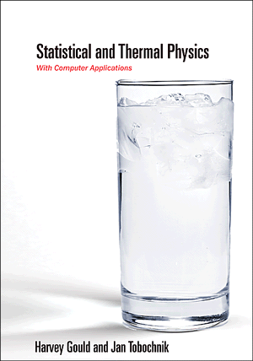
PHY 341/641 Thermodynamics and Statistical Mechanics
10-10:50 AM MWF Olin 107
Instructor: Natalie Holzwarth (Olin 300)
Course Webpage: http://www.wfu.edu/~natalie/s12phy341
Supplemental webpage:
http://www.compadre.org/STP/

Slide 6
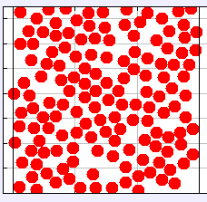
What will you learn?
Energy Analysis
Macroscopic picture
Microscopic picture
ΔU
Q
{T, P, V, N, …}
W

Slide 7
Chapter 1 – From Microscopic to Macrosopic Behavior
Assignment: Read Chapter 1 (quickly) during this week and checkout some of the corresponding simulations (HW 1 and HW 2).
“The purpose of this introductory [material] is to whet your appetite… “ The chapter introduces a lot of the concepts that we will use (more carefully) throughout the course.

Slide 8
Comment on simulation tools
Molecular dynamics
r_{i}
Example model pair potential (Lennard-Jones):

Slide 9
Simulation available from: http://www.compadre.org/STP/
stp_LJ2DMD.jar
Note: in order to easily control the simulation, you need to use:
Display → Switch GUI

Slide 10
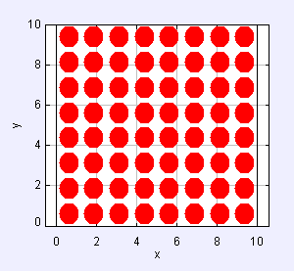
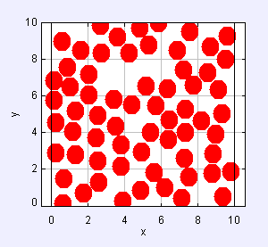
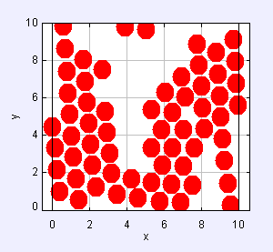
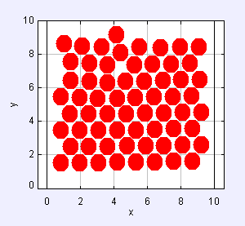
Results for N=64, L=10
Initial (uniform) configuration:
Thermalized (liquid-like) configuration:
Cooled (condensed) configuration:
Cooled (condensed) configuration:

Slide 11
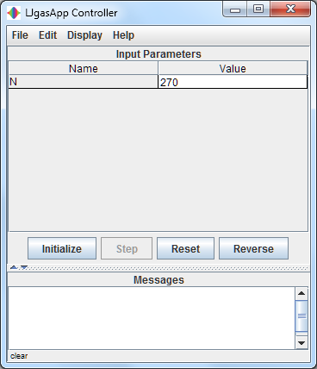
Simulation available from: http://www.compadre.org/STP/
stp_MDApproachToEquilibriumThreePartitions.jar
Note: in order to easily control the simulation, you need to use:
Display → Switch GUI

Slide 12
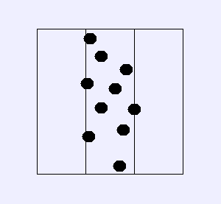
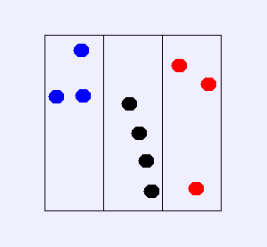
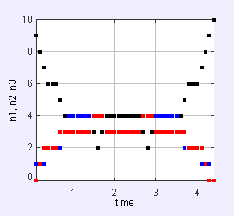
Results for N=10, t≈10 followed by reversal (v → -v)
Initial configuration:
After ~ 10 time steps
→
Plot of time sequence before and after reversal:

Slide 13
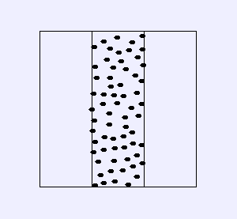
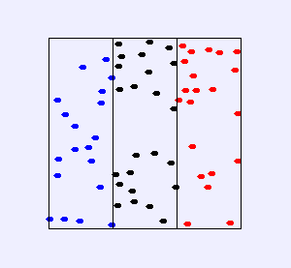
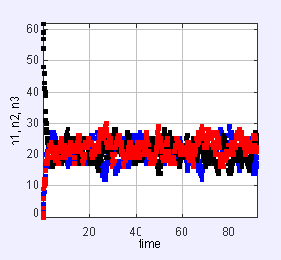
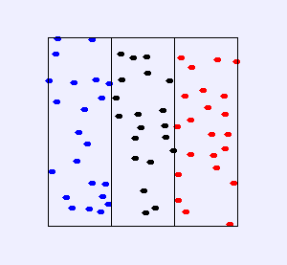
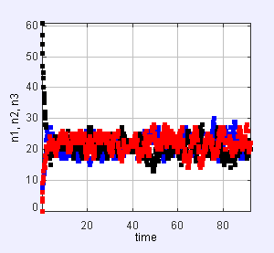
Results for N=64, t≈45-90, with and without reversal
t=0
t=90 -- normal simulation
t=0
t=90 -- v→-v at t=45

Slide 14
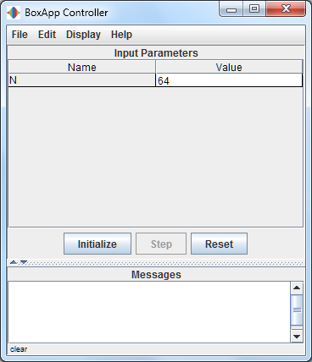
Simulation available from: http://www.compadre.org/STP/
stp_ApproachToEquilibrium.jar
Note: in order to easily control the simulation, you need to use:
Display → Switch GUI

Slide 15
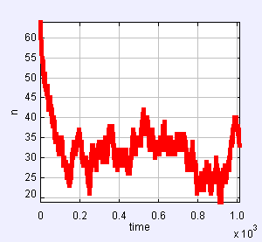
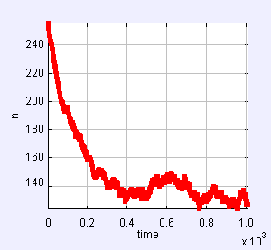
N=64, t≈1000 <n> = 32.08, <n²> = 1,067.13, σ² = 38.12, σ/<n> = 0.19
N=64, t≈1000 <n> = 149.57, <n²> = 23,086.17, σ² = 714.56, σ/<n> = 0.18

