Slide 1
PHY 341/641
Thermodynamics and Statistical Physics
Lecture 10
Probability concepts (Chapter 3 in STP)
Binomial distribution (continued)
Central Limit theorem
Poisson distribution and others

Slide 2
Comment on HW problem:

Slide 3
Binomial distribution (review) –
Assume each elemental event has 2 possible outcomes (for example H with probability p and T with probability q=1-p). P_{N}(n) gives the probability
distribution for N elemental events having n instances of H.

Slide 5
More general importance of Gaussian probability distribution – “central limit theorem”
One-dimensional random walk
It is possible to describe a version of a random walk process as a binomial distribution. If each step has a fixed length s, then an elementary event is a step to the right with probability p or a step to the left with probability q. The probability of n steps to the right is then the binomial distribution.

Slide 6
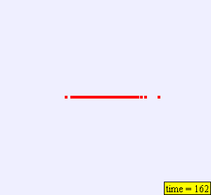
Example of random walk:
stp_RandomWalk2D.jar

Slide 7
One-dimensional fixed step walk, continued
For N total steps and n steps to the right with probability P_{N}(n), displacement is
x=ns-(N-n)s=(2n-N)s
<x>=(2<n>-N)s=(2p-1)Ns
<x²>-<x>² =4pqNs²
Generalization – one-dimensional variable step (s_{i}) walk
(derivations following Fundamentals of statistical and thermal physics by F. Reif (1965))

Slide 11
Poisson probability distribution –
Approximation to binomial distribution for small p

Slide 12
Other probability distributions:

