Slide 1
PHY 341/641
Thermodynamics and Statistical Physics
Lecture 11
Some further comments about probability theory and a beginning discussion of methodologies of statistical mechanics. (Chapters 3&4 in STP)
Poisson distribution and other distributions
Examples of macrostates and microstates

Slide 2
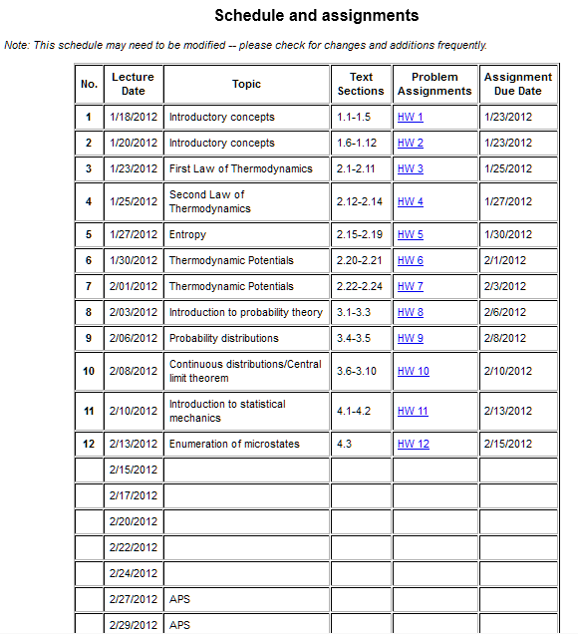

Slide 3
Poisson probability distribution –
Approximation to binomial distribution for small p

Slide 4
Other probability distributions:

Slide 5
Some methodologies of statistical mechanics
Example: Isolated closed system in a particular “macrostate”; analyze possible “microstates”
System 1: N=5 spins, where s_{n}=+1 or -1 and Σs_{n}=1
Ω=10
Note: If the magnetic moment of each spin is μs_{i}, then in a magnetic field B, this system has fixed energy E=-μB.

Slide 6
System 2: “Einstein solid” with N=3, E=3

Slide 7
Einstein solid with N=2, E_{A}=5, Ω_{Α}=6
Einstein solid with N=2, E_{B}=1, Ω_{Β}=2

Slide 8
Now, allow the barrier to accommodate energy transfer

Slide 10
Note that, for the constrained system:
For the system with thermal exchange:

Slide 11
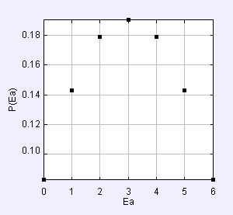
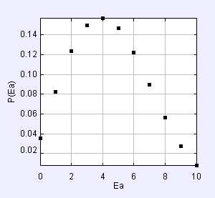
Simulation program stp_EinsteinSolids.jar
E_{A}=5, E_{B}=1, N_{A}=2, N_{B}=2
E_{A}=10, E_{B}=0, N_{A}=3, N_{B}=4

Slide 12
More results for E_{A}=10, E_{B}=0, N_{A}=3, N_{B}=4:

Slide 13
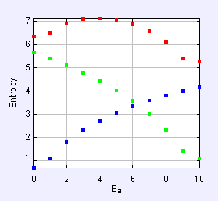
Simulation stp_Entropy EinsteinSolid.jar
S_{A+B}
S_{B}
S_{A}

