Slide 1
PHY 341/641
Thermodynamics and Statistical Physics
Lecture 12
Methodologies of statistical mechanics. (Chapter 4 in STP)
Examples of macrostates and microstates
S=k ln(Ω)
Counting microstates

Slide 3
Review from Lecture 11 – 2 subsystems sharing total energy
N_{A}=2, N_{B}=2

Slide 5
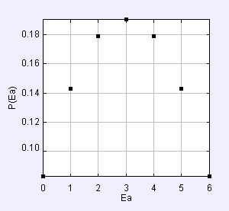
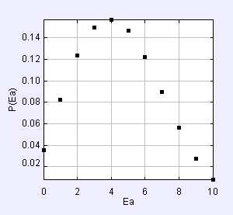
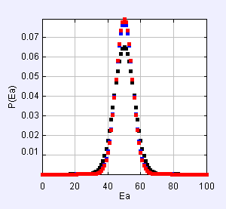
Simulation program stp_EinsteinSolids.jar
E_{A}=5, E_{B}=1, N_{A}=2, N_{B}=2
E_{A}=10, E_{B}=0, N_{A}=3, N_{B}=4
E_{A}=100, E_{B}=0, N_{A}=N_{B}=100,1000,10000

Slide 6
Properties of microstate number function:
Properties of Boltzmann entropy function

Slide 7
Other examples of microstate analysis for both classical and quantum systems.
For N particles moving according to the classical mechanical (Newton’s) laws of physics in d-dimensional space (d=1,2,3), Liouville’s theorem shows that phase space d^{dN}r d^{dN}p spans all possibilites. In order to count the number of microstates, it is useful to define:

Slide 8
Relationship between classical and quantum microstate analyses:
Example for quantum particle in 1-dimensional box:
0
L

Slide 9
Example: single particle of mass m confined within a 1 dimensional box of length L; d=1, N=1:

Slide 10
Example: single particle of mass m confined within a 2-dimensional square box of length L; d=2, N=1:

Slide 11
Discretization effects in quantum case:

Slide 12
Example: single particle of mass m confined within a 3-dimensional square box of length L; d=3, N=1:

Slide 13
Many particles; N>1
Consider N=2, d=1
0
L

Slide 14
n₁²+n₂²=2
n₁²+n₂²=3
n₁²+n₂²=4
n₁²+n₂²=10
n₁²+n₂²=13
n₁²+n₂²=18
n₁²+n₂²=17
n₁²+n₂²=20
n₁²+n₂²=25
n₁²+n₂²=32

