Slide 1
PHY 341/641
Thermodynamics and Statistical Physics
Lecture 16
Methodologies of statistical mechanics. (Chapter 5 in STP)
Simulations of ensembles
Examples of ensembles for spin systems

Slide 3
Review:
Canonical ensemble:
E_{b}
E_{s}

Slide 4
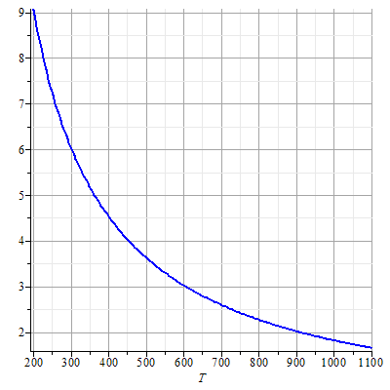
Example of canonical ensemble (Prob. 4.24 in STP)
E_{s}
trans
cis
log(P_{trans}/P_{cis})

Slide 5
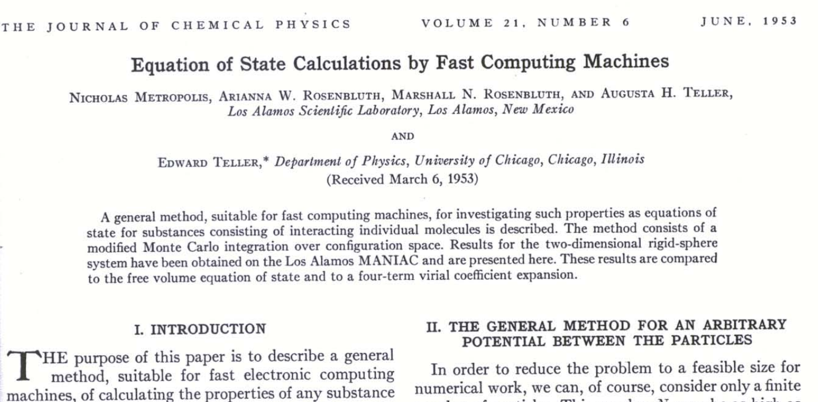
Simulation of the canonical ensemble
Link to pdf file of article

Slide 6
Metropolis algorithm:
Start the simulation with a random choice of microstates to compose a system state s.
Choose a random microstate a to b and calculate the change of the system energy from ε_{b}-ε_{a}:

Slide 7
Examine Δε= ε_{b}-ε_{a} :
If Δε<0 ⎝ then accept the change.
If Δε>0 ⎝ then accept the change with the probability . This can be done by generating a uniformly distributed random number r such that 0 < r < 1. If then accept the new state otherwise, retain the previous state.
Repeat steps 2 and 3 M times, accumulating the summations in the numerator and denominator.
Compute the average.
Note: Some of the programs at the www.compadre.org/stp site use this method.

Slide 8
Grand canonical ensemble
E_{b},N_{b}
E_{s,}N_{s}
Assume E_{s}<<E_{b}, N_{s}<<N_{b}

Slide 9
Summary of ensemble results:
 | Partition function | Thermodynamic potential
Microcanonical | Ω(E,V,N) | S(E,V,N)=k ln(Ω)
Canonical | Z(T,V,N) | F(T,V,N)=-kT ln(Z) F=E-TS
Grand canonical | Z_{G}(T,V,μ) | Ω_{Landau}(T,V,μ)=-kT ln(Z_{G}) Ω_{landau}=F-μN

Slide 10
Examples of ensembles for magnetic interactions
(Chapter 5 in STP)

Slide 11
Calculation of Z₁
Thermodynamic functions:

Slide 12
Magnetic field dependence of Z:

