Slide 1
PHY 341/641
Thermodynamics and Statistical Physics
Lecture 18
Methodologies of statistical mechanics. (Chapter 5 in STP)
Ising model systems
Definition
Exact solution for 1-dimension
Mean field solution

Slide 3
Statistical mechanics of spin ½ systems

Slide 4
Calculation of Z₁
Thermodynamic functions:

Slide 5
Independent particle system
Interacting particle system – Ising model

Slide 6
Ising model for H = 0 and N=2

Slide 7
Ising model for H ≠ 0 and N=2

Slide 8
Partition function for 1-dimensional Ising system of N spins with periodic boundary conditions (s_{N+1}=s₁)

Slide 9
1-dimensional Ising system of N spins with periodic boundary conditions (s_{N+1}=s₁) (continued)

Slide 10
1-dimensional Ising system of N spins with periodic boundary conditions (s_{N+1}=s₁) (continued)

Slide 11
1-dimensional Ising system of N spins with periodic boundary conditions (s_{N+1}=s₁) (continued)

Slide 12
1-dimensional Ising system of N spins with periodic boundary conditions (s_{N+1}=s₁) (continued)

Slide 13
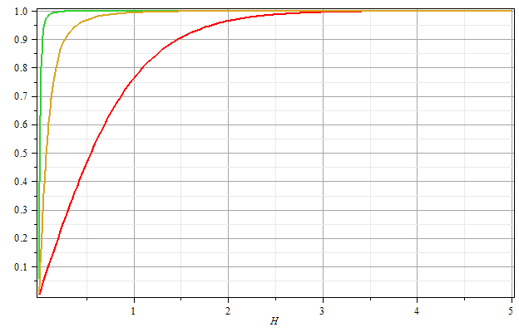
βJ=2
βJ=1
βJ=0
Μ/Ν
βH

Slide 14
Mean field approximation for 1-dimensional Ising model

Slide 15
Mean field partition function and Free energy:

