Slide 1
PHY 341/641
Thermodynamics and Statistical Physics
Lecture 19
Methodologies of statistical mechanics. (Chapter 5 in STP)
Ising model systems
Definition
Exact solution for 1-dimension
Mean field solution for 1-d
Ising model for 2 dimensions

Slide 3
Ising model

Slide 4
Exact solution for 1-dimensional Ising system of N spins with periodic boundary conditions (s_{N+1}=s₁)

Slide 5
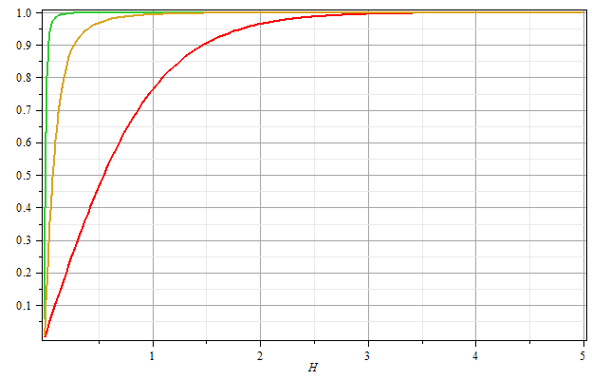
βJ=2
βJ=1
βJ=0
Μ/Ν
βH

Slide 6
Mean field approximation for 1-dimensional Ising model

Slide 7
Mean field partition function and Free energy:

Slide 8
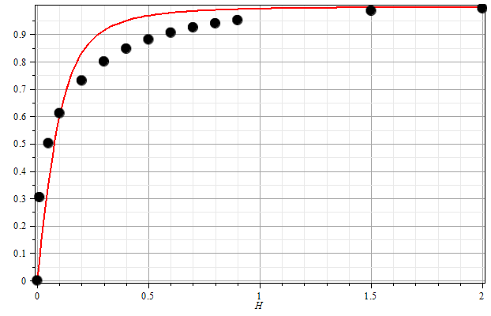
One dimensional Ising model with periodic boundary conditions:
β=1
J=1
H

Slide 9
Two-dimensional Ising model – paramagnetic ⬅➔ferromagnetic phase transition

Slide 10
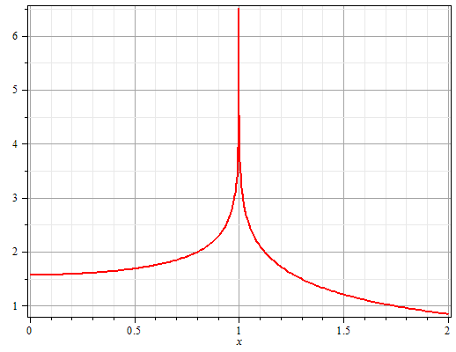
Behavior of Elliptic integral function K₁(x)
Re[K₁(x)]

Slide 12
Magnetic properties of 2-dimensional Ising model

Slide 13
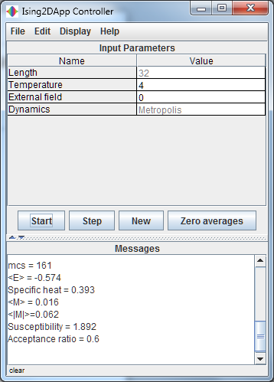
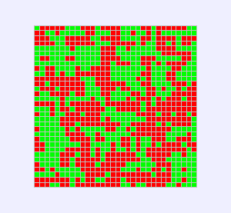
Simulation of 2-dimensional Ising model with Monte Carlo sampling
stp_Ising2D.jar

Slide 14
Ising model in various lattices – mean field solutions
q=4
q=6

Slide 15
Self-consistency condition for mean field treatment

Slide 16
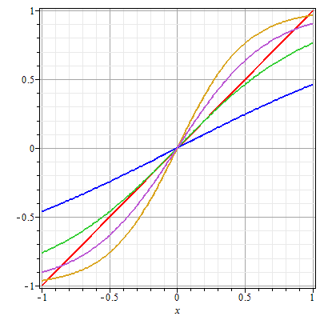
Mean field self-consistency condition:
H=0
➔Mean field solutions exhibit “critical behavior” (phase transition) at β_{c}Jq=1.

Slide 17
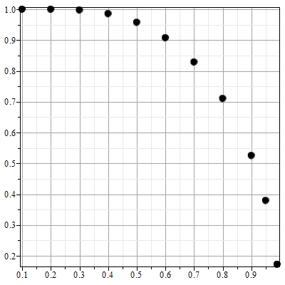
Mean field self-consistency condition for H=0:
m
T/T_{c}

