Slide 1
PHY 341/641
Thermodynamics and Statistical Physics
Lecture 2
Continued discussion of microscopic models (Chapter 1)
Notion of equilibrium in statistical mechanics/thermodynamics
Macrostates/microstates
Introduction to thermodynamics (Chapter 2)
Definition of “the system”
Thermodynamic variables (T, P, V, N, …)
First law of thermodynamics

Slide 2
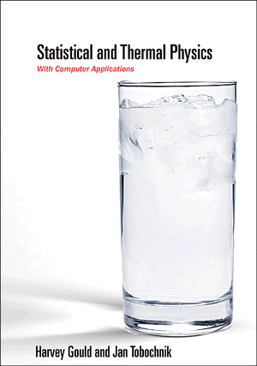
Review from last time --
Chapter 1 – From Microscopic to Macrosopic Behavior
Assignment: Read Chapter 1 (quickly) during this week and checkout some of the corresponding simulations (HW 1 and HW 2) due Monday 1/23.
“The purpose of this introductory [material] is to whet your appetite… “ The chapter introduces a lot of the concepts that we will use (more carefully) throughout the course.

Slide 3
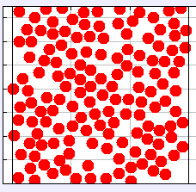
What will you learn?
Energy Analysis
Macroscopic picture
Microscopic picture
ΔU
Q
{T, P, V, N, …}
W

Slide 4
Comment on simulation tools
Molecular dynamics
r_{i}
Example model pair potential (Lennard-Jones):

Slide 5
For an “ideal gas”--

Slide 6
Modeling of a dilute gas of non-interacting particles:
L R
L R
L R
t = 0
t > 0
t >> 0

Slide 7
Enumeration of possibilities for N=4
Microstates n
----------------------------------------------------------------------
L L L L 4 1/16
L L L R
L L R L 3 4/16
L R L L
R L L L
L L R R
L R R L
R R L L 2 6/16
L R L R
R L R L
R L L R
R R R L
R R L R 1 4/16
R L R R
L R R R
R R R R 0 1/16

Slide 8
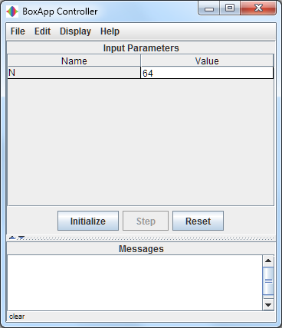
Simulation available from: http://www.compadre.org/STP/
stp_ApproachToEquilibrium.jar
Note: in order to easily control the simulation, you need to use:
Display → Switch GUI

Slide 9
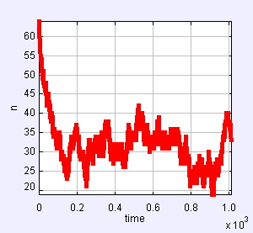
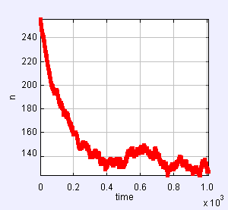
N=64, t≈1000 <n> = 32.08, <n²> = 1,067.13, σ² = 38.12, σ/<n> = 0.19
N=256, t≈1000 <n> = 149.57, <n²> = 23,086.17, σ² = 714.56, σ/<n> = 0.18

Slide 10
Macroscopic viewpoint – thermodynamics
(start reading Chapter 2)
System of study
Controlling medium

Slide 11
Variables of thermodynamics
Temperature
T
Zeroth law of thermodynamics: Two systems in thermal equilibrium with a third system are in thermal equilibrium with eachother.
Pressure
P=F/A
Volume
V
Number of particles
N
The relationships between these variables depends on the “equation of state” of the system.

Slide 12
Examples of “Equations of State”

Slide 13
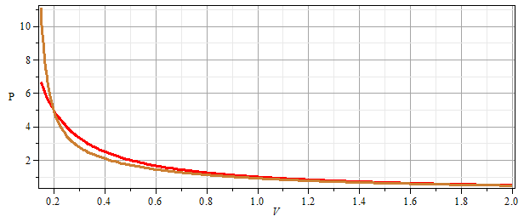
Comparison of
Ideal gas equation
van der Waals gas equation

Slide 14
In general the “state” of a system will depend on the thermodynamic variables. For example, the internal energy:
Thermodynamic “processes” ➔ change the state of the system

Slide 15
Thermodynamic process -- work (performed ON the system)

Slide 16
Work performed during a cyclic process:

Slide 17
Thermodynamic process -- heat (added TO the system)
First law of thermodynamics

Slide 18
Example: Adiabatic expansion V₁ ➔ V₂ for an ideal gas system
To be continued…..

