Slide 1
PHY 341/641
Thermodynamics and Statistical Physics
Lecture 20
Methodologies of statistical mechanics. (Chapter 5 in STP)
Phase transitions in spin systems
Mean field approximation

Slide 3
Ising model in various lattices – mean field solutions
Note: textbooks differ with counting neighbors q without double counting. Here q implies “unique” neighbors.
q=4/2
q=6/2

Slide 4
Self-consistency condition for mean field treatment

Slide 5
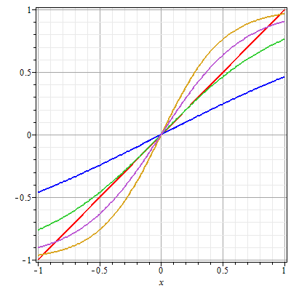
Mean field self-consistency condition:
H=0
➔Mean field solutions exhibit “critical behavior” (phase transition) at β_{c}Jq=1.

Slide 6
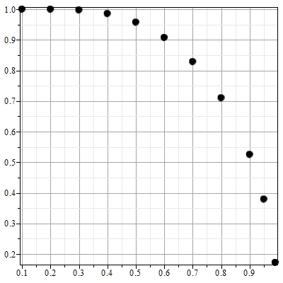
Mean field self-consistency condition for H=0:
m
T/T_{c}

Slide 7
Summary of results for mean field treatment of Ising model

Slide 8
Summary of results for mean field treatment of Ising model (continued)

Slide 9
Summary of results for mean field treatment of Ising model (continued)

Slide 10
Summary of results for mean field treatment of Ising model (continued)
Behavior for T near T_{c} where m is small

Slide 11
Summary of results for mean field treatment of Ising model (continued) -- behavior for T near T_{c} where m is small

Slide 12
Summary of results for mean field treatment of Ising model (continued) -- behavior for T near T_{c} where m is small

Slide 13
Behavior of magnetic susceptibility (in scaled units):

Slide 14
Behavior of magnetic susceptibility (in scaled units) -- continued:

Slide 15
Behavior of magnetization at T_{c}:

Slide 16
Critical exponents:

