Slide 1
PHY 341/641
Thermodynamics and Statistical Physics
Lecture 21
Many particle systems (Chapter 6 in STP)
  Ideal gas systems
  Distinguishable/indistinguishable particles
  Quantum/classical dynamics

Slide 2
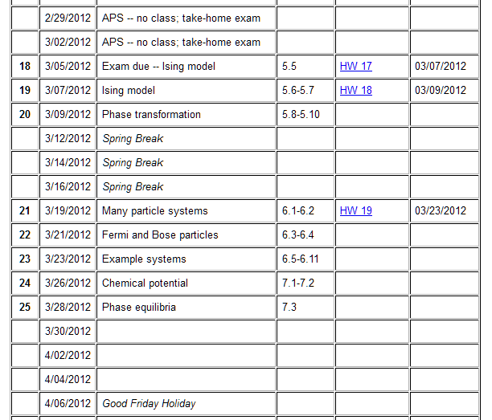
Reminder – second exam in April
-- student presentations 4/30, 5/2 (need to pick topics)

Slide 3
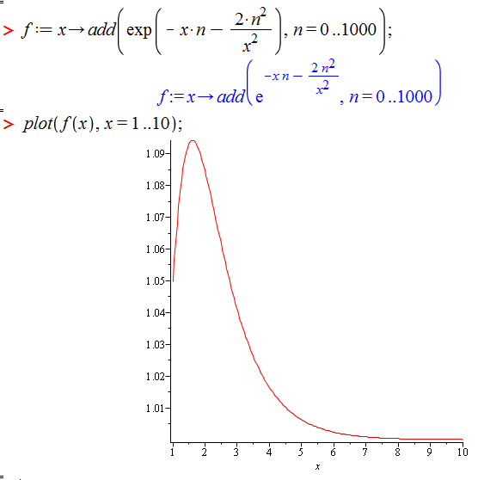
Comment on HW 19:
Maple syntax for numerical evaluation of sum --

Slide 4
Example: Canonical distribution for free particles

Slide 5
Note:
?

Slide 6
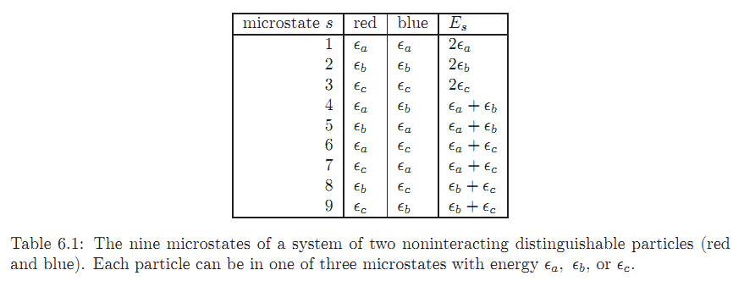
Example:
1
2
3

Slide 7
Classical ⬅➔ quantum systems
Consider a system of non-interacting particles in a box of volume L³
Classical treatment: Quantum treatment:

Slide 8
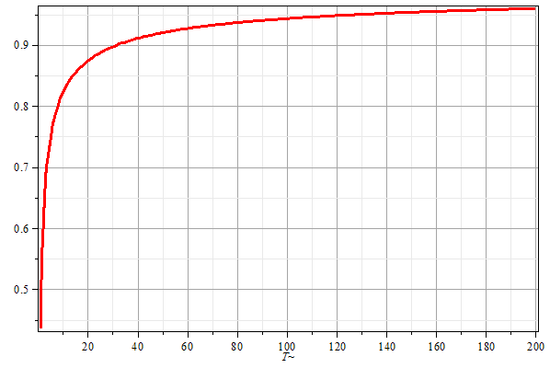

Slide 9
Interacting systems
Classical treatment

