Slide 1
PHY 341/641
Thermodynamics and Statistical Physics
Lecture 22
Many particle systems (Chapter 6 in STP)
Maxwell velocity distribution
Non-interacting Fermi particles
Non-interacting Bose particles

Slide 2
Reminder – second exam in April
-- student presentations 4/30, 5/2 (need to pick topics)

Slide 3
Interacting systems – N identical particles of mass m:
Classical treatment

Slide 4
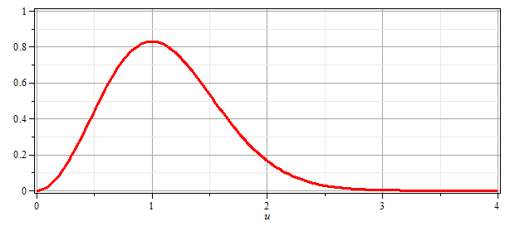
Maxwell velocity distribution
➔ For classical particles the Maxwell velocity distribution is the same for all particle interaction potentials.

Slide 5
Statistics of non-interacting quantum particles

Slide 7
Fermi particle case :

Slide 8
Bose particle case :

Slide 9
Bose particle case :
Note a detail:

Slide 10
Summary of results for Landau potential for non-interacting Fermi and Bose particles

Slide 11
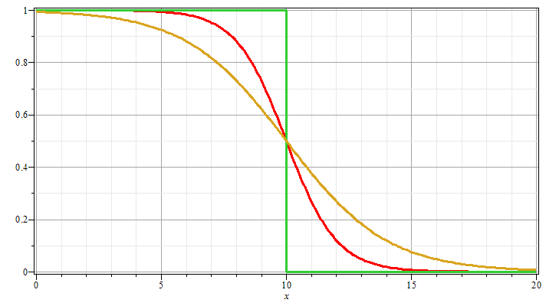
Case of Fermi particles
T = 0
n_{k}
μ = 10
T >> 0
ε_{k}

Slide 12
Case of Fermi particles
Non-interacting spin ½ particles of mass m at T=0 moving in 3-dimensions in large box of volume V=L³: Assume that each state e_{k} is doubly occupied (due to spin)
spin degeneracy

Slide 13
Case of Fermi spin ½ particles for T →0.

