Slide 1
PHY 341/641
Thermodynamics and Statistical Physics
Lecture 23
Many particle systems (Chapter 6 in STP)
Non-interacting Fermi particles
Non-interacting Bose particles

Slide 2
Reminder – second exam in April
-- student presentations 4/30, 5/2 (need to pick topics)

Slide 3
Summary of results for Landau potential for non-interacting Fermi and Bose particles

Slide 4
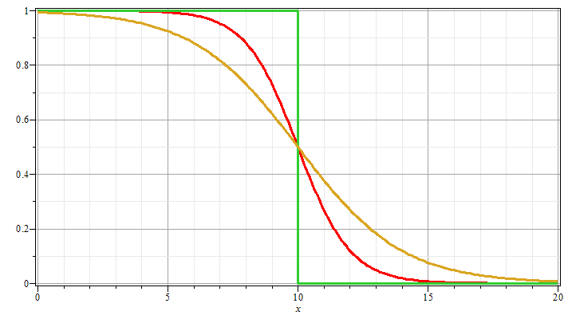
Case of Fermi particles
T = 0
n_{k}
μ = 10
T >> 0
ε_{k}

Slide 5
Case of Fermi particles
Non-interacting spin ½ particles of mass m at T=0 moving in 3-dimensions in large box of volume V=L³: Assume that each state e_{k} is doubly occupied (due to spin)
spin degeneracy

Slide 6
Case of Fermi spin ½ particles for T →0.

Slide 7
Case of Fermi spin ½ particles for T →0 continued.

Slide 8
Case of Fermi spin ½ particles for low temperature

Slide 9
Some useful integrals:

Slide 10
Case of Bose particles
Non-interacting spin 0 particles of mass m at low T moving in 3-dimensions in large box of volume V=L³: Assume that each state e_{k} is singly occupied.

Slide 11
Case of Bose particles at low T

Slide 12
Critical temperature for Bose condensation:
condensate
“normal” state

