Slide 1
PHY 341/641
Thermodynamics and Statistical Physics
Lecture 24
Many particle systems (Chapter 6 in STP)
Non-interacting Bose particles
Bose condensation
Photons
Phonons

Slide 2
Reminder – second exam in April
-- student presentations 4/30, 5/2 (need to pick topics)

Slide 3
Case of Bose particles
Non-interacting spin 0 particles of mass m at low T moving in 3-dimensions in large box of volume V=L³: Assume that each state e_{k} is singly occupied.

Slide 4
Case of Bose particles at low T

Slide 5
Critical temperature for Bose condensation:
condensate
“normal” state

Slide 6
Systematic treatment of Bose case
(Ref. L. E. Reichl, A Modern Course in Statistical Mechanics, Wiley-Interscience 1998, J. D. Walecka, Introduction to Statistical Mechanics, World Scientific 2011)

Slide 7
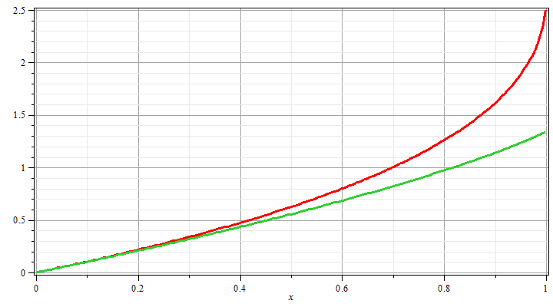
Some convenient integrals
g_{3/2}(z)
g_{5/2}(z)
z

Slide 8
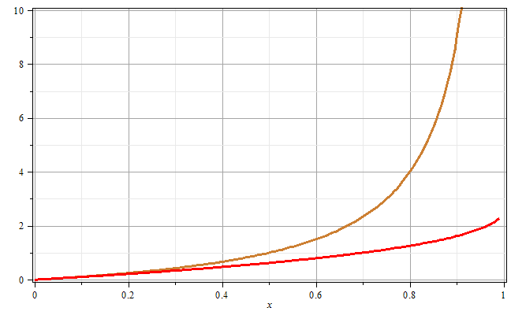
g_{3/2}(z)
z

Slide 10
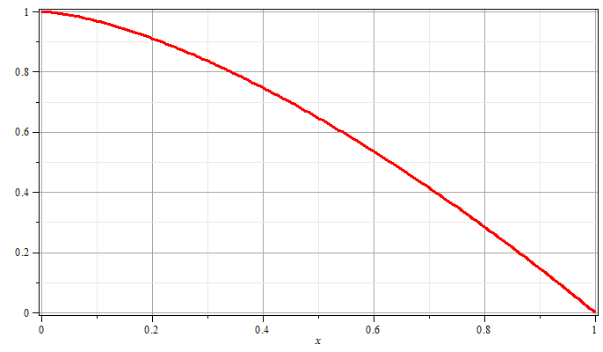
T/T_{E}

Slide 11
http://www.colorado.edu/physics/2000/bec/three_peaks.html
⁸⁷Rb atoms (~2000 atoms in condensate)

Slide 13
Other systems with Bose statistics
Thermal distribution of photons -- blackbody radiation:
In this case, the number of particles (photons) is not conserved so that μ=0.

Slide 14
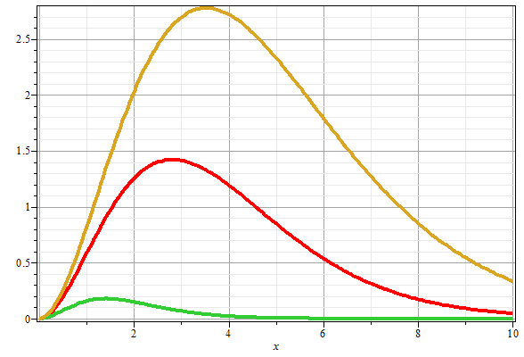
Blackbody radiation distribution:
T₃>T₂
T₂>T₁
T₁
ν

Slide 15
Other systems with Bose statistics
Thermal distribution of vibrations -- phonons:
In this case, the number of particles (phonons) is not conserved so that μ=0.

Slide 16
Other systems with Bose statistics -- continued
Thermal distribution of vibrations -- phonons:

