Slide 1
PHY 341/641
Thermodynamics and Statistical Physics
Lecture 27
Chemical potentials and phase equilibria (Chapter 7 in STP)
Phase diagrams
Clausius-Clapeyron equation

Slide 2
Reminder – second exam in April
-- student presentations 4/30, 5/2 (need to pick topics)

Slide 3
Thermodynamic description of the equilibrium between two forms “phases” of a material under conditions of constant T and P

Slide 4
Example of phase diagram :

Slide 5
Phase diagram for water:

Slide 6
piston
T,P
A
B

Slide 7
piston
T,P
A
B

Slide 8
P
g_{A} < g_{B}
g_{A} > g_{B}
T

Slide 10
Journal de l'École polytechnique 23: 153–190 (1834)

Slide 11
Annalen der Physik Volume 155, Issue 4, pages 500–524, 1850

Slide 16
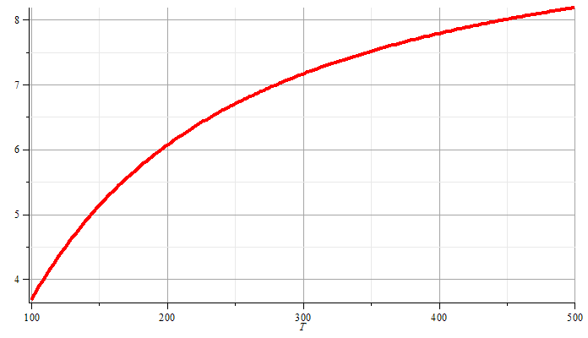
Approximate liquid-gas vaporization curve from Clausius-Clapeyron equation:
P

