Slide 1
PHY 341/641
Thermodynamics and Statistical Physics
Lecture 26
Chemical potentials and phase equilibria (Chapter 7 in STP)
Phase diagrams
Van der Waals equation of state

Slide 2
Reminder – second exam in April
-- student presentations 4/30, 5/2 (need to pick topics)

Slide 3
Review:

Slide 4
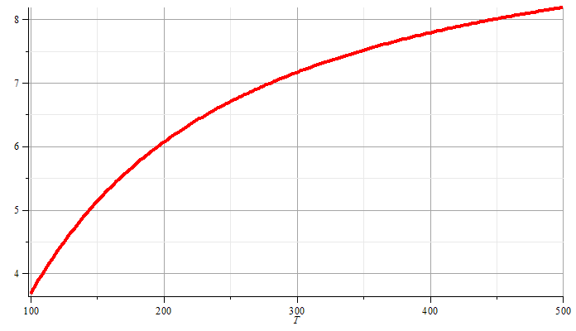
Approximate liquid-gas vaporization curve from Clausius-Clapeyron equation:
P

Slide 5
The van der Waals equation of state
-- More realistic than the ideal gas law; contains some of the correct attributes for liquid-gas phase transitions.

Slide 6
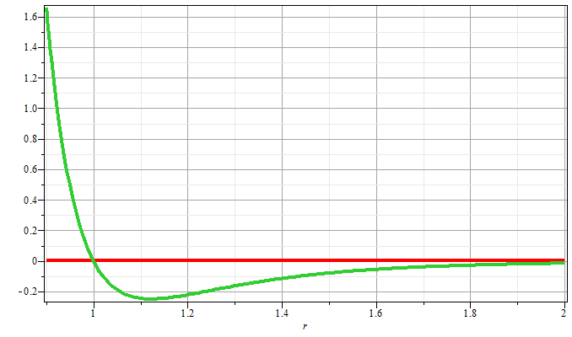
Some motivation for van der Waals equation of state
Johannes Diderik van der Waals – Ph. D. Thesis written in 1873 (The Netherlands) -- received Nobel Prize in 1910
General potential between two particles:

Slide 7
Substance | a (10⁻³⁰eV m³) | b (10⁻³⁰ m³)
water | 9.55 | 50.7
SO₂ | 11.9 | 94.7
CO₂ | 6.3 | 71.3
O₂ | 2.38 | 52.9
Ar | 2.36 | 53.8
N₂ | 2.36 | 64.3
H₂ | 0.428 | 44.3
⁴He | 0.0597 | 39.4
From: Baierlein, Thermal Physics

Slide 8
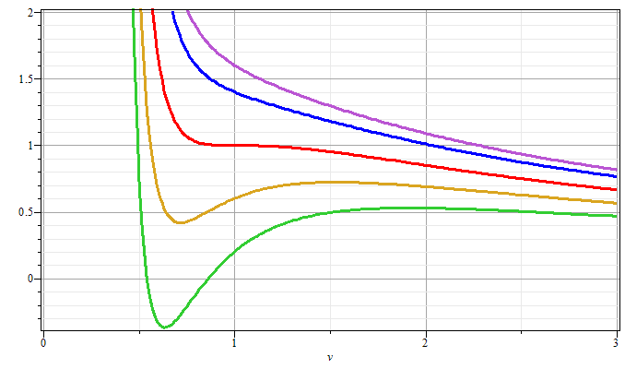
Gas
T/T_{c}>1
T/T_{c}=1
P/P_{c}
Liquid
T/T_{c}<1
V/V_{c}

Slide 9
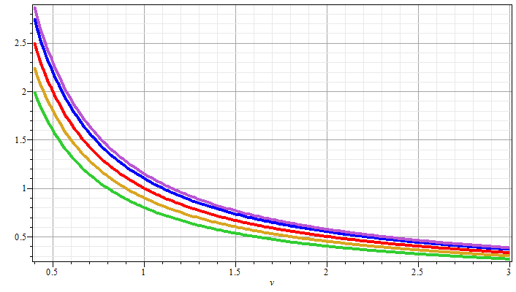
P/P_{c}
Decreasing values of T
V/V_{c}

Slide 10
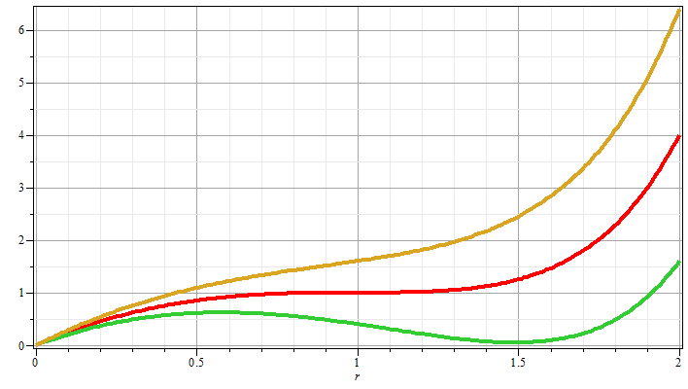
P
⬅ unphysical
ρ

Slide 11
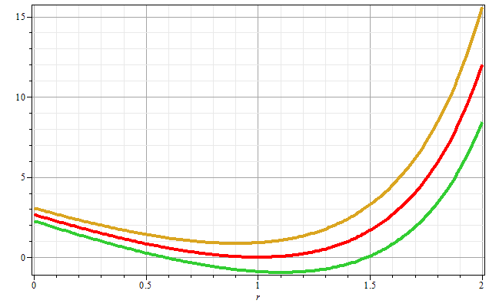
ρ

Slide 12
Behavior of the thermodynamic potentials for the van der Waals equation of state

Slide 13
Behavior of the thermodynamic potentials for the van der Waals equation of state

Slide 14
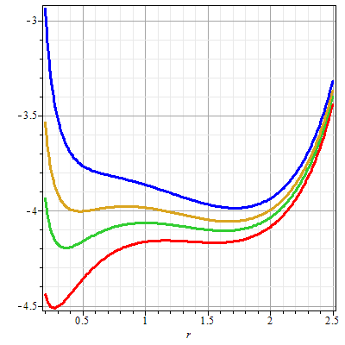
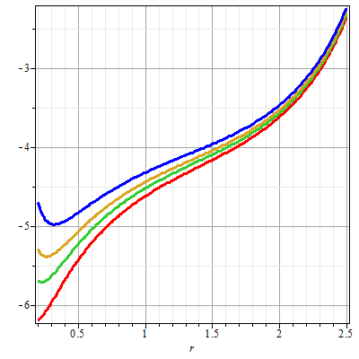

Slide 15
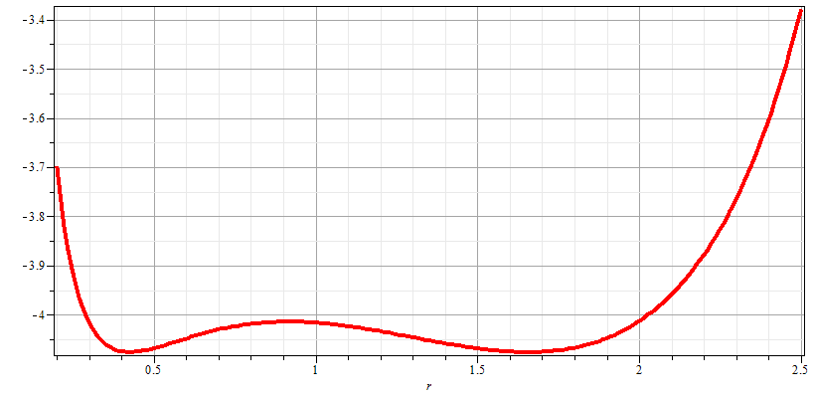
Gibbs chemical potential at coexistence point
gas
liquid

