Slide 1
PHY 341/641
Thermodynamics and Statistical Physics
Lecture 27
Chemical potentials and phase equilibria (Chapter 7 in STP)
Van der Waals equation of state
Chemical reactions

Slide 2
Second exam: April 9-13
-- student presentations 4/30, 5/2 (need to pick topics)

Slide 3
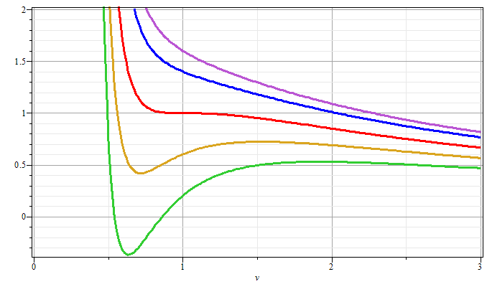
Gas
T/T_{c}>1
T/T_{c}=1
P/P_{c}
Liquid
T/T_{c}<1
V/V_{c}

Slide 4
Behavior of the thermodynamic potentials for the van der Waals equation of state

Slide 5
Behavior of the thermodynamic potentials for the van der Waals equation of state

Slide 6
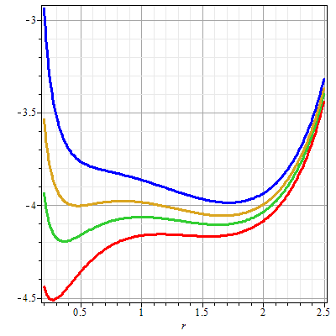
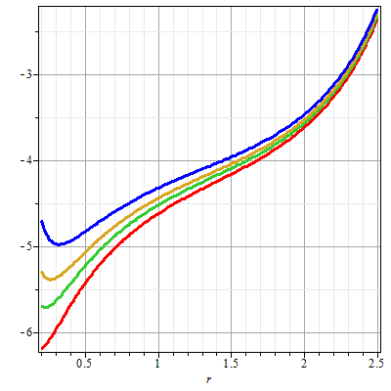

Slide 7
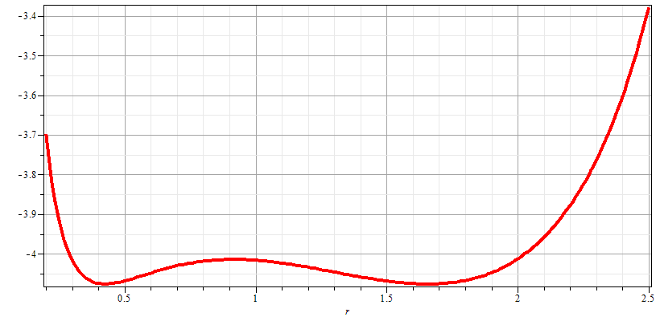
Gibbs chemical potential at coexistence point
gas
liquid

Slide 9
Analysis of gas-liquid coexistence conditions

Slide 10
Analysis of gas-liquid coexistence conditions -- continued

Slide 12
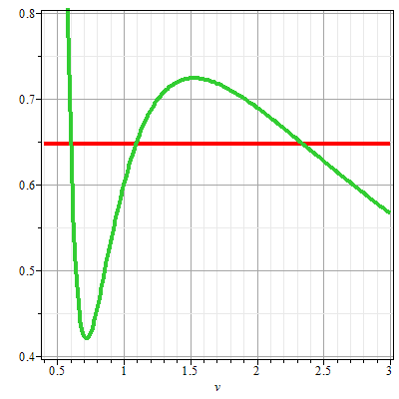
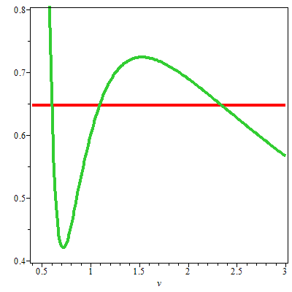
P-V diagram for van der Waals material at T/T_{c}=0.9
P/P_{c}
P/P_{c}
liquid
➔
liquid & gas
gas
V/V_{c}
V/V_{c}

Slide 14
Phase diagram for van der Waals material
P/P_{c}
1
0.65
liquid
gas
0.9
1
T/T_{c}

Slide 15
Extension of analysis of Gibbs Free energy to analyze chemical equilibria:

