Slide 1
PHY 341/641
Thermodynamics and Statistical Physics
Lecture 29
Review (Chapters 5-7 in STP)
Magnetic systems; Ising model
Fermi statistics
Bose statistics
Phase transformations
Chemical equilibria

Slide 2
Second exam: April 9-13
-- student presentations 4/30, 5/2 (need to pick topics)

Slide 3
Review of statistical mechanics of spin ½ systems -- Chapter 5 in STP
Fist consider system with independent particles in a magnetic field:

Slide 4
Calculation of Z₁
Thermodynamic functions:

Slide 5
Magnetic field dependence of Z:

Slide 6
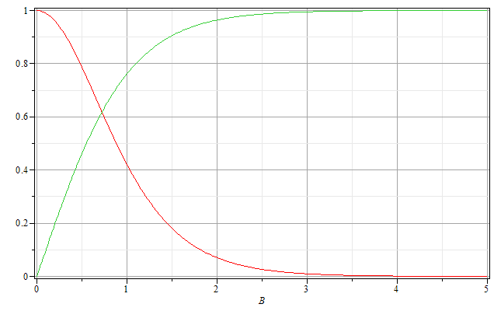
Magnetization and susceptibility of independent spin ½ particles
M/M₀
χ/χ₀
βμB

Slide 7
Effects of interactions between particles:
Independent particle system
Interacting particle system – Ising model

Slide 8
Partition function for 1-dimensional Ising system of N spins with periodic boundary conditions (s_{N+1}=s₁)

Slide 9
1-dimensional Ising system of N spins with periodic boundary conditions (s_{N+1}=s₁) (continued)

Slide 10
1-dimensional Ising system of N spins with periodic boundary conditions (s_{N+1}=s₁) (continued)

Slide 11
1-dimensional Ising system of N spins with periodic boundary conditions (s_{N+1}=s₁) (continued)

Slide 12
1-dimensional Ising system of N spins with periodic boundary conditions (s_{N+1}=s₁) (continued)

Slide 13
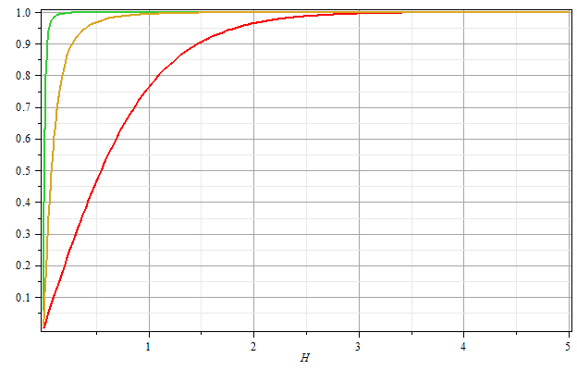
βJ=2
βJ=1
βJ=0
Μ/Ν
βH

Slide 14
Mean field approximation for 1-dimensional Ising model

Slide 15
Mean field partition function and Free energy:

Slide 16
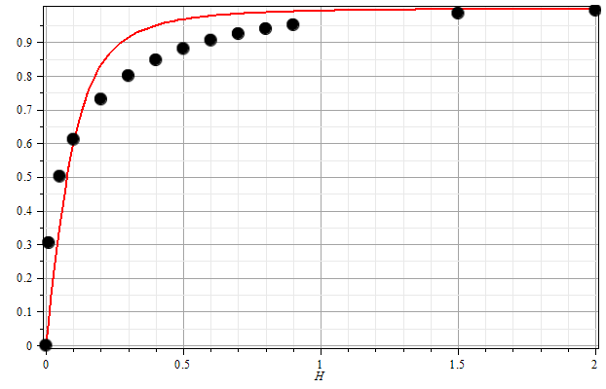
One dimensional Ising model with periodic boundary conditions:
β=1
J=1
H

Slide 17
Summary of qualitative results of Ising model systems :
Exact solutions of one-dimensional system show no phase transitions
Exact solution by Onsager for two-dimensions system shows phase transitions as a function of T in zero magnetic field
Mean field approximation shows phase transitions for all dimensions as a function of T in zero magnetic field
Mean field approximation for fixed T as a function of magnetic field is qualitatively similar to exact solution for one dimension

Slide 18
Self-consistency condition for mean field treatment for general system with q nearest neighbors

Slide 19
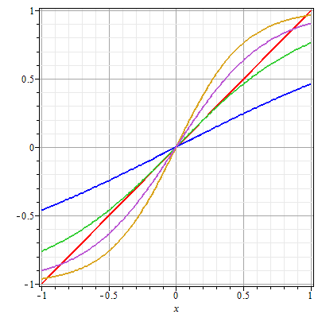
Mean field self-consistency condition:
H=0
➔Mean field solutions exhibit “critical behavior” (phase transition) at β_{c}Jq=1.

Slide 20
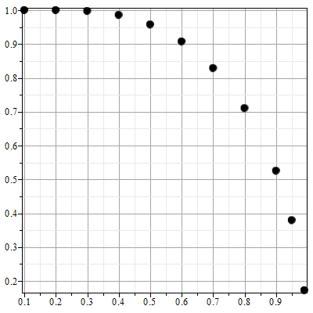
Mean field self-consistency condition for H=0:
m
T/T_{c}

Slide 21
Summary of results for mean field treatment of Ising model

Slide 22
Behavior of magnetic susceptibility (in scaled units):

Slide 23
Behavior of magnetic susceptibility (in scaled units) -- continued:

Slide 24
Many particle systems with translational degrees of freedom – Chapter 6 of STP
Interacting systems – N identical particles of mass m:
Classical treatment

Slide 25
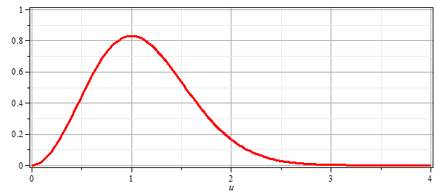
Maxwell velocity distribution
➔ For classical particles the Maxwell velocity distribution is the same for all particle interaction potentials.

Slide 26
Statistics of non-interacting quantum particles

Slide 28
Fermi particle case :

Slide 29
Bose particle case :

Slide 30
Bose particle case :
Note a detail:

Slide 31
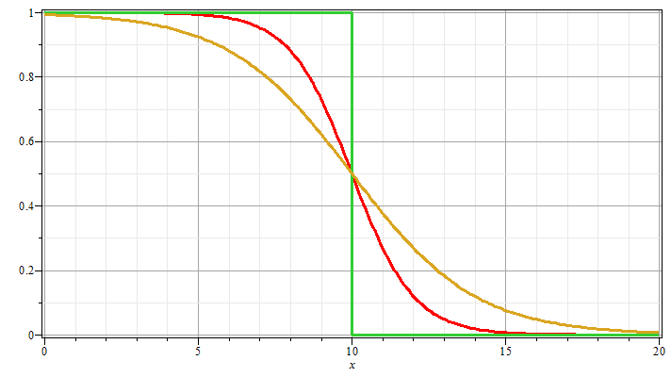
Case of Fermi particles
T = 0
n_{k}
μ = 10
T >> 0
ε_{k}

Slide 32
Case of Fermi particles
Non-interacting spin ½ particles of mass m at T=0 moving in 3-dimensions in large box of volume V=L³: Assume that each state e_{k} is doubly occupied (due to spin)
spin degeneracy

Slide 33
Case of Fermi spin ½ particles for T →0 in 3-dimensional box.

Slide 34
Case of Bose particles
Non-interacting spin 0 particles of mass m at low T moving in 3-dimensions in large box of volume V=L³: Assume that each state e_{k} is singly occupied.

Slide 35
Critical temperature for Bose condensation:
condensate
“normal” state

Slide 36
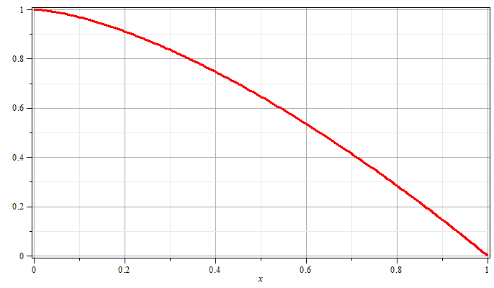
T/T_{E}

Slide 37
Other systems with Bose statistics
Thermal distribution of photons -- blackbody radiation:
In this case, the number of particles (photons) is not conserved so that μ=0.

Slide 38
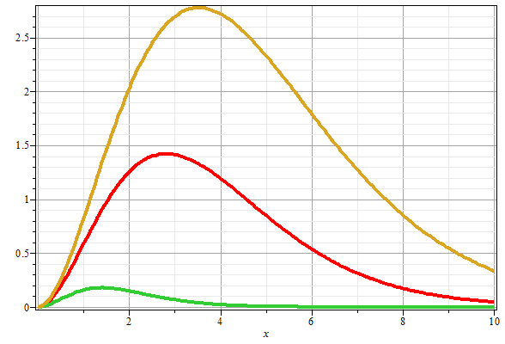
Blackbody radiation distribution:
T₃>T₂
T₂>T₁
T₁
ν

Slide 39
Other systems with Bose statistics
Thermal distribution of vibrations -- phonons:
In this case, the number of particles (phonons) is not conserved so that μ=0.

Slide 40
Other systems with Bose statistics -- continued
Thermal distribution of vibrations -- phonons:

Slide 41
Thermodynamic description of the equilibrium between two forms “phases” of a material under conditions of constant T and P -- Chapter 7 in STP

Slide 42
Example of phase diagram :

Slide 43
P
g_{A} < g_{B}
g_{A} > g_{B}
T

Slide 47
Other topics
Van der Waals equation of state
Chemical equilibria

