Slide 1
PHY 341/641
Thermodynamics and Statistical Physics
Lecture 3
Introduction to thermodynamics (Chapter 2)
Definition of “the system”
Thermodynamic variables (T, P, V, N, …)
First law of thermodynamics -- the sign of work
Some examples for ideal gas systems
Some cyclic processes
Efficiency of process

Slide 2
Macroscopic viewpoint – thermodynamics
(start reading Chapter 2)
System of study
Controlling medium

Slide 3
Thermodynamic process -- WORK
various sign conventions !!!#$#!!!

Slide 4
Work sign conventions in various text books:
Work done BY the system
Work done ON the system
Textbook | Sign
Gould & Tobochnik, Statistical and Thermal Physics (2010) | −
Kittel & Kroemer, Thermal Physics (1980) | −/+
Serway & Jewitt, Physics (8th Ed.) (2010) | −
Serway & Beichner, Physics (5th Ed.) (2000) | +
Baierlein, Thermal Physics (1999) | +
Callen, Thermodynamics (1985) | −
Bailyn, A Survey of Thermodynamics (1994) | +
Fermi, Thermodynamics (1936) | +

Slide 5
First law of thermodynamics
Q
W
System of study
Controlling medium

Slide 6
Examples of heat and work performed by ideal gas

Slide 7
Various ideal gas processes (assuming N constant)
Process | Variables | Q | W | ΔU
Constant V | V₁,P₁,T₁➔V₁,P₂,T₂ |  | 0
Constant P | V₁,P₁,T₁➔V₂,P₁,T₂
Constant T | V₁,P₁,T₁➔V₂,P₂,T₁ |  |  | 0
Q = 0 | V₁,P₁,T₁➔V₂,P₂,T₂ | 0

Slide 8
Some details of the adiabatic case: Q = 0

Slide 9
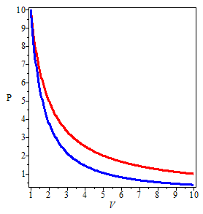
Ideal gas expansions
ΔT = 0
ΔQ = 0

Slide 10
Work performed during a cyclic process:

Slide 11
Efficiency of cyclic processes:
The notions of work and heat can be used for practical devices
Example: Internal combustion engine
Otto cycle:
http://www.howstuffworks.com/engine1.htm
General measure of process efficiency (assuming no frictional losses;
“completely reversible processes”):

Slide 13
Analysis of an ideal heat engine
Nicholas Carnot (French Engineer) 1834
isothermal
adiabatic
adiabatic
isothermal

Slide 14
Analysis of Carnot cycle for ideal gas system

