Slide 1
PHY 341/641
Thermodynamics and Statistical Physics
Lecture 30
More about the Chemical Potential
The Widom insertion method
Computer simulation

Slide 2
-- student presentations 4/30, 5/2 (need to pick topics)

Slide 3
Chemical potential for large N:

Slide 4
Chemical potential for large N -- continued:

Slide 5
Chemical potential for large N -- continued:

Slide 6
Chemical potential for large N -- continued:

Slide 7
Widom insertion method for evaluating
Use Metropolis algorithm on a system of N particles modeled by interacting potential U(r₁,r₂,….r_{N}) where on each “step” a particle is added at a random position to determine ΔU and to accumulate .
Computer simulation using Widom insertion method with Lennard-Jones fluid
stp_WidomInsertionMethod.jar

Slide 8
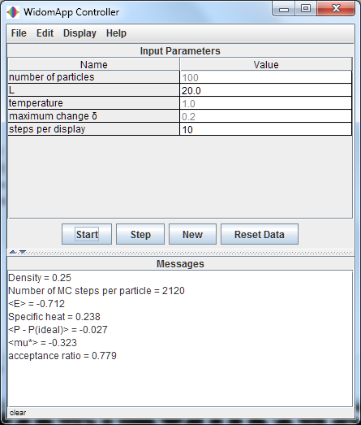
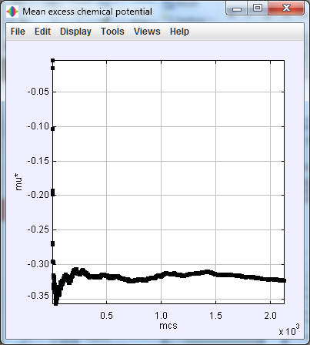

Slide 9
Chemical potential
for density = 0.25
Chemical potential
for temperature = 1
Temperature →
Density →

Slide 10
Some references:
B. Widom “Some topics in the theory of fluids”, J. Chem. Phys. 39, 2808-2812 (1963)
C. H. Bennett, “Efficient estimation of free energy differences from Monte Carlo data”, C. Comp. Phys. 22, 245-265 (1976)
K. Binder “Applications of Monte Carlo methods to statistical physics” Rep. Prog. Physics 60, 487-559 (1997)
More recent example:
A. Arslanargin and T. L. Beck, “Free energy partitioning analysis of the driving forces that determine ion
density profiles near the water liquid-vapor interface”, J. Chem. Phys. 136, 104503 (2012)

