Slide 1
PHY 341/641
Thermodynamics and Statistical Physics
Lecture 31
Analysis of classical gases and liquids
Interaction potentials
Approximations to the partition function

Slide 2
-- student presentations 4/30, 5/2 (need to pick topics)

Slide 3
Part of SPS zone 5 conference
April 20-21, 2012
www.wfu.edu/physics/sps/spszone52012conf/welcome.html

Slide 4
Consider a canonical ensemble of N particles moving in 3 dimensions within a volume V at temperature T=1/kβ

Slide 7
Model simulations of Z_{C}
u_{HC}(r)
σ
r

Slide 11
Virial expansion for hard-core potential

Slide 12
Modified hard-core potential – square well potential
u_{SW}(r)
σ
Rσ
r
-ε

Slide 14
Virial expansion for modified hard-core potential

Slide 16
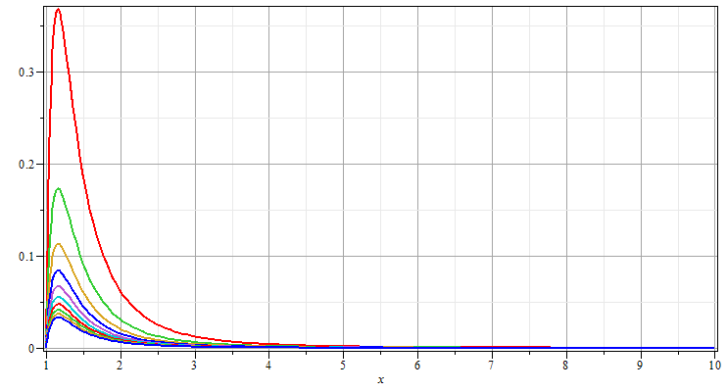
Evaluation of B₂(T) for Lennard-Jones potential -- continued
4εβ=1
4εβ=0.1

Slide 17
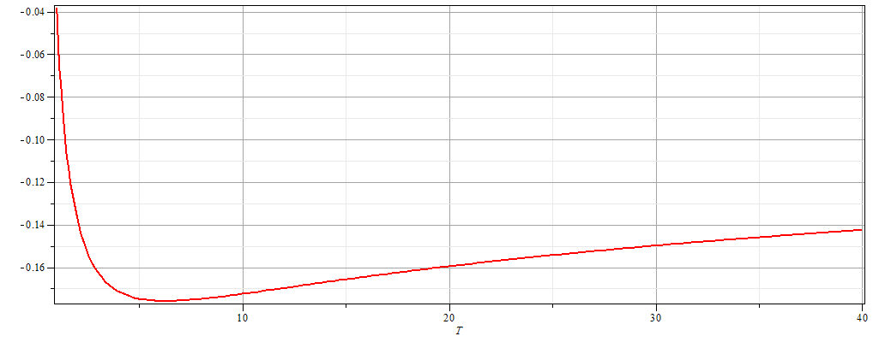
Evaluation of B₂(T) for Lennard-Jones potential -- continued
1/(4εβ) ◊

