Slide 1
PHY 341/641
Thermodynamics and Statistical Physics
Lecture 32
Analysis of classical gases and liquids (STP Chapt. 8)
Comments about exam
Virial coefficients
Radial distribution functions

Slide 2
-- student presentations 4/30, 5/2 (need to pick topics)

Slide 4
Part of SPS zone 5 conference
April 20-21, 2012
Received 1997 Nobel Prize with Steven Chu and Claude Cohen-Tannoudji “for development of methods to cool and trap atoms with laser light”
www.wfu.edu/physics/sps/spszone52012conf/welcome.html

Slide 5
Suggestions for efficient learning of topics covered on exam
Let it stand as is
Redo exam – turn in work to count points in HW grade
Redo exam – meet with instructor to discuss remaining issues (grading points to be determined)
Other??

Slide 6
ε
H=0 or S=0
H>0 S=2
H>0 S=1/2

Slide 7
Hint for finding single particle partition function

Slide 8
Hint for Problem 1 continued:

Slide 9
Hint for Problem 1 continued:

Slide 10
Hint for Problem 1 continued:

Slide 11
Hint for Problem 1 continued:

Slide 12
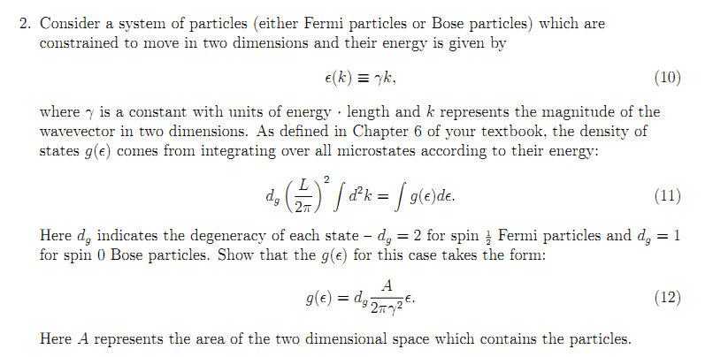

Slide 14
Hint for #3 continued:

Slide 16
See STP Chapt. 7 and Lecture Notes 28

Slide 17
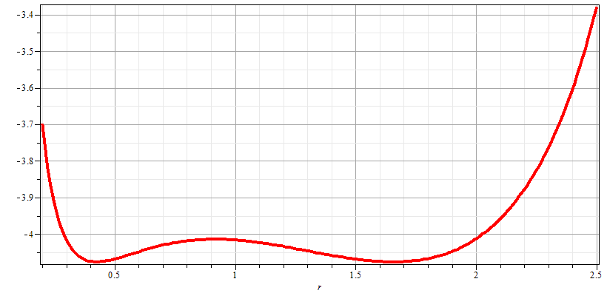
Gibbs chemical potential at coexistence point
gas
liquid

Slide 18
Suggestions for efficient learning of topics covered on exam
Let it stand as is
Redo exam – turn in work to count points in HW grade
Redo exam – meet with instructor to discuss remaining issues (grading points to be determined)
Other??

Slide 19
Resume discussion of virial coefficients:

Slide 20
Model simulations of Z_{C}
u_{HC}(r)
σ
r

