Slide 1
PHY 341/641
Thermodynamics and Statistical Physics
Lecture 33
Analysis of classical gases and liquids (STP Chapt. 8)
Virial coefficients
Radial distribution functions

Slide 2
-- student presentations 4/30, 5/2 (need to pick topics)

Slide 3
Part of SPS zone 5 conference
April 20-21, 2012
Received 1997 Nobel Prize with Steven Chu and Claude Cohen-Tannoudji “for development of methods to cool and trap atoms with laser light”
www.wfu.edu/physics/sps/spszone52012conf/welcome.html

Slide 4
Estimate of partition function for interacting gas or fluid; virial expansion:

Slide 5
Model simulations of Z_{C}
u_{HC}(r)
σ
r

Slide 9
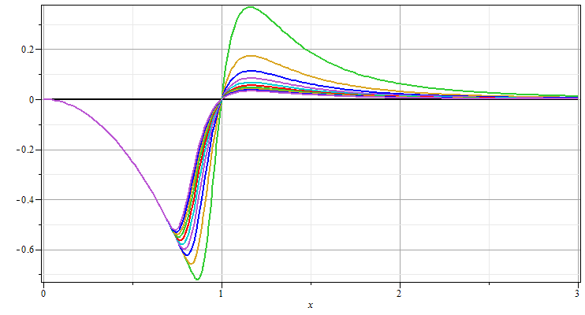
1/(4εβ) = 1
1/(4εβ) = 10

Slide 10
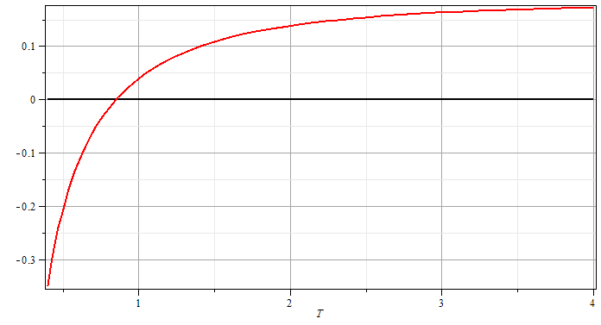
1/(4εβ)
Note: Correlates well with experimental measurements on N₂, Ne, Ar, and He (less well)

Slide 11
Radial distribution function g(r)

Slide 12
The quantity in () is related to the “pair distribution function” g(r₁,r₂) – given a particle at r₁ what is the probability of finding a second particle at r₂.

Slide 13
Radial distribution function – continued --
Measurement of g(r) by neutron scattering:

Slide 14
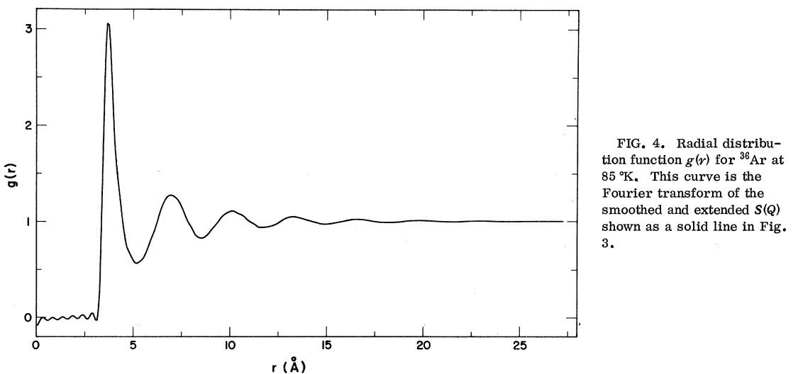

Slide 15
Experiment measures neutron scattering signal as a function of the change in neutron wave number Q:

Slide 16
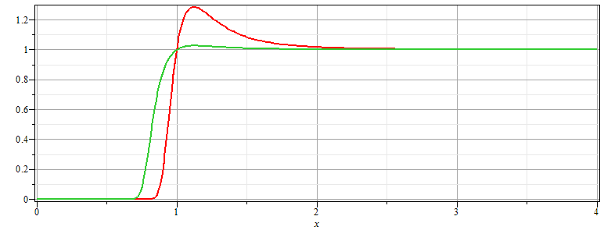
Estimate of g(r) from theory:
For systems described by pair potentials in the dilute limit:
1/(4εβ) = 1
1/(4εβ) = 10

