Slide 1
PHY 341/641
Thermodynamics and Statistical Physics
Lecture 34
Analysis of classical gases and liquids (STP Chapt. 8)
Virial coefficients
Radial distribution functions
Equation of state for classical fluid

Slide 2
-- student presentations 4/30, 5/2 (need to pick topics)

Slide 3
Estimate of partition function for interacting gas or fluid; virial expansion:

Slide 6
Note: A more careful derivation of the previous result takes care to count the contributing terms in a systematic “cluster expansion”. In the words of another textbook on this subject (Statistical mechanics by Normand Davidson): “The derivation given [on the previous slide] is a fraud and a hoax.”

Slide 7
More properties of 2nd virial coefficient:

Slide 8
Alternative derivation -- radial distribution function g(r)

Slide 9
The quantity in () is related to the “pair distribution function” g(r₁,r₂) – given a particle at r₁ what is the probability of finding a second particle at r₂.

Slide 10
Radial distribution function – continued --

Slide 11
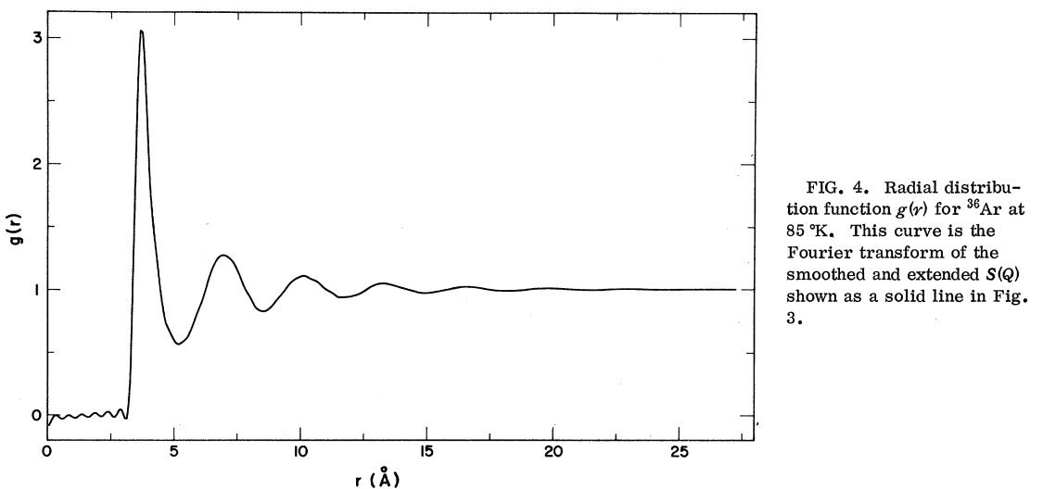

Slide 12
Experiment measures neutron scattering signal as a function of the change in neutron wave number Q:

Slide 13
Formulation of equation of state in terms of pair distribution function:

Slide 14
Formulation of equation of state in terms of pair distribution function – continued:

Slide 15
Equation of state:

Slide 18
Summary of results for classical fluid with pair potential:

