Slide 1
PHY 341/641
Thermodynamics and Statistical Physics
Lecture 35
Review and examples
Chemical potential example – atmospheric pressure
Chemical potential example – battery operation

Slide 2
4/30– Laurence, Zac, Eric
5/2 -- Kristen, Audrey, Griffin

Slide 4
Example systems involving analysis of chemical potentials
Ref. Kittel and Kroemer, Statistical Physics
In the following examples, the “internal chemical potential” is augmented with an external potential which can be added to make a “total” chemical potential
Model of the variation of the atomospheric pressure with altitude based on the consideration of two volumes of gas at different heights in a uniform gravitational field in thermal and diffusive contact. (Ignor temperature and gravitational potential variations with height.)

Slide 5
System 2
Φ_{gravity}(y)=mgy
y
System 1
Φ_{gravity}(0)=0
Here m denotes the average mass per particle, and g denotes the gravitation acceleration.

Slide 7
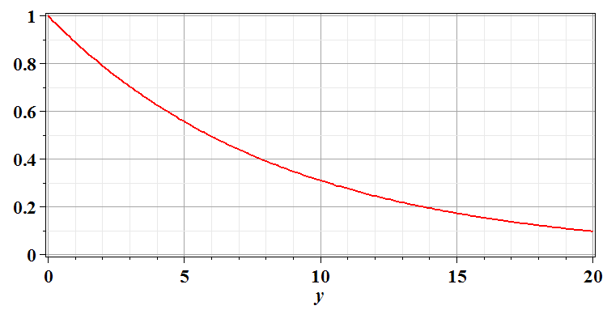
Sea level
Airplane

Slide 8
Another example of chemical potential analysis -- battery
e⁻
-
+

Slide 9
c
-
+

Slide 10
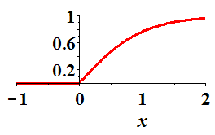
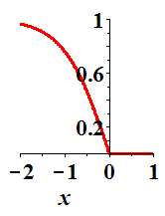
Pb
PbO₂/Pb
H⁺
SO₄⁻²
H⁺
2e⁻
2e⁻
SO₄⁻²
H₂SO₄ H₂O
H⁺
SO₄⁻²
H⁺

