Slide 1
PHY 341/641
Thermodynamics and Statistical Physics
Lecture 8
Complete discussion of example 2.21
Begin introduction to probability concepts (Chapter 3 in STP)

Slide 2
Example from your text on functional dependences in black body radiation following analysis by Boltzmann in 1884.

Slide 3
Example from your text on functional dependences in black body radiation following analysis by Boltzmann in 1884 – continued --

Slide 4
Concepts of Probability – Chapter 3 of STP
Probability analysis is helpful for correlating microscopic and macroscopic physics.
Example – 2-sided coin toss
P(heads) = ½
P(tails) = ½
Suppose we have 4 coins tossed at once. On any given toss, what is the probability of having n occurrences of heads?

Slide 5
Outcomes for tossing 4 coins
Configurations | n | P(n)
TTTT | 0 | 1/16
HTTT,THTT,TTHT,TTTH | 1 | 4/16
TTHH,THHT,HHTT,THTH,HTHT,HTTH | 2 | 6/16
THHH,HTHH,HHTH,HHHT | 3 | 4/16
HHHH | 4 | 1/16
Simulation of coin tosses:
stp_CoinToss.jar

Slide 6
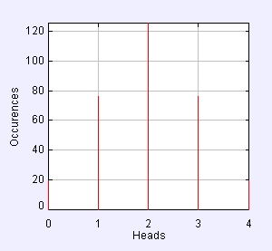
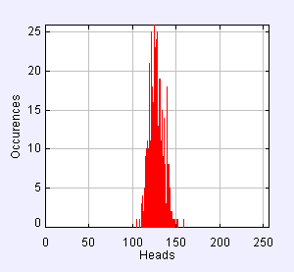
Distribution of outcomes for tossing N coins
N=4 -- 316 trials
N=256 -- 443 trials

Slide 7
Mathematics of probability theory
For each event I, we assign a probability P(i) with the conditions:
For two independent events i and j, the probability of I or j is
For two independent events I and j, the probability of I and j is

Slide 8
Example (similar to 3.8 of your textbook)
Suppose that in a certain class of 100 students the grade distribution averaged over many years is given as shown in the second column. What is the probability of getting each grade assuming that the distribution remains the same:
Grade | 100 student Distribution | Probabilty
A | 16 | 0.16
B | 32 | 0.32
C | 48 | 0.48
D | 4 | 0.04
F | 0 | 0.00

Slide 9
Calculation of averages

Slide 10
Example:
Grade | 100 student Distribution | Probabilty
A (4) | 16 | 0.16
B (3) | 32 | 0.32
C (2) | 48 | 0.48
D (1) | 4 | 0.04
F (0) | 0 | 0.00

Slide 11
Example: Dice throws
Example 3.10. On average, how many times must a die be thrown until “4” appears?

