Slide 1
PHY 341/641
Thermodynamics and Statistical Physics
Lecture 9
Probability concepts (Chapter 3 in STP)
Bayes’ theorm
Binomial distribution

Slide 2
Construction of an “uncertainty” function

Slide 3
Bayes’ theorm

Slide 4
Bayes’ theorem continued:
Example: Suppose B represents a data set and A represents a model which can be generalized to several mutually exclusive models A_{i}

Slide 6
Binomial distribution
Appropriate for describing systems with exactly two elemental outcomes such as
Coin Toss – HT -- P_{H}=p, P_{T}=1-p=q
Spin ↑↓ -- P↑=p, P↓=1-p=q
Typically, we are interested in the number n of elemental outcomes of type 1 (H, ↑, etc.) in a total of N processes.
Example: N=4, n=#H’s, p=1/2=q
Configurations | n | P(n)
TTTT | 0 | 1/16
HTTT,THTT,TTHT,TTTH | 1 | 4/16
TTHH,THHT,HHTT,THTH,HTHT,HTTH | 2 | 6/16
THHH,HTHH,HHTH,HHHT | 3 | 4/16
HHHH | 4 | 1/16

Slide 7
Binomial distribution
Example: N=4, n=#H’s, p=1/2=q
Configurations | n | P(n)
TTTT | 0 | 1/16
HTTT,THTT,TTHT,TTTH | 1 | 4/16
TTHH,THHT,HHTT,THTH,HTHT,HTTH | 2 | 6/16
THHH,HTHH,HHTH,HHHT | 3 | 4/16
HHHH | 4 | 1/16
Example: N=3, n#H’s, p=1/2=q
Configurations | n | P(n)
TTT | 0 | 1/8
HTT,THT,TTH | 1 | 3/8
THH,HTH,HHT | 2 | 3/8
HHH | 3 | 1/8

Slide 8
Binomial distribution (continued)

Slide 9
Average value of n in binomial distribution

Slide 11
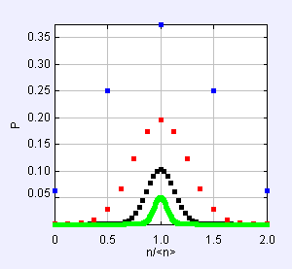
Binomial distribution in the limit N →∞
Result from stp_Binomial.jar
N=4
N=16
N=60
N=256

Slide 12
Stirling’s approximation to factorial
Evaluate Binomial distribution as Taylor’s expansion of
ln (P_{N}(n)) about <n>:

Slide 14
Poisson probability distribution –
Approximation to binomial distribution for small p

