Slide 1
PHY 712 Electrodynamics
10-10:50 AM MWF Olin 107
Plan for Lecture 24:
Continue reading Chap. 11 – Theory of Special Relativity
Transformations of the Electromagnetic Fields
Connection to Liénard-Wiechert potentials for constant velocity sources

Slide 3
Velocity transformation detail from Lecture 26:

Slide 4
Special theory of relativity and Maxwell’s equations

Slide 5
More 4-vectors:

Slide 6
Lorentz transformations

Slide 7
4-vector relationships

Slide 8
Special theory of relativity and Maxwell’s equations

Slide 9
Electric and Magnetic field relationships

Slide 10
Field strength tensor
Transformation of field strength tensor

Slide 11
Inverse transformation of field strength tensor

Slide 12
Example:
y
y’
v
b
q
x
x’
z
z’

Slide 13
Example:
y
y’
v
b
q
x
x’
z
z’

Slide 14
Example:
y
y’
v
b
q
x
x’
z
z’
Expression in terms of consistent coordinates

Slide 15
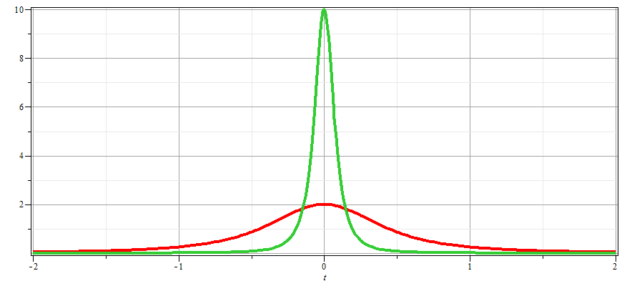
γ_{v}=10
γ_{v}=2

Slide 16
Examination of this system from the viewpoint of the
the Liènard-Wiechert potentials (temporarily keeping SI units

Slide 17
Examination of this system from the viewpoint of the
the Liènard-Wiechert potentials – continued (SI units)

Slide 18
Examination of this system from the viewpoint of the
the Liènard-Wiechert potentials – continued (SI units)

Slide 19
Examination of this system from the viewpoint of the
the Liènard-Wiechert potentials – continued (Gaussian units)

Slide 20
Examination of this system from the viewpoint of the
the Liènard-Wiechert potentials – continued (Gaussian units)

