Slide 1
PHY 712 Electrodynamics
10-10:50 AM MWF Olin 107
Plan for Lecture 29:
Start reading Chap. 15 –
Radiation from collisions of charged particles
Overview
X-ray tube

Slide 2
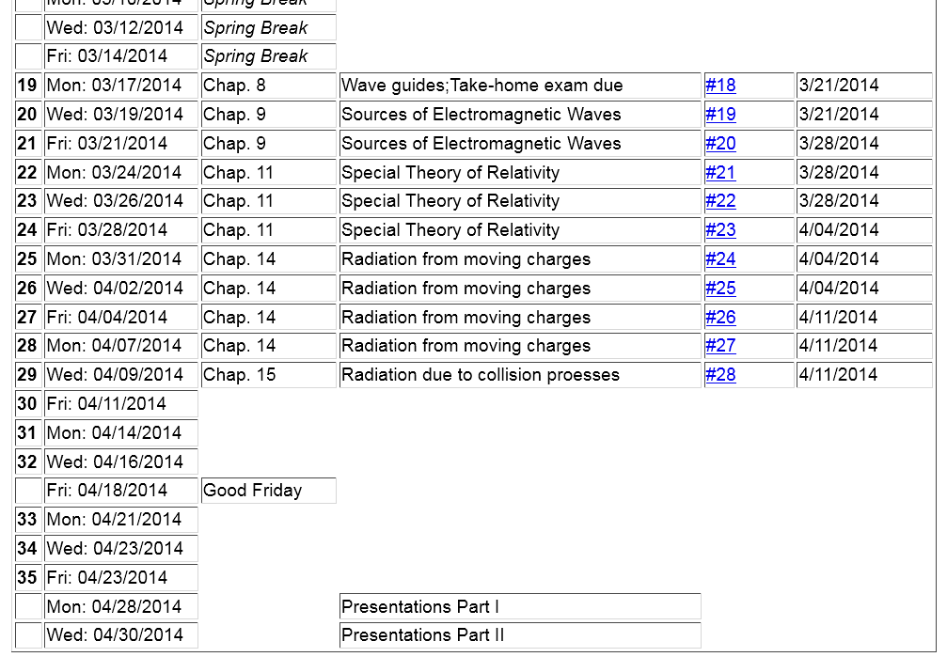

Slide 3
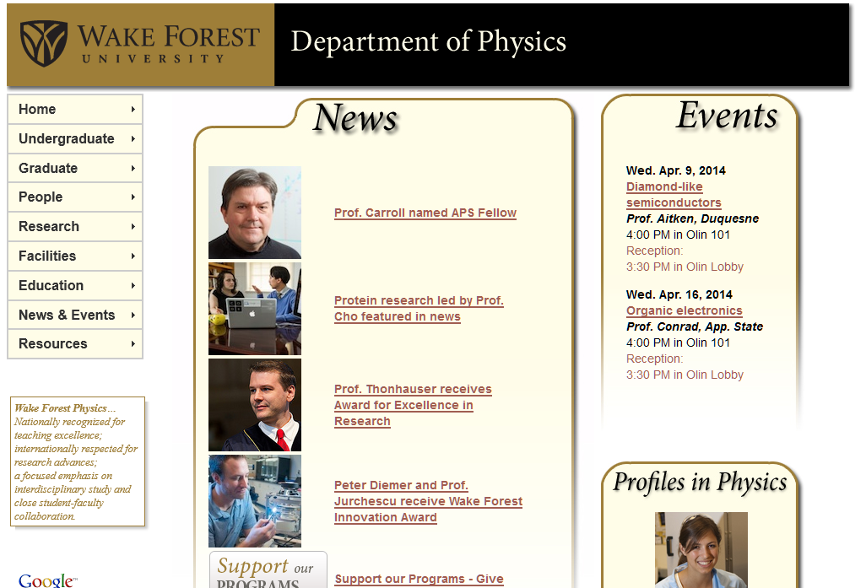

Slide 5
Generation of X-rays in a Coolidge tube
https://www.orau.org/ptp/collection/xraytubescoolidge/coolidgeinformation.htm

Slide 6
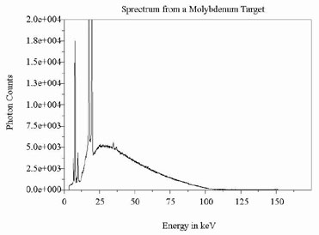
http://www.ndt-ed.org/EducationResources/CommunityCollege/Radiography/Physics/xrays.htm

Slide 7
Radiation during collisions
β(t)
β(t+Δt)

Slide 8
Radiation during collisions -- continued

Slide 9
Radiation during collisions -- continued
β
r
θ
φ
Δβ
polarization in r and β plane
polarization perpendicular to r and β plane

Slide 10
z
Radiation during collisions -- continued
β
r
θ
y
φ
Δβ
x

Slide 11
Estimation of Δβ
q
Δβ
q
β(t)
β(t+Δt)
mass of particle having charge q

Slide 12
Estimation of Δβ -- for the case of Rutherford scattering
q
Δβ
q
β(t)
β(t+Δt)
Ze

Slide 13
Case of Rutherford scattering -- continued
q
p(t+Δt)
θ’
Q
Ze
p(t)

Slide 14
Case of Rutherford scattering -- continued
q
p(t+Δt)
θ’
Q
Ze
p(t)

Slide 15
Comment on frequency dependence --

Slide 16
λ= “fudge factor” of order unity

