Slide 1
PHY 712 Electrodynamics
10-10:50 AM MWF Olin 107
Plan for Lecture 32:
Special Topics in Electrodynamics:
Electromagnetic aspects of superconductivity -- continued

Slide 3
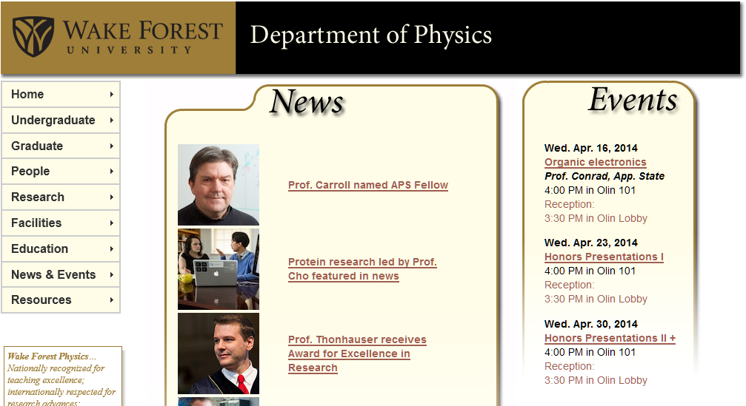

Slide 5
Behavior of superconducting material – exclusion of magnetic field according to the London model
λ_{L}
x

Slide 6
Magnetization field

Slide 7
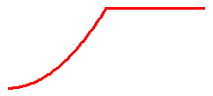
Magnetization field (for “type I” superconductor)
B
H
H_{C}
-4πM
H
H_{C}
G_{S}-G_{N}
H_{C}
H

Slide 8
Examples of type I superconductors
http://hyperphysics.phy-astr.gsu.edu/hbase/tables/supcon.html#c1

Slide 9
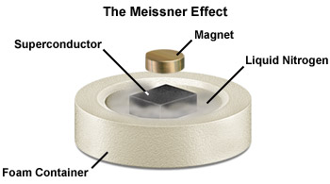

Slide 10
Josephson junction -- tunneling current between two superconductors
d
x
B_{z}

Slide 11
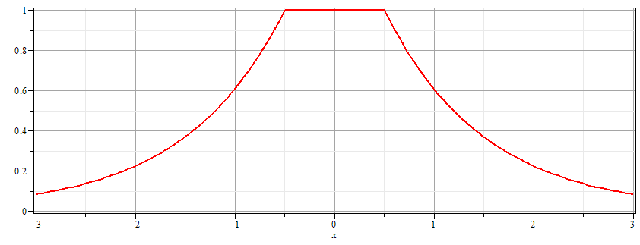
Josephson junction -- continued
Supercon left
Junction
Supercon right
B_{z}
d

Slide 12
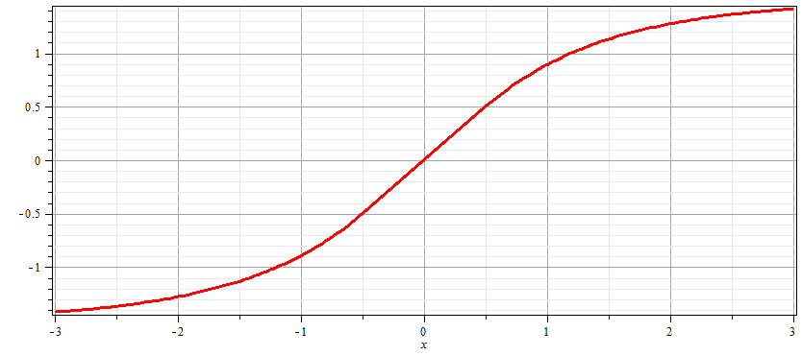
Josephson junction -- continued
Supercon left
Junction
Supercon right
A_{y}
d

Slide 13
Josephson junction -- continued
d
L
R
x

Slide 14
Josephson junction -- continued

Slide 15
Josephson junction -- continued
J_{L}
J_{R}
J_{T}
L
R
x

Slide 16
Josephson junction -- continued
J_{L}
J_{R}
J_{T}
L
R
x

Slide 17
Josephson junction -- continued
J_{L}
J_{R}
J_{T}
L
R
x

Slide 18
Josephson junction -- continued
J_{L}
J_{R}
J_{T}
L
R
x

