Slide 1
PHY 770 -- Statistical Mechanics
10-10:50 AM MWF Olin 107
Instructor: Natalie Holzwarth (Olin 300)
Course Webpage: http://www.wfu.edu/~natalie/s14phy770
http://www.wiley.com/WileyCDA/WileyTitle/productCd-3527407820.html

Slide 2
Textbook Chapters Course topics
Introduction
Complexity and entropy 3
Thermodynamics 1
Thermodynamics of phase transitions 2
Equilibrium Statistical Mechanics I 4
Equilibrium Statistical Mechanics II 5
Brownian Motion 6
Hydrodynamics 7
Transport coefficients 8
Nonequilibrium phase transitions 9

Slide 5
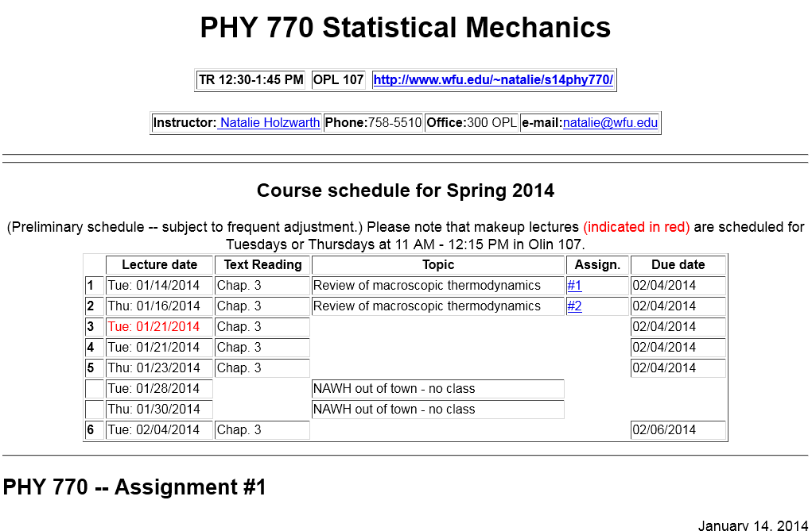

Slide 7
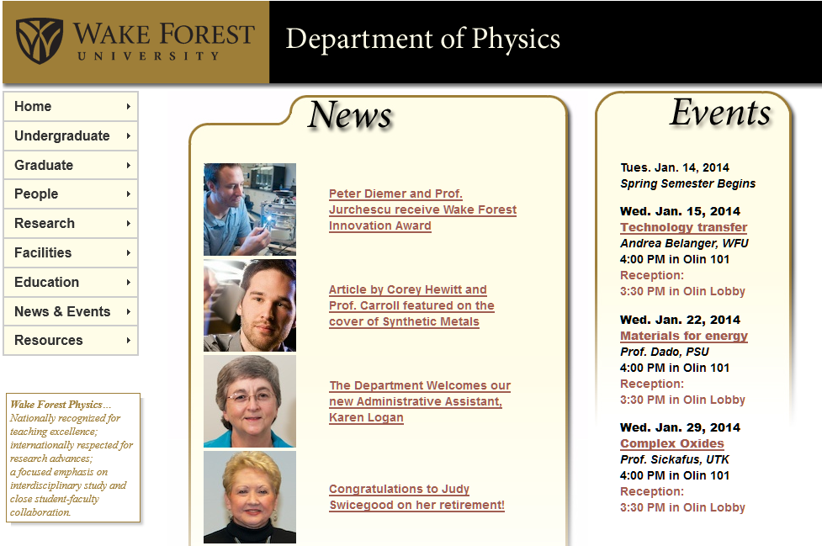

Slide 8
Today’s topics – review of thermodynamics (Chapter 3 of text)
Overview and motivation
Important definitions
Meaning of thermodynamic equilibrium
Notion of exact differential and its opposite
State variables
First law of thermodynamics
Carnot cycle
Notion of entropy

Slide 9
Thermodynamics
Overview and motivation
Some ideas from Advanced Statistical Mechanics,
Barry M. McCoy (2010)
The development of the notions of thermodynamics occurred in the 19th century with its results at the “heart of the industrial revolution”.
Notions of thermodynamics do not logically follow from Newton’s laws. (Within Statistical Mechanics, connections between the macroscopic thermodynamic principles and the microscopic viewpoint of Newton’s laws are explored.
“We are forced to study thermodynamics because nature empirically turns out to work this way. Because thermodynmic behavior exits it must follow from the microscopic laws of nature, regardless of how much we may not like it.”

Slide 10
Thermodynamics
2. Important definitions
Macroscopic system, “thermodynamic limit”
Intensive variable: (such as T, P, μ, ….)
Extensive variable: (such as N ….)

Slide 11
Thermodynamics
3. Notion of thermodynamic equilibrium
We observe that the properties of an isolated macroscopic system measured as a function of time, eventually reach constant values. (This is not true, in general, for a system of few particles.)

Slide 13
Thermodynamics
4. Notion of exact differential and its opposite

Slide 14
Example (from appendix B.1 of textbook)

Slide 15
Thermodynamics
5. State variables
State variables are quantities that can be analyzed as exact differentials
Examples :
(Under reversible conditions)
Internal energy U
Entropy S

Slide 16
Thermodynamics
6. First law of thermodynamics

Slide 17
Elaboration on work:
Specific example:
Consider an ideal gas in a complete cycle

Slide 18
Carnot cycle:
Analysis of an ideal heat engine
Nicholas Carnot (French Engineer) 1834
isothermal
adiabatic
adiabatic
isothermal

Slide 19
Analysis of Carnot cycle for ideal gas system

Slide 20
More analysis of Carnot cycle for ideal gas system

Slide 21
Definition of entropy for a reversible process:
Example for Carnot cycle:
T
1
2
T_{high}
T_{low}
4
3
S_{low}
S_{high}
S

Slide 22
Analysis of state variables U and S for an ideal gas

Slide 23
Analysis of ideal gas entropy continued:
quantum effects; consistent with “constant”

Slide 24
Analysis of ideal gas entropy and internal energy continued:

Slide 25
Some practical (idealized) thermodynamic cycles
5→1:Intake stroke: constant pressure (P₀) intake of air and gas
1→2:Adiabatic compression of air/gas mixture.
2→3:Constant volume pressurization of air/gas misture due to spark.
3→4:Power stroke due to adiabatic expansion of air/gas mixture.
4→1: Exhaust at constant volume.

Slide 26
Otto cycle continued:

Slide 27
Diesel cycle diagram (http://en.wikipedia.org/wiki/Diesel_cycle)
5→1:Intake stroke: constant pressure (P₀) intake of air and gas
1→2:Adiabatic compression of air/gas mixture.
2→3:Constant pressure combustion and expansion.
3→4:Power stroke due to adiabatic expansion of air/gas mixture.
4→1: Exhaust at constant volume.
5

Slide 28
Diesel cycle continued:

Slide 29
Comparison of Otto and Diesel cycle efficiencies:
Suppose
Otto cycle:
Diesel cycle:

