Slide 1
PHY 770 -- Statistical Mechanics
12:00-1:45 PM TR Olin 107
Instructor: Natalie Holzwarth (Olin 300)
Course Webpage: http://www.wfu.edu/~natalie/s14phy770
Lecture 12 -- Chapter 5
Equilibrium Statistical Mechanics
Canonical ensemble
Magnetic effects
Ising model

Slide 3
Summary of results for the canonical ensemble

Slide 4
Canonical ensemble – example including magnetic effects
Consider a system of N particles in a box of volume V , treated in the semiclassical limit. Since we are in the semiclassical limit, we can use the relationship

Slide 5
Canonical ensemble – example including magnetic effects -- continued

Slide 6
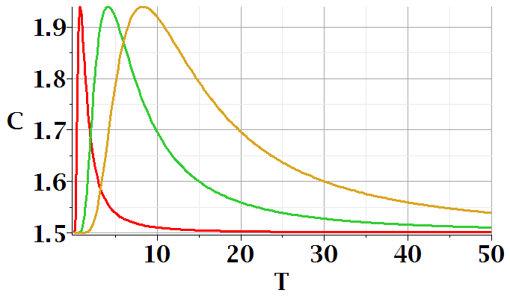
Canonical ensemble – example including magnetic effects -- continued
B=5
B=10
B=1

Slide 7
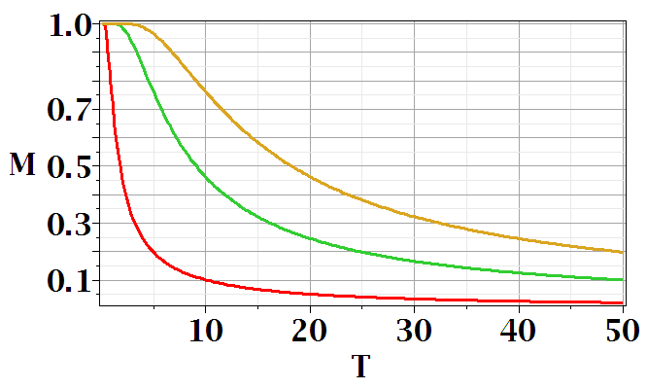
Canonical ensemble – example including magnetic effects -- continued

Slide 8
Statistical mechanics of the Ising model
Spin ½ system with competing effects of nearest-neighbor interactions and spin alignment energy in a magnetic field

Slide 9
Calculation of Z₁
Thermodynamic functions:

Slide 10
Statistical mechanics of the Ising model -- continued
Spin ½ system with competing effects of nearest-neighbor interactions and spin alignment energy in a magnetic field
1
2
3
4
5
6
7
ε₁₂
ε₂₃
ε₃₄
ε₄₅
ε₅₆
ε₆₇

Slide 11
Ising model – effects of interaction term alone for N=2; ε_{ij}=ε

Slide 12
Ising model -- full model for N=2; ε_{ij}=ε

Slide 13
Partition function for 1-dimensional Ising system of N spins with periodic boundary conditions (s_{N+1}=s₁)

Slide 14
1-dimensional Ising system of N spins with periodic boundary conditions (s_{N+1}=s₁) (continued)

Slide 15
1-dimensional Ising system of N spins with periodic boundary conditions (s_{N+1}=s₁) (continued)

Slide 16
1-dimensional Ising system of N spins with periodic boundary conditions (s_{N+1}=s₁) (continued)

Slide 17
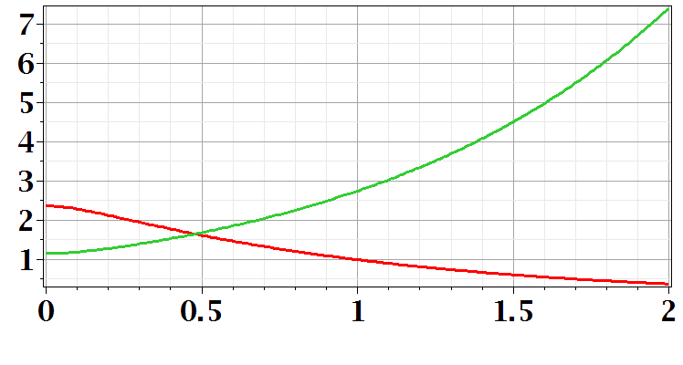
1-dimensional Ising system of N spins with periodic boundary conditions (s_{N+1}=s₁) (continued)
βε=1
λ₁
λ₁,λ₂
λ₂
βμB

Slide 18
1-dimensional Ising system of N spins with periodic boundary conditions (s_{N+1}=s₁) (continued)

Slide 19
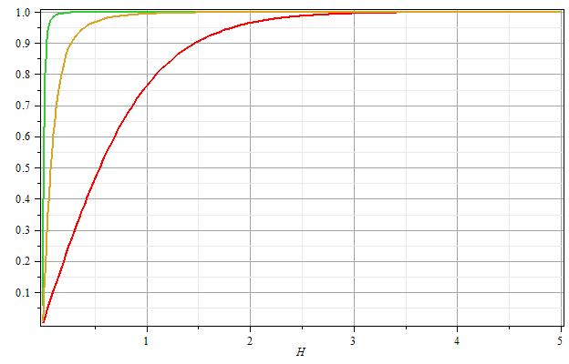
βε=2
βε=1
βε=0
Μ/Ν
βμB

Slide 20
Mean field approximation for 1-dimensional Ising model

Slide 21
Mean field partition function and Free energy:

Slide 22
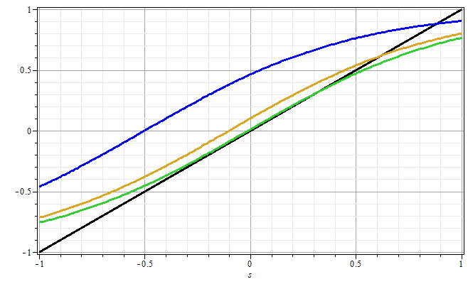
s

Slide 23
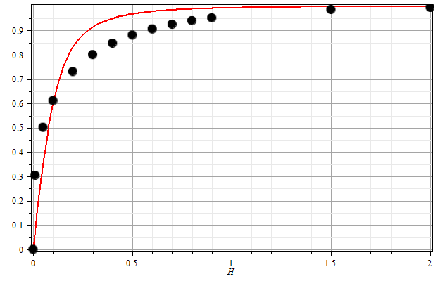
One dimensional Ising model with periodic boundary conditions:
β=1
ε=1
μB

Slide 24
Extension of mean field analysis to more complicated geometries

Slide 25
Extension of mean field analysis to more complicated geometries -- continued
Mean field partition function and Free energy:

Slide 26
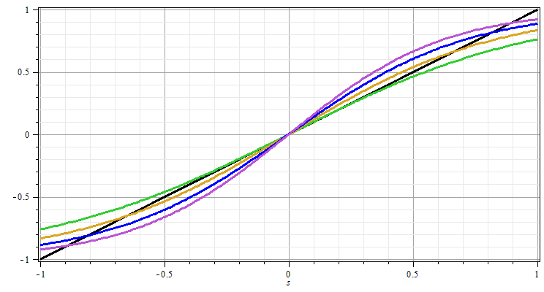
Extension of mean field analysis to more complicated geometries -- continued
<s>

Slide 27
Extension of mean field analysis to more complicated geometries -- continued

Slide 28
Extension of mean field analysis to more complicated geometries -- continued

Slide 29
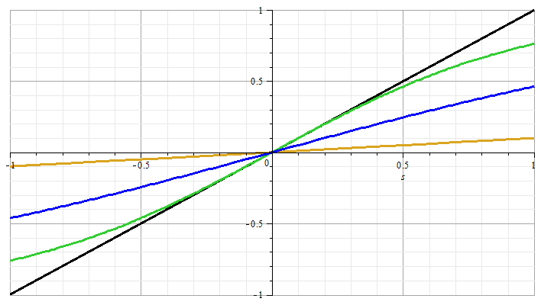
Extension of mean field analysis to more complicated geometries -- continued

Slide 30
Extension of mean field analysis to more complicated geometries -- continued

