Slide 1
PHY 770 -- Statistical Mechanics
12:00* - 1:45 PM TR Olin 107
Instructor: Natalie Holzwarth (Olin 300)
Course Webpage: http://www.wfu.edu/~natalie/s14phy770
Lecture 16
Chap. 7 – Brownian motion and other non-equilibrium phenomena
Overview
Langevin equation
Correlation function and spectral density
Fokker-Planck equation
*Partial make-up lecture -- early start time

Slide 5
http://famousbiologists.org/robert-brown/

Slide 6
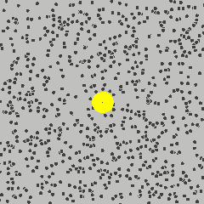
Brownian motion:
Phonomenon: Under a microscope a large particle (~1 μ in diameter) immersed in a fluid with the same density as the particle, appears to be in a state of agitation, undergoing rapid and random motions.
http://upload.wikimedia.org/wikipedia/commons/c/c2/Brownian_motion_large.gif

Slide 7
Brownian motion:
Description based on the Langevin equation of motion
friction coefficient

Slide 8
Brownian motion and Langevin equation of motion -- continued

Slide 9
Brownian motion and Langevin equation of motion – continued
Note that since ξ(t) is a stochastic variable, so is v(t) and x(t)

Slide 10
Brownian motion and Langevin equation of motion – continued
Note that since ξ(t) is a stochastic variable, so is v(t) and x(t)

Slide 11
Brownian motion and Langevin equation of motion – continued
It is interesting to take the Fourier transform of the correlation function

Slide 12
Example of Brownian system
Consider a particle of mass m attached to a harmonic spring with spring constant mω₀² constrained to move in one dimension:

Slide 13
Example of Brownian system -- continued

Slide 14
Example of Brownian system -- continued

Slide 15
Example of Brownian system -- continued

Slide 16
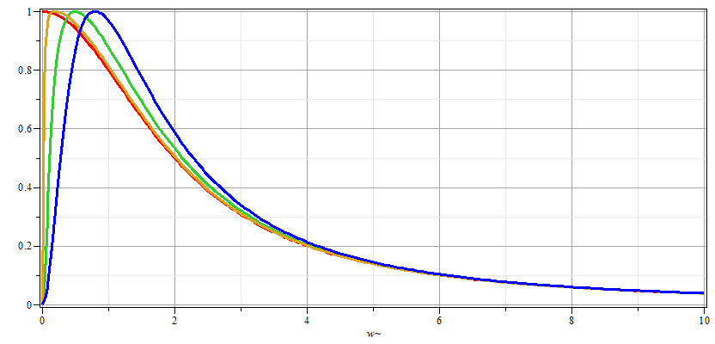
Example of Brownian system -- continued
ω

Slide 17
Probability analysis of Brownian motion Fokker-Planck equation

Slide 18
Probability analysis of Brownian motion Fokker-Plank equation
Justification of Fokker-Plank equation
v
S
x

Slide 19
Probability analysis of Brownian motion Fokker-Plank equation
Justification of Fokker-Plank equation

Slide 20
Probability analysis of Brownian motion Fokker-Plank equation
Justification of Fokker-Plank equation

Slide 21
Probability analysis of Brownian motion Fokker-Plank equation
Justification of Fokker-Plank equation

Slide 22
Probability analysis of Brownian motion Fokker-Plank equation
Justification of Fokker-Plank equation

Slide 23
Probability analysis of Brownian motion Fokker-Plank equation
Justification of Fokker-Plank equation

Slide 24
Probability analysis of Brownian motion Fokker-Plank equation
Justification of Fokker-Plank equation

