Slide 1
PHY 770 -- Statistical Mechanics
12:00* - 1:45 PM TR Olin 107
Instructor: Natalie Holzwarth (Olin 300)
Course Webpage: http://www.wfu.edu/~natalie/s14phy770
Lecture 17
Chap. 7 – Brownian motion and other non-equilibrium phenomena
Comments on mid-term exam
Fokker-Planck equation
Diffusion solutions
*Partial make-up lecture -- early start time

Slide 3
Comments on the mid-term exam

Slide 4
A
C
B

Slide 5
A
B
C

Slide 10
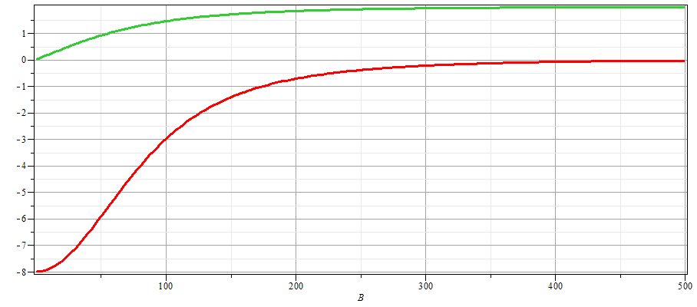
B

Slide 11
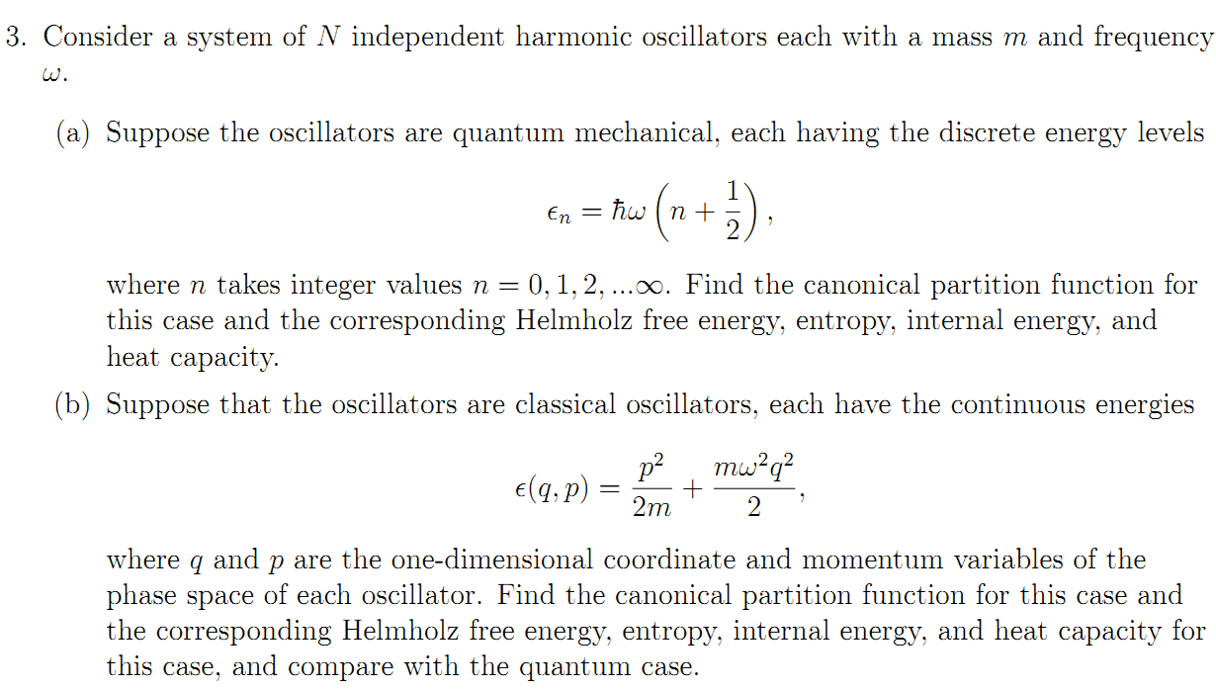

Slide 14
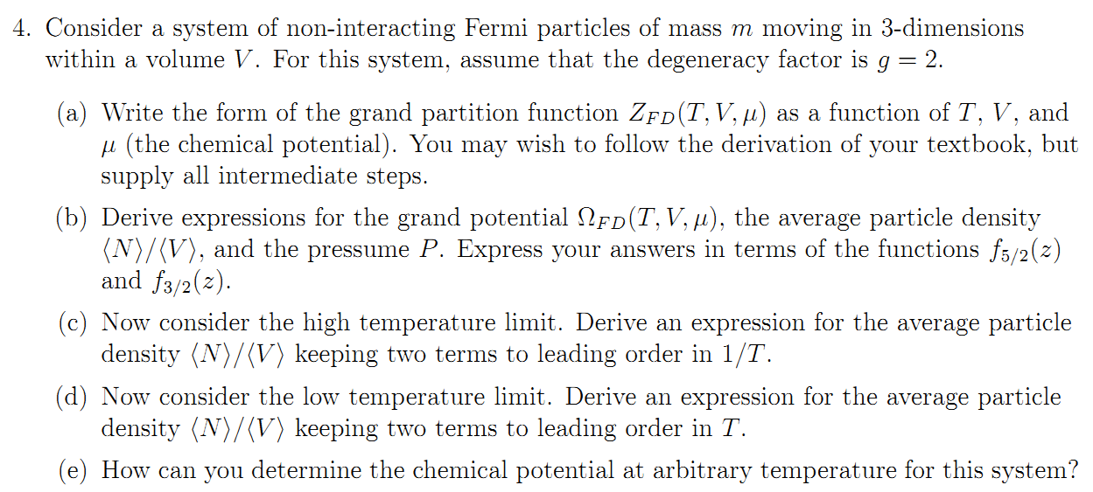

Slide 19
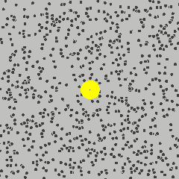
Brownian motion:
Phonomenon: Under a microscope a large particle (~1 μ in diameter) immersed in a fluid with the same density as the particle, appears to be in a state of agitation, undergoing rapid and random motions.
http://upload.wikimedia.org/wikipedia/commons/c/c2/Brownian_motion_large.gif

Slide 20
Probability analysis of Brownian motion -- Fokker-Planck equation

Slide 21
Probability analysis of Brownian motion Fokker-Planck equation
Justification of Fokker-Planck equation

Slide 22
Probability analysis of Brownian motion Fokker-Plank equation

Slide 23
Example solution in the limit of large friction

Slide 24
Example solution in the limit of large friction -- continued

Slide 25
Example solution in the limit of large friction -- continued

Slide 26
Example solution in the limit of large friction -- continued

Slide 27
Example solution in the limit of large friction -- continued

Slide 28
Example solution in the limit of large friction -- continued

Slide 29
Example solution in the limit of large friction -- continued

Slide 30
Example solution in the limit of large friction -- continued

