Slide 1
PHY 770 -- Statistical Mechanics
12:00* - 1:45 PM TR Olin 107
Instructor: Natalie Holzwarth (Olin 300)
Course Webpage: http://www.wfu.edu/~natalie/s14phy770
Lecture 19
Chap. 9 – Transport coefficients
“Elementary” transport theory
The Boltzmann equation
*Partial make-up lecture -- early start time

Slide 3
What is transport theory?
Mathematical description of the averaged motion of particles or other variables through a host medium.
Examples of transport parameters
Thermal conductivity
Electrical conductivity
Diffusion coefficients
Viscosity

Slide 4
Simple transport theory
Base system – low density gas near thermal equilibrium;
assume that the interaction energy is negligible compared to the kinetic energy of the particles.

Slide 5
Estimation of mean free path for hard spheres
A
B
A
A
B
A
B
Collision radius d_{AB}
A

Slide 6
Estimation of mean free path for hard spheres

Slide 7
When there is only one type of particle (A):
d_{AA}
λ

Slide 8
Self-diffusion
z
Assume that, in addition to geometric factors, the particle will reach the detector only if it does not have a collision.
r
θ
φ

Slide 9
Self-diffusion
z
r
θ
φ

Slide 10
The Boltzmann Equation
(Additional reference: Statistical Mechanics, Kerson Huang)
Assume a dilute gas of N particles of mass m in a box of volume V. In order to justify a classical treatment:

Slide 11
The Boltzmann equation – continued
In absence of collisions, the distribution of particles remains constant as
t+ δt
v
t
r

Slide 12
The Boltzmann equation – continued

Slide 13
The Boltzmann equation – continued

Slide 14
Digression on two particle scattering theory (see Appendix E)
r₁
z
r₂
y
x

Slide 15
Review of scattering analysis from classical mechanics class:

Slide 16
Scattering theory:

Slide 17
b
Figure from Marion & Thorton, Classical Dynamics

Slide 18
Differential cross section

Slide 19
Note: The following is in the center of mass frame of reference.
In laboratory frame: In center-of-mass frame:
V₁
v₁
μ
m₁
r
origin
v_{CM}
m_{target}
Also note: We are assuming that the interaction between particle and target V(r) conserves energy and angular momentum.

Slide 21
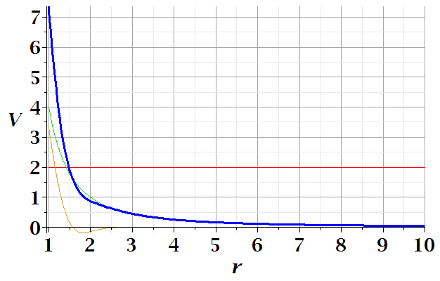
In center of mass reference frame:
E
r_{min}

Slide 27
φ
r_{min}
r(φ)

Slide 28
Evaluation of scattering expression:

Slide 29
Relationship between scattering angle θ and impact parameter b for interaction potential V(r):

Slide 30
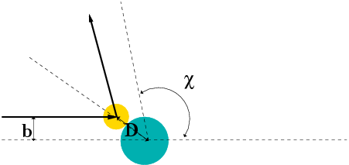
Hard sphere scattering

Slide 31
The results above were derived in the center of mass reference frame; relationship between normal laboratory reference and center of mass:
Laboratory reference frame:
Before After
m₁
m₂
u₁
v₁
ψ
u₂=0
ζ
v₂
Center of mass reference frame:
Before After
m₁
m₂
V₁
U₁
U₂
θ
θ
V₂

Slide 32
Relationship between center of mass and laboratory frames of reference
V_{CM}
U₁
V_{CM}
V₁
v₁
θ
ψ
u₁

Slide 33
Relationship between center of mass and laboratory frames of reference -- continued

Slide 34
Relationship between center of mass and laboratory frames of reference
V_{CM}
V₁
v₁
θ
ψ
For elastic
scattering

Slide 35
Digression – elastic scattering
Also note:

Slide 36
Relationship between center of mass and laboratory frames of reference – continued (elastic scattering)
V_{CM}
V₁
v₁
ψ
θ

Slide 37
Differential cross sections in different reference frames

Slide 38
Differential cross sections in different reference frames – continued:

Slide 39
Example: suppose m₁ = m₂

Slide 40
Back to Boltzmann equation:
If we can assume that the collisions are due to binary interactions, such that particles 1 and 2 interact:

