Slide 1
PHY 770 -- Statistical Mechanics
12:00* - 1:45 PM TR Olin 107
Instructor: Natalie Holzwarth (Olin 300)
Course Webpage: http://www.wfu.edu/~natalie/s14phy770
Lecture 22
Chap. 9 – Transport coefficients
Linearized Bolzmann equation
Systematic approximation of the transport coefficients
*Partial make-up lecture -- early start time

Slide 2
Signup schedule for presentations available this afternoon. Please list the title of your presentation when you sign up.

Slide 3
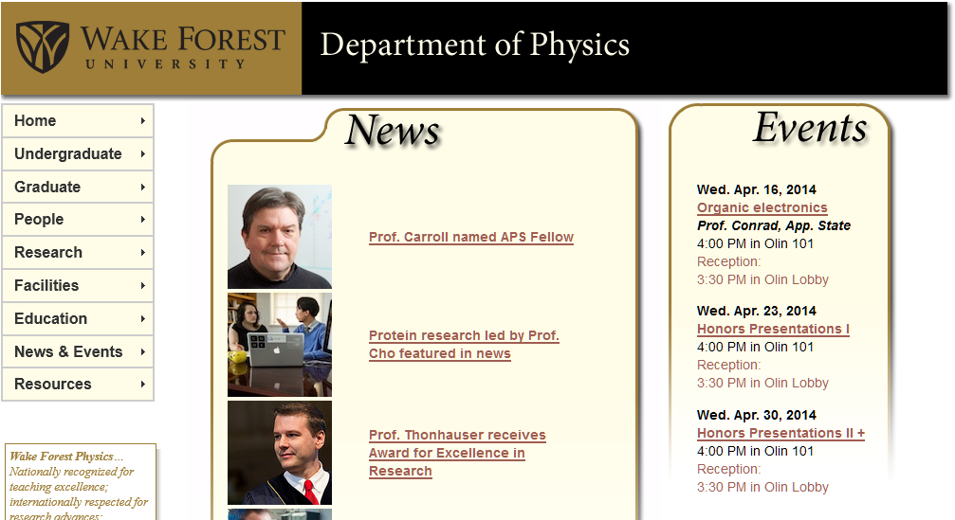

Slide 5
The Boltzmann equation:

Slide 6
The Boltzmann equation:
Detailed solution for a dilute gas of N identical particles of mass m in volume V in absence of external force (F=0). In order to help the analysis, we will imagine that ½ the particles are “normal” with label “N” and ½ the particles are “tracers” with label “T”. The density of particles is denoted n₀=N/V.

Slide 7
The Boltzmann equation – approximation by linearization
for a=N or T.

Slide 8
Linearized Boltzmann equation for normal and tracer particles

Slide 9
Linearized Boltzmann equation for normal and tracer particles

Slide 10
Linearized Boltzmann equation for normal and tracer particles – remarkable properties of collision operators

Slide 11
Linearized Boltzmann equation for normal and tracer particles – remarkable properties of collision operators -- continued

Slide 12
Linearized Boltzmann equation for normal and tracer particles – remarkable properties of collision operators – continued
Summary of results:

Slide 13
Analysis of the diffusion coefficient

Slide 14
Analysis of the diffusion coefficient

Slide 15
Analysis of the diffusion coefficient -- continued

Slide 16
Analysis of the diffusion coefficient -- continued

Slide 17
Analysis of the diffusion coefficient -- continued

Slide 18
Analysis of the diffusion coefficient -- continued

Slide 19
Analysis of the diffusion coefficient -- continued

Slide 20
Analysis of Viscosity and Thermal Conductivity

Slide 21
Analysis of viscosity and thermal conductivity -- continued

Slide 22
Analysis of viscosity and thermal conductivity -- continued

Slide 23
Analysis of viscosity and thermal conductivity -- continued

Slide 24
Analysis of thermal conductivity -- continued

Slide 25
Analysis of shear viscosity-- continued

