Slide 1
PHY 770 -- Statistical Mechanics
12:30-1:45 PM TR Olin 107
Instructor: Natalie Holzwarth (Olin 300)
Course Webpage: http://www.wfu.edu/~natalie/s14phy770
Lecture 3-4* -- Chapter 3
Review of Thermodynamics – continued
Properties of thermodynamic potentials
Response functions
Thermodynamic stability
*Special double lecture, starting at 11 AM on 1/21/2014

Slide 2
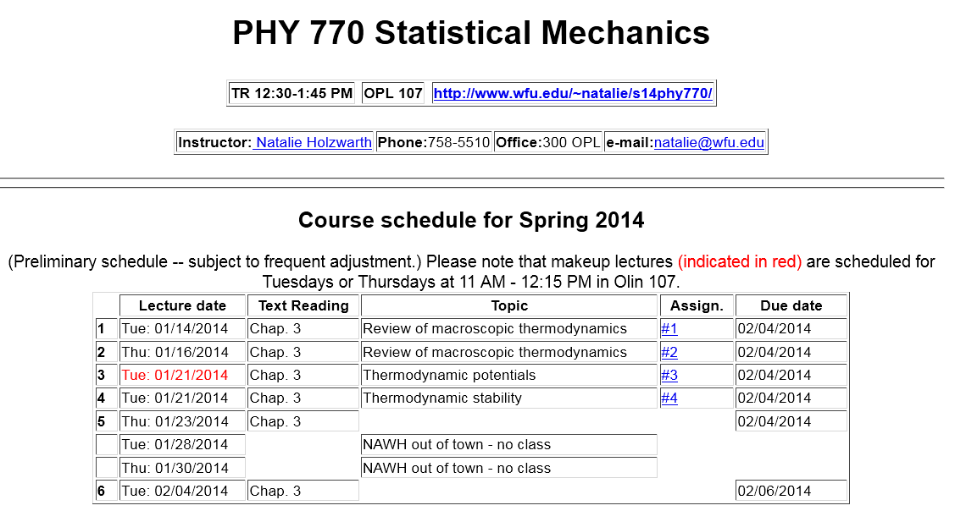

Slide 5
Summary of thermodynamic potentials
Potential | Variables | Total Diff | Fund. Eq.
U | S,X,N_{i}
H | S,Y,N_{i}
A | T,X,N_{i}
G | T,Y,N_{i}
Ω | T,X,μ_{i}

Slide 6
Derivative relationships of thermodynamic potentials

Slide 7
Properties of thermodynamic potentials
“Potential” in the sense that energy can be stored and retrieved through thermodynamic work
Equalities ⬅➔ reversible processes
Inequalities ⬅➔ general processes
Entropy
Entropy production due to irreversible processes
Reversible entropy contribution

Slide 8
Inequalities associated with thermodynamic potentials – continued
Entropy
➔ At equilibrium when dS=0 , S is a maximum

Slide 9
Inequalities associated with thermodynamic potentials – continued
Internal energy
At equilibrium when dU=0 , U is a minimum
(for fixed S, X, and {N_{i}})

Slide 10
Inequalities associated with thermodynamic potentials – continued
Enthalpy
At equilibrium when dH=0 , H is a minimum
(for fixed S, Y, and {N_{i}})

Slide 11
Inequalities associated with thermodynamic potentials – continued
Helmholz free energy
At equilibrium when dA=0 , A is a minimum
(for fixed T, X, and {N_{i}})

Slide 12
Inequalities associated with thermodynamic potentials – continued
Gibbs free energy
At equilibrium when dG=0 , G is a minimum
(for fixed T, Y, and {N_{i}})

Slide 13
Inequalities associated with thermodynamic potentials – continued
Grand potential
At equilibrium when dΩ=0 , Ω is a minimum
(for fixed T, X, and {μ_{i}})

Slide 14
Example:
Consider a system having a constant electrostatic potential φ at fixed T and P containing a fixed number of particles {N_{i}} for i=1,…ν−1. Find the change in the Gibbs free energy when dN_{ν} particles, each with charge q_{ν} are reversibly added to the system.

Slide 15
Thermodynamic response functions -- heat capacity

Slide 16
Thermodynamic response functions -- heat capacity -- continued

Slide 17
Example: Heat capacity

Slide 18
Thermodynamic response functions -- heat capacity -- continued

Slide 19
Thermodynamic response functions -- mechanical response
Results stated here without derivation:

Slide 20
Thermodynamic response functions -- mechanical response
Typical parameters:
Isothermal susceptiblity ⬅➔ isothermal compressibility
Adiabatic susceptiblity ⬅➔adiabatic compressibility
Thermal expansivity⬅➔ Thermal expansivity

Slide 21
Example: mechanical responses for an ideal gas

Slide 22
Stability analysis of the equilibrium state
⬅
➔
Assume that the total system is isolated, but that there can be exchange of variables A and B.

Slide 23
Stability analysis of the equilibrium state
⬅
➔
Note that this result does not hold for non-porous partition.

Slide 24
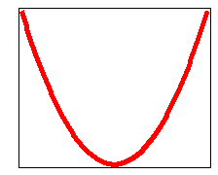
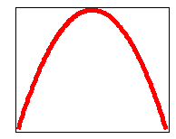
Stability analysis of the equilibrium state – continued
Note that the equilibrium condition can be a stable or unstable equilibrium.
f
f
x
x
Stable function
(convex)
Unstable function
(concave)

Slide 25
Stability analysis of the equilibrium state -- continued

