Slide 1
PHY 770 -- Statistical Mechanics
12:30-1:45 PM TR Olin 107
Instructor: Natalie Holzwarth (Olin 300)
Course Webpage: http://www.wfu.edu/~natalie/s14phy770
Lecture 6 -- Chapter 4
Review of Thermodynamics – continued
Thermodynamics of phase transitions
Phase equilibria; Clausius-Clapeyron equation

Slide 5
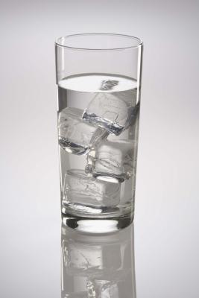
Thermodynamics of phase equilibria and transitions
Initially, focus on one component systems with multiple phases
Example: water
Phase I: Solid
Phase II: Liquid
Phase III: Gas

Slide 6
Phase diagram of water (http://www1.lsbu.ac.uk/water/phase.html)

Slide 7
Comments about phase transitions at constant T and P (or more generally T and Y).
G^{I}(T,Y)=G^{II}(T,Y) and μ^{I}(T,Y)=μ^{II}(T,Y)
Coexistence line defined by Y^{I-II}_{coexist}(T).
In this case, the coexistance of three phases is only possible at a point in the Y,T plane.
Phase transition can be first order when G has discontinuous first derivatives
Phase transition can be second order when G has continuous first derivatives

Slide 9
Thermodynamic description of the equilibrium between two forms “phases” of a material under conditions of constant T and P

Slide 10
Example of phase diagram :

Slide 11
Phase diagram for water:

Slide 12
piston
T,P
Consider a two phase system at constant T and P
A
B
Note: A and B denote different phases (previously I and II)

Slide 13
piston
T,P
A
B

Slide 14
P
g_{A} < g_{B}
g_{A} > g_{B}
T

Slide 16
Example – liquid – solid transition in water
P constant
G
Liquid
Solid
Melting T_{m}
T

Slide 18
More details

Slide 22
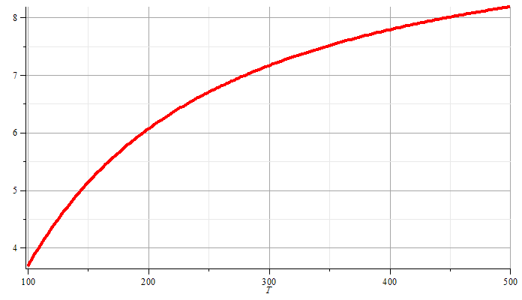
Approximate liquid-gas vaporization curve from Clausius-Clapeyron equation:
P

Slide 23
The van der Waals equation of state
-- More realistic than the ideal gas law; contains some of the correct attributes for liquid-gas phase transitions.

Slide 24
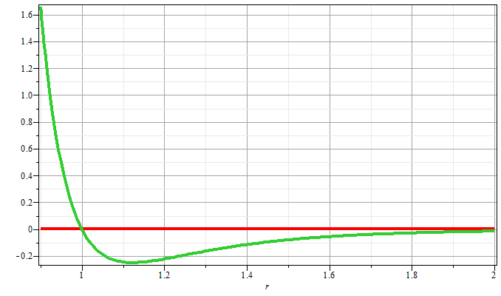
Some motivation for van der Waals equation of state
Johannes Diderik van der Waals – Ph. D. Thesis written in 1873 (The Netherlands) -- received Nobel Prize in 1910
General potential between two particles:

Slide 25
Substance | a (10⁻³⁰eV m³) | b (10⁻³⁰ m³)
water | 9.55 | 50.7
SO₂ | 11.9 | 94.7
CO₂ | 6.3 | 71.3
O₂ | 2.38 | 52.9
Ar | 2.36 | 53.8
N₂ | 2.36 | 64.3
H₂ | 0.428 | 44.3
⁴He | 0.0597 | 39.4
From: Baierlein, Thermal Physics

Slide 26
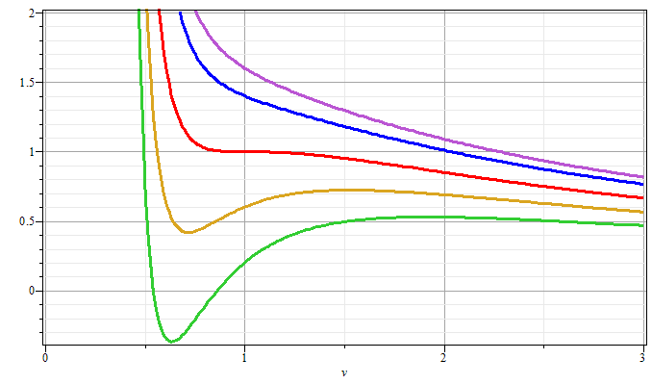
Gas
T/T_{c}>1
T/T_{c}=1
P/P_{c}
Liquid
T/T_{c}<1
V/V_{c}

Slide 27
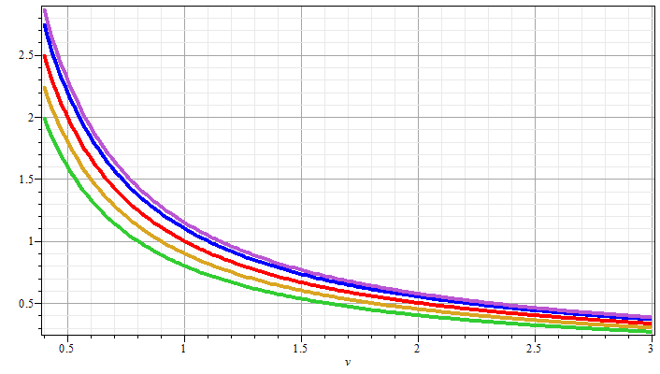
P/P_{c}
Decreasing values of T
V/V_{c}

Slide 28
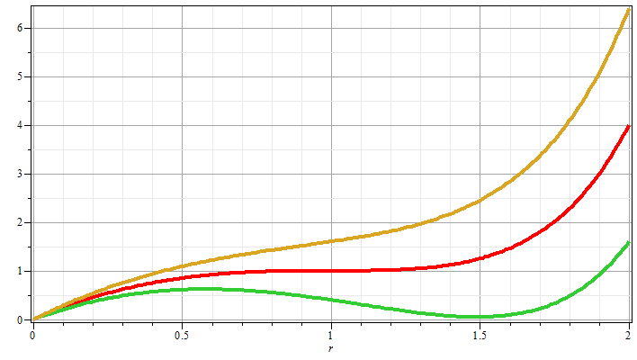
P
⬅ unphysical
ρ

Slide 29
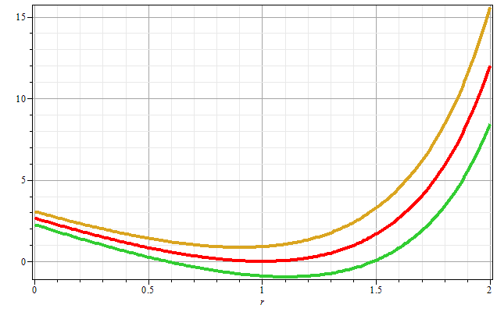
ρ

Slide 30
Behavior of the thermodynamic potentials for the van der Waals equation of state

Slide 31
Behavior of the thermodynamic potentials for the van der Waals equation of state

Slide 32
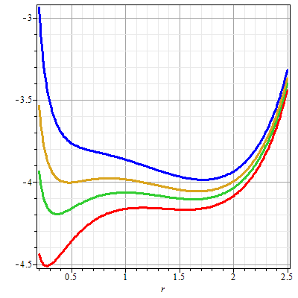
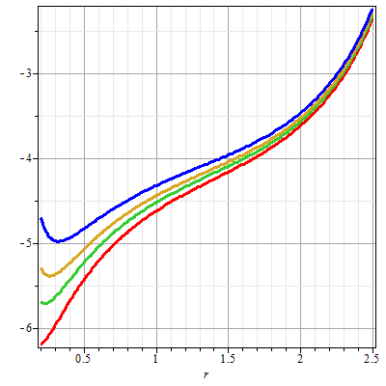

Slide 33
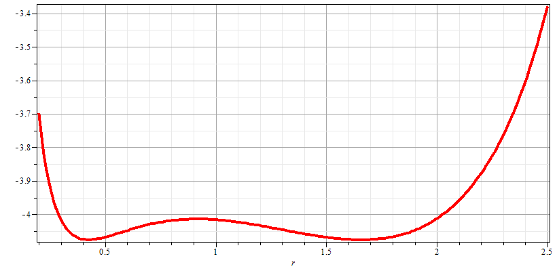
Gibbs chemical potential at coexistence point
gas
liquid

Slide 35
Analysis of gas-liquid coexistence conditions

Slide 36
Analysis of gas-liquid coexistence conditions -- continued

Slide 38
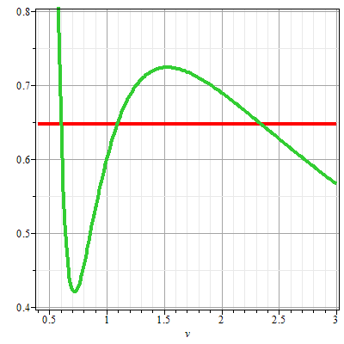
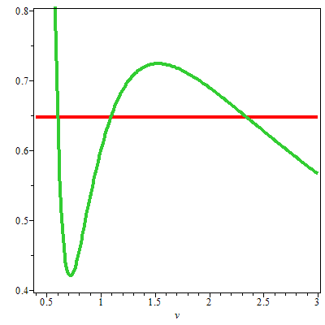
P-V diagram for van der Waals material at T/T_{c}=0.9
P/P_{c}
P/P_{c}
liquid
➔
liquid & gas
gas
V/V_{c}
V/V_{c}

Slide 40
Phase diagram for van der Waals material
P/P_{c}
1
0.65
liquid
gas
0.9
1
T/T_{c}

