Slide 1
PHY 712 Electrodynamics
9-9:50 AM MWF Olin 103
Plan for Lecture 10:
Complete reading of Chapter 4
Microscopic ⬅➔macroscopic polarizability
Clausius-Mossotti equation
Electrostic energy in dielectric media

Slide 2
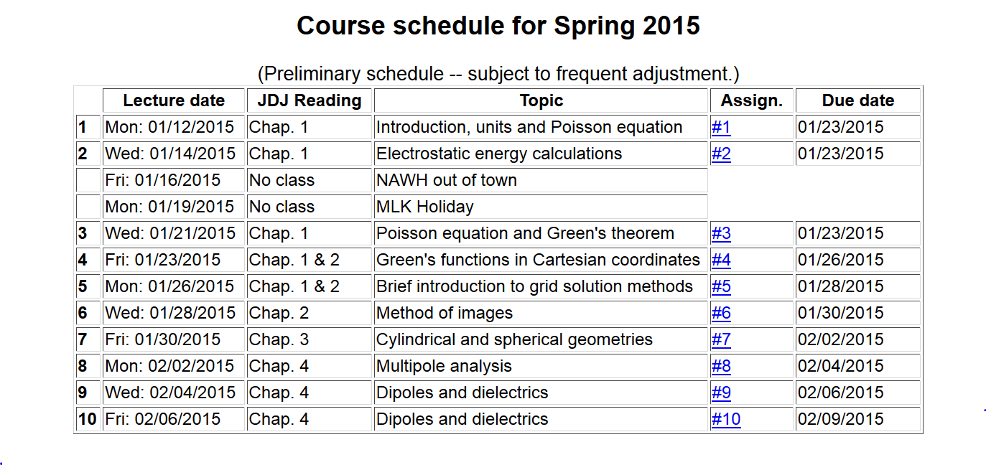

Slide 3
Focus on dipolar fields:

Slide 4
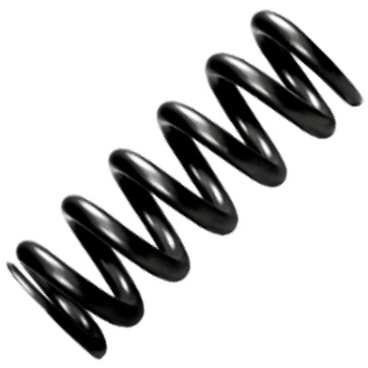
Microscopic origin of dipole moments
Polarizable isotropic atoms/molecules
Charge anisotropic molecules
Polarizable isotropic atoms/molecules
E
+q
k=mω₀²
x

Slide 5
Polarizable isotropic atoms/molecules – continued:
+q
E
k=mω₀²
δx

Slide 6
Alignment of molecules with permanent dipoles p₀:
E
p₀
+
-

Slide 7
Field due to collection of induced dipoles
1
2
7
3
6
5
4
9
8

Slide 8
Field due to collection of induced dipoles -- continued
2
1
7
3
5
6
4
9
8

Slide 9
Field due to collection of induced dipoles -- continued
2
1
7
3
5
6
4
9
8
Claussius-Mossotti equation

Slide 10
Example of the Clausius-Mossotti equation –
Pentane (C₅H₁₂) at various densities
Density (g/cm3) | Mol/m3 | ε/ε0 | 3V*(ε/ε0-1)/(ε/ε0+2)
0.613 | 5.12536E+27 | 1.82 | 1.25646E-28
0.701 | 5.86114E+27 | 1.96 | 1.24084E-28
0.796 | 6.65544E+27 | 2.12 | 1.22536E-28
0.865 | 7.23236E+27 | 2.24 | 1.2131E-28
0.907 | 7.58353E+27 | 2.33 | 1.2151E-28
γ_{mol} = 1.2 x 10⁻²⁸ m³= 0.12 nm³

Slide 11
Re-examination of electrostatic energy in dielectric media

Slide 12
Comment on the “Modern Theory of Polarization”
Some references:
R. D.King-Smith and D. Vanderbilt, Phys. Rev. B 47, 1651 (1993)
R. Resta, Rev. Mod. Physics 66, 699 (1994)
R. Resta, J. Phys. Condens. Matter 23, 123201 (2010)
N. A. Spaldin, J. Solid State Chem. 195, 2 (2012)
Note: In general P is highly dependent on the boundary values; often it is more convenient/meaningful to calculate ΔP.

Slide 13
Comment on the “Modern Theory of Polarization”
-- continued
By contrast, the concept of the polarization of a periodic solid is not unique:

Slide 14
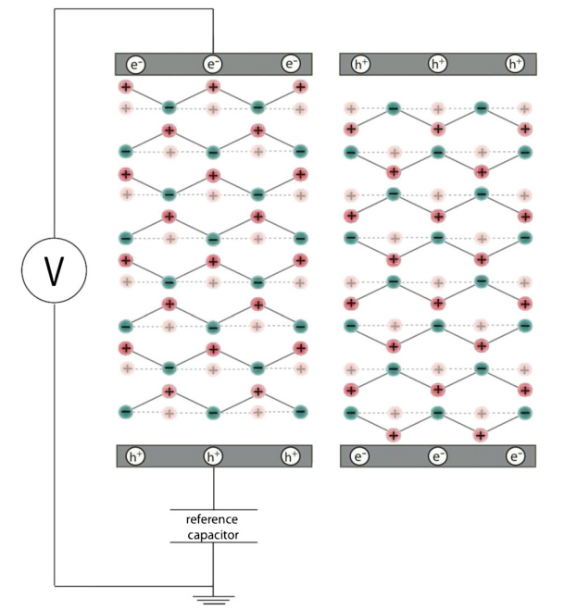
ΔP example

Slide 15
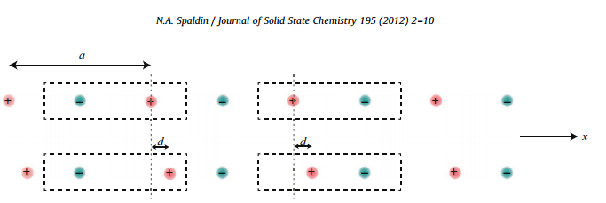
ΔP example -- linear visualization
Effects on the electronic distribution
Na
Cl

