Slide 1
PHY 712 Electrodynamics
9-9:50 AM MWF Olin 103
Plan for Lecture 4:
Reading: Chapter 1 & 2 in JDJ
Electrostatic potentials
One, two, and three dimensions (Cartesian coordinates)
Mean value theorem for the electrostatic potential

Slide 2
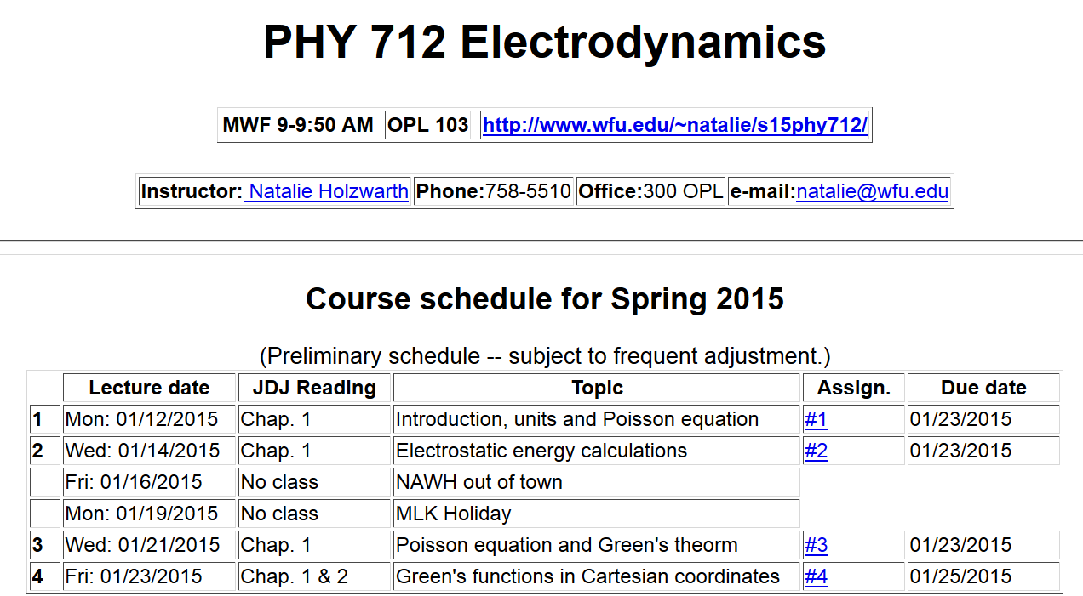

Slide 3
Poisson Equation

Slide 4
Poisson equation for one-dimensional system

Slide 5
General procedure for constructing Green’s function for one-dimensional system using 2 independent solutions of the homogeneous equations
Beautiful method; but only works in one dimension.

Slide 7
Orthogonal function expansion -- continued

Slide 8
Example

Slide 9
Example -- continued

Slide 10
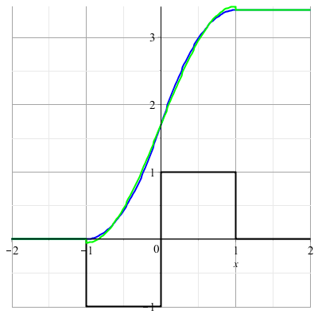
Example -- continued

Slide 11
Orthogonal function expansions in 2 and 3 dimensions
(See Eq. 3.167 in Jackson for example.)

Slide 12
Combined orthogonal function expansion and homogeneous solution construction of Green’s function
in 2 and 3 dimensions.
For the two and three dimensional cases, we can use this technique in one of the dimensions in order to reduce the number of summation terms. These ideas are discussed in Section 3.11 of Jackson.

Slide 13
Green’s function construction -- continued

Slide 14
Green’s function construction -- continued
b
a

Slide 15
b
a

Slide 17
