Slide 1
PHY 712 Electrodynamics
9-9:50 AM Olin 103
Plan for Lecture 17:
Read Chapter 7
Real and imaginary contributions to electromagnetic response
Frequency dependence of dielectric materials; Drude model
Kramers-Kronig relationships

Slide 2
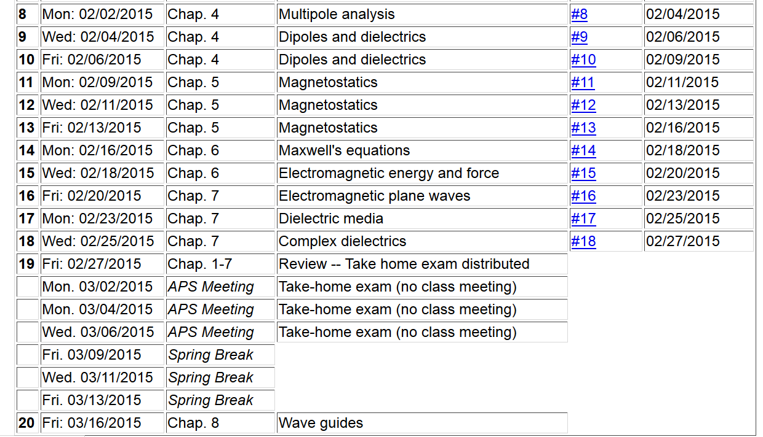

Slide 3
Maxwell’s equations

Slide 4
Plane wave solutions to sourceless Maxwell’s equations; extension of analysis to complex dielectric functions

Slide 5
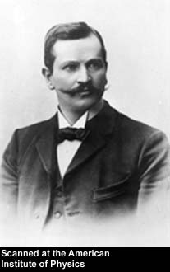
Paul Karl Ludwig Drude 1863-1906
http://photos.aip.org/history/Thumbnails/drude_paul_a1.jpg

Slide 6
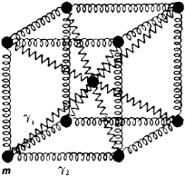
Drude model:
Vibrations of charged particles near equilibrium:
δr
http://img.tfd.com/ggse/d6/gsed_0001_0012_0_img2972.png

Slide 7
Drude model:
Vibration of particle of charge q and mass m near equilibrium:
δr
http://img.tfd.com/ggse/d6/gsed_0001_0012_0_img2972.png
Note that:
γ > 0 represents dissipation of energy.
ω₀ represents the natural frequency of the vibration; ω₀=0 would represent a free (unbound) particle

Slide 8
Drude model:
Vibration of particle of charge q and mass m near equilibrium:
δr
http://img.tfd.com/ggse/d6/gsed_0001_0012_0_img2972.png

Slide 9
Drude model:
Vibration of particle of charge q and mass m near equilibrium:
δr
http://img.tfd.com/ggse/d6/gsed_0001_0012_0_img2972.png

Slide 10
Drude model:
Vibration of particle of charge q and mass m near equilibrium:
δr
http://img.tfd.com/ggse/d6/gsed_0001_0012_0_img2972.png

Slide 11
Drude model dielectric function:

Slide 12
Drude model dielectric function:

Slide 13
Drude model dielectric function – some analytic properties:

Slide 14
Drude model dielectric function – some analytic properties:

Slide 15
Analytic properties of the dielectric function (in the Drude model or from “first principles” -- Kramers-Kronig transform
Im(z)
α
Re(z)

Slide 16
Kramers-Kronig transform -- continued
Im(z)
α
Re(z)
=0

Slide 17
Kramers-Kronig transform -- continued

Slide 18
Kramers-Kronig transform -- continued

Slide 19
u
a u_{s} b

Slide 21
Analysis for Drude model dielectric function:

Slide 22
Analysis for Drude model dielectric function – continued --
Analytic properties:

Slide 23
Kramers-Kronig transform – for dielectric function:

Slide 24
Further comments on analytic behavior of dielectric function

