Slide 1
PHY 712 Electrodynamics
9-9:50 AM Olin 103
Plan for Lecture 18:
Complete reading of Chapter 7
Summary of complex response functions in electromagnetic fields
Summary of TEM plane wave solutions to Maxwell’s equations
Comments on some homework problems

Slide 2
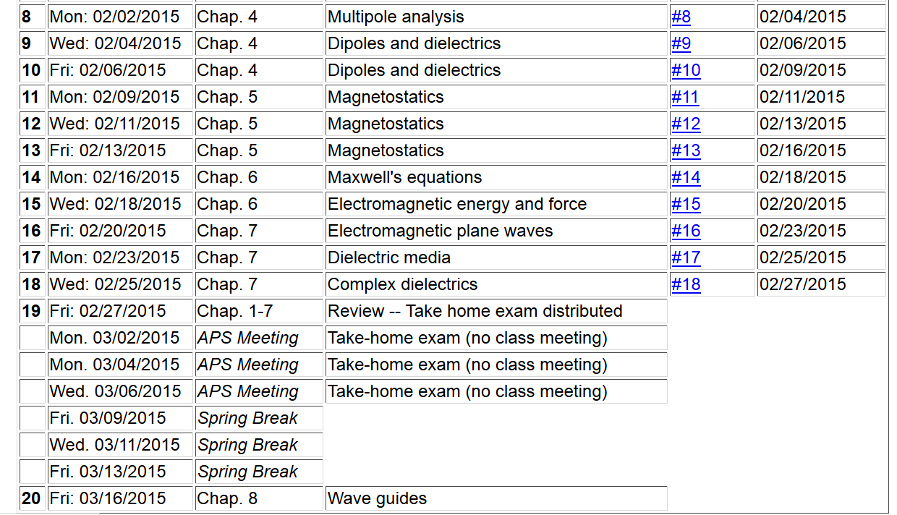

Slide 4
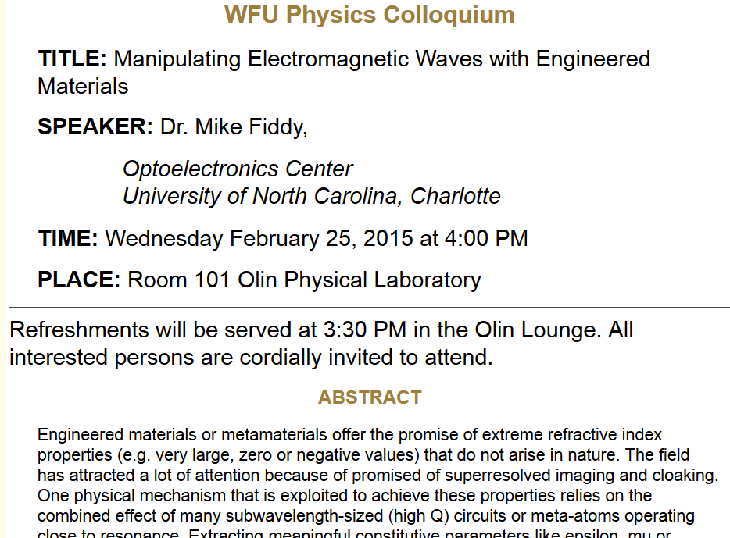

Slide 5
Review: Drude model dielectric function:

Slide 6
Drude model dielectric function:

Slide 7
Drude model dielectric function – some analytic properties:

Slide 8
Analysis for Drude model dielectric function – continued --
Analytic properties:

Slide 9
Because of these analytic properties, Cauchy’s integral theorem results in:
Kramers-Kronig transform – for dielectric function:

Slide 10
Further comments on analytic behavior of dielectric function

Slide 11
Review: Electromagnetic plane waves in isotropic medium with real permeability and permittivity: μ ε.

Slide 12
Review:
Reflection and refraction between two isotropic media
μ’ ε’
θ
k’
μ ε
k_{i}
k_{R}
i
R

Slide 13
Reflection and refraction between two isotropic media -- continued
μ’ ε’
θ
k’
μ ε
k_{i}
k_{R}
i
R
Total internal reflection:

Slide 14
For s-polarization
For p-polarization

Slide 15
Special case: normal incidence (i=0, θ=0)
PHY 712 Spring 2013 -- Lecture 19
15

Slide 16
Extension to complex refractive index n= n_{R} + i n_{I}

Slide 17
Fields near the surface on an ideal conductor

Slide 18
Fields near the surface on an ideal conductor -- continued

Slide 19
Fields near the surface on an ideal conductor -- continued
r||
0
z

Slide 20
Fields near the surface on an ideal conductor -- continued
r||
0
z

Slide 21
Boundary values for ideal conductor
E₀
At the boundary of an ideal conductor, the E and H fields decay in the direction normal to the interface, the field directions are in the plane of the interface.
Waveguide terminology
TEM: transverse electric and magnetic (both E and H fields are perpendicular to wave propagation direction)
TM: transverse magnetic (H field is perpendicular to wave propagation direction)
TE: transverse electric (E field is perpendicular to wave propagation direction)

Slide 22
TEM waves
Transverse electric and magnetic (both E and H fields are perpendicular to wave propagation direction)

Slide 23
Wave guides
Coaxial cable
TEM modes
Simple optical pipe
TE or TM modes

Slide 24
Comment on HW #11
Consider an infinitely long wire with radius a, oriented along the z axis. There is a steady uniform current inside the wire. Specifically the current is along the z-axis with the magnitude of J₀ for ρ ≤ a and zero for ρ > a, where ρ denotes the radial parameter of the natural cylindrical coordinates of the system.
Find the vector potential (A) for all ρ.
Find the magnetic flux field (B) for all ρ.
Solution to problem using PHY 114 ideas
In this case, it is convenient to solve part b first.
Top view for ρ < a
Top view for ρ > a
J₀
B
B

Slide 25
Comment on HW #11 -- continued
Top view for ρ < a
Top view for ρ > a
B
B

Slide 26
Comment on HW #11 -- continued
J₀

Slide 27
Comment on HW #12
A sphere of radius a carries a uniform surface charge distribution σ. The sphere is rotated about a diameter with constant angular velocity ω. Find the vector potential A and magnetic field B both inside and outside the sphere.
ω
r

Slide 28
Comment on HW #12 -- continued

