Slide 1
PHY 712 Electrodynamics
9-9:50 AM Olin 103
Plan for Lecture 19:
Review Chapter 1-7 in Jackson
Brief review
Comments on some homework problems
Distribution of take home exam

Slide 2
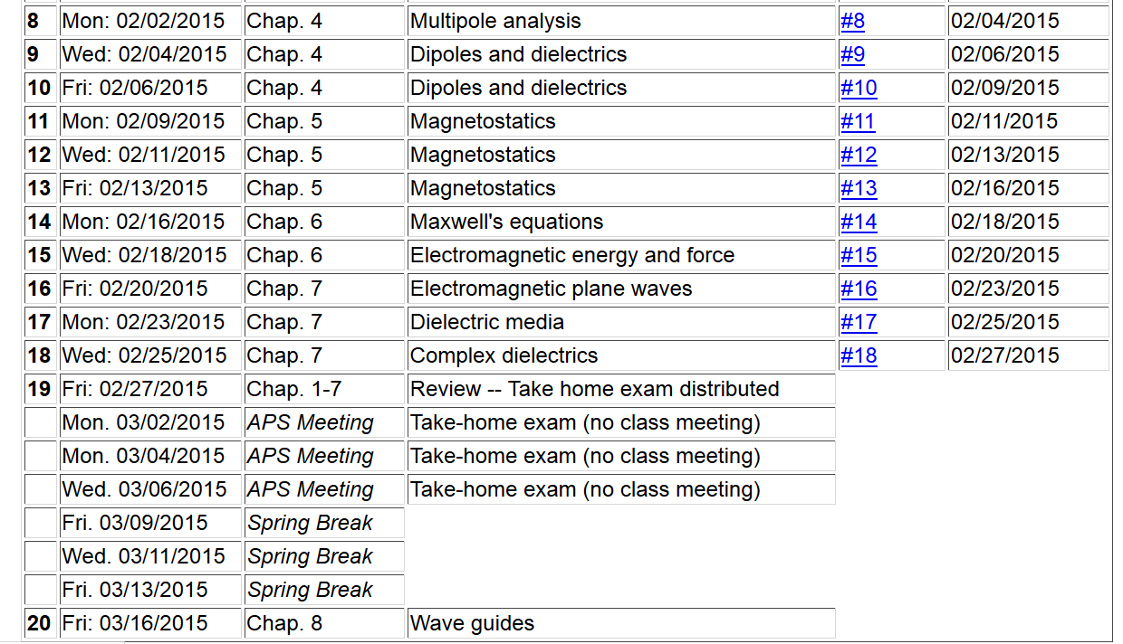

Slide 3
Review
Maxwell’s equations

Slide 4
Review -- continued
Maxwell’s equations

Slide 5
Review -- continued

Slide 6
Review -- continued

Slide 7
Review -- continued
When to solve equations using integral form
versus differential form?
Examples from electrostatic and magnetostatic cases:
Useful for spatially confined sources.

Slide 8
Review -- continued
Useful identity:

Slide 9
Review -- continued
Some spherical harmonic functions:

Slide 10
Review -- continued

Slide 11
Review -- continued
Hyperfine interaction energy:
Putting all of the terms together:
In this expression the brackets indicate evaluating the expectation value relative to the electronic state.

Slide 12
Review of HW problem:
4.9 in Jackson
A point charge q is located in free space a distance d from the center of a dielectric sphere of radius a (a<d) and dielectric constant ε/ε₀. Find the electrostatic potential.
a
q
d

Slide 13
Review of HW -- continued

Slide 14
Comment about HW 17 (7.4 in Jackson)

