Slide 1
PHY 712 Electrodynamics
9-9:50 AM MWF Olin 103
Plan for Lecture 21:
Start reading Chap. 8 in Jackson.
Examples of waveguides
TEM, TE, TM modes
Resonant cavities

Slide 2
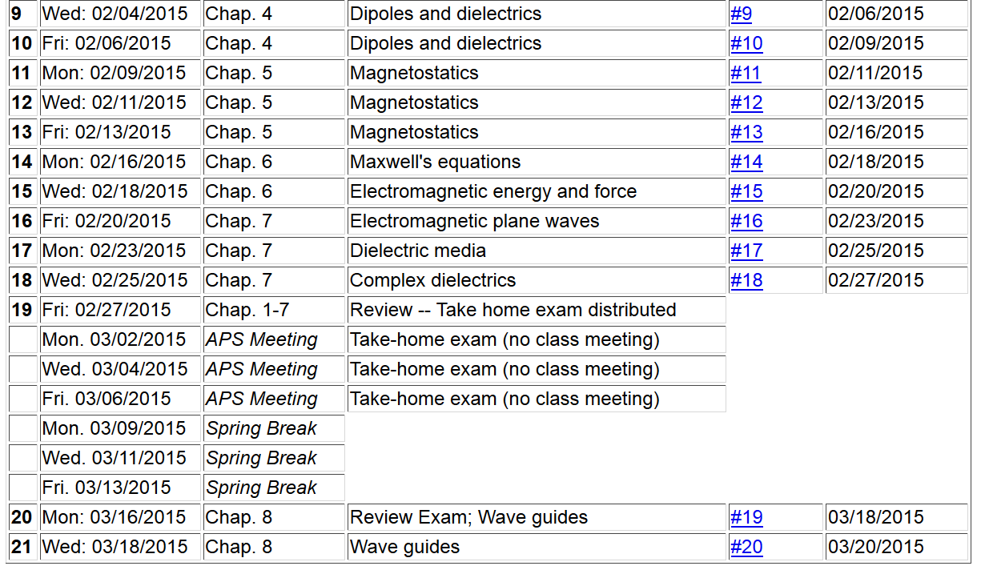

Slide 5
Reminder:
Topic choices for “computational project”
– suggestions available upon request
-- due Monday March 30th?

Slide 6
Fields near the surface on an ideal conductor

Slide 7
Fields near the surface on an ideal conductor -- continued

Slide 8
Fields near the surface on an ideal conductor -- continued

Slide 9
Fields near the surface on an ideal conductor -- continued

Slide 10
Boundary values for ideal conductor
At the boundary of an ideal conductor, the E and H fields decay in the direction normal to the interface.
H₀

Slide 11
Waveguide terminology
TEM: transverse electric and magnetic (both E and H fields are perpendicular to wave propagation direction)
TM: transverse magnetic (H field is perpendicular to wave propagation direction)
TE: transverse electric (E field is perpendicular to wave propagation direction)

Slide 12
Wave guides
Top view:
z
μ ε
Inside medium, μ ε assumed to be real
a
b
Coaxial cable
TEM modes
(following problem 8.2 in Jackson’s text)

Slide 13
Electromagnetic waves in a coaxial cable -- continued
Top view:
μ ε
ρ
a
φ
b

Slide 14
Electromagnetic waves in a coaxial cable -- continued
Top view:
μ ε
ρ
a
φ
b

Slide 15
Analysis of rectangular waveguide
Boundary conditions at surface of waveguide:
E_{tangential}=0, B_{normal}=0
y
x
z
Cross section view
b
a

Slide 16
Analysis of rectangular waveguide
y
x
z

Slide 17
Maxwell’s equations within the pipe:

Slide 18
Solution of Maxwell’s equations within the pipe:

Slide 19
TE modes for retangular wave guide continued:

Slide 20
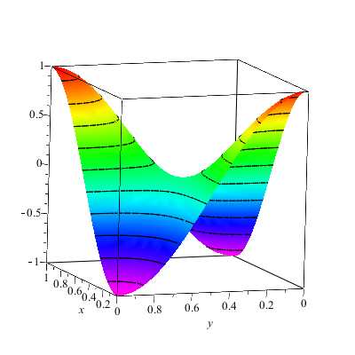
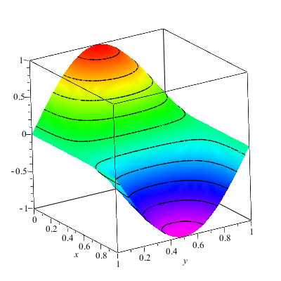
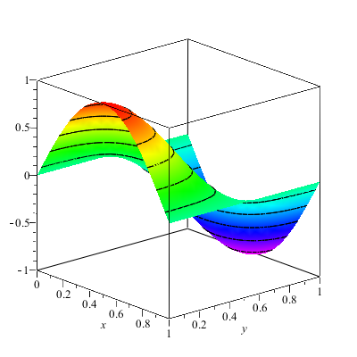
Solution for m=n=1

Slide 21
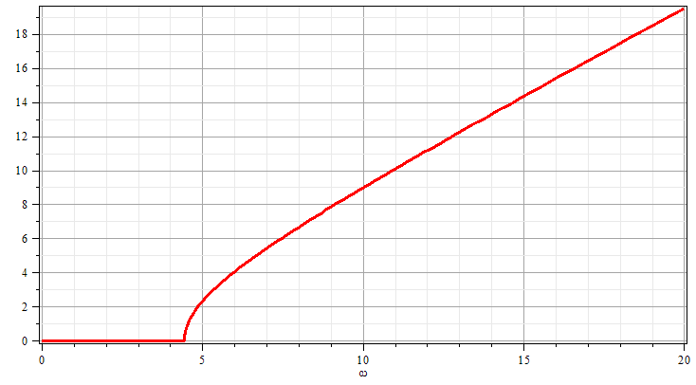
Solution for m=n=1
k
ω

Slide 22
Resonant cavity
y
x
z
22

Slide 23
Resonant cavity
y
x
z

