Slide 1
PHY 712 Electrodynamics
9-9:50 AM MWF Olin 103
Plan for Lecture 22:
Start reading Chap. 9
Electromagnetic waves due to specific sources
Dipole radiation patterns

Slide 2
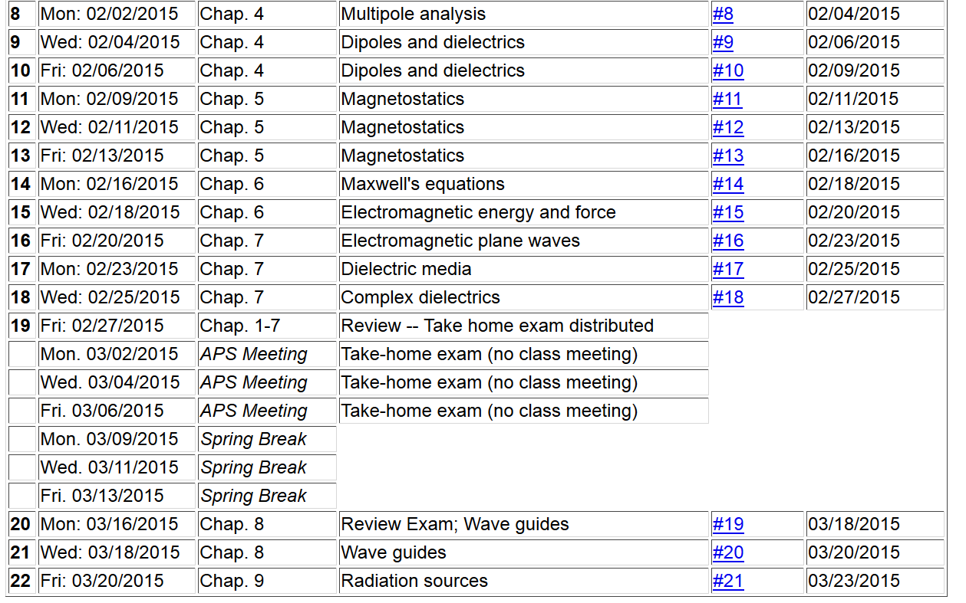

Slide 3
Maxwell’s equations

Slide 4
Formulation of Maxwell’s equations in terms of vector and scalar potentials

Slide 5
Formulation of Maxwell’s equations in terms of vector and scalar potentials -- continued

Slide 6
Solution of Maxwell’s equations in the Lorentz gauge -- continued

Slide 7
Electromagnetic waves from time harmonic sources

Slide 8
Electromagnetic waves from time harmonic sources – continued:

Slide 9
Electromagnetic waves from time harmonic sources – continued:

Slide 10
Electromagnetic waves from time harmonic sources – continued:

Slide 11
Electromagnetic waves from time harmonic sources – continued:

Slide 12
Forms of spherical Bessel and Hankel functions:

Slide 13
Electromagnetic waves from time harmonic sources – continued:

Slide 14
Electromagnetic waves from time harmonic sources – continued:

Slide 15
Electromagnetic waves from time harmonic sources – continued:

Slide 16
Electromagnetic waves from time harmonic sources – continued:
Note: in this case we have assumed a restricted extent of the source such that kr’<<1.

Slide 17
Electromagnetic waves from time harmonic sources – continued:

Slide 18
Example of dipole radiation source

Slide 19
Example of dipole radiation source -- continued
Relationship to pure dipole approximation (exact when kR➔0)

