Slide 1
PHY 712 Electrodynamics
9-9:50 AM MWF Olin 103
Plan for Lecture 23:
Continue reading Chap. 9 & 10
Electromagnetic waves due to specific sources
Dipole radiation examples
Scattered radiation

Slide 2
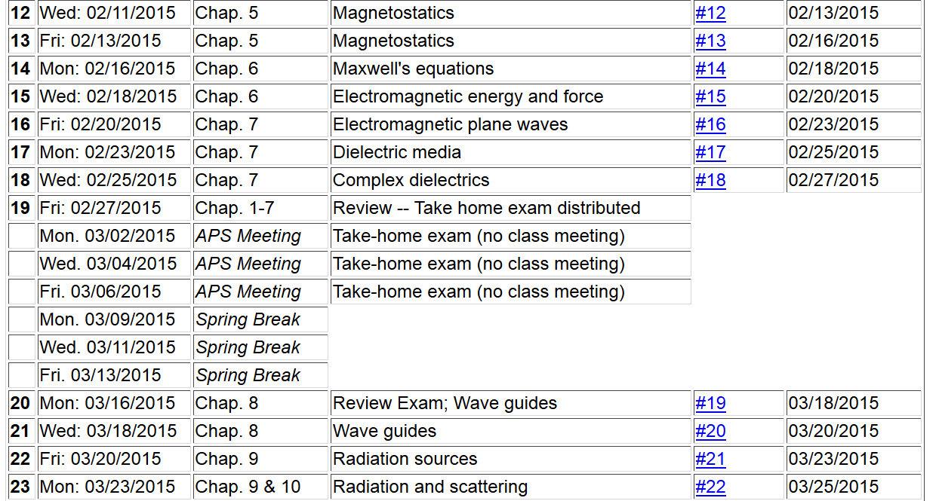

Slide 3
Review:
Maxwell’s equations

Slide 4
Review:
Formulation of Maxwell’s equations in terms of vector and scalar potentials:

Slide 5
Review:
Electromagnetic waves from time harmonic sources

Slide 6
Review:
Electromagnetic waves from time harmonic sources – continued:

Slide 7
Review:
Forms of spherical Bessel and Hankel functions:

Slide 8
Review:
Electromagnetic waves from time harmonic sources – continued:

Slide 9
Review:
Electromagnetic waves from time harmonic sources – continued:

Slide 10
Properties of dipole radiation field for kr >>1:
z
Example:
r
θ
p
y
B
x
E

Slide 11
Alternative approach

Slide 12
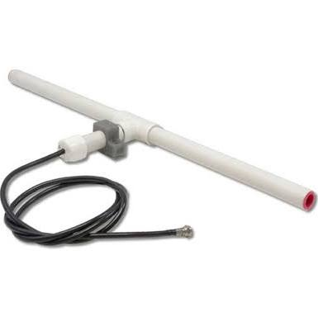
r
Alternative approach -- continued
z
Linear center-fed antenna
θ
d/2

Slide 13
Alternative approach – linear center-fed antenna continued

Slide 14
Alternative approach – linear center-fed antenna continued

Slide 15
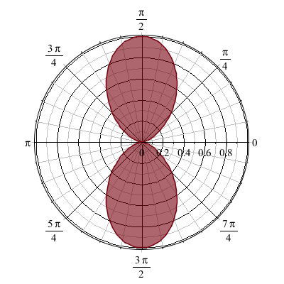
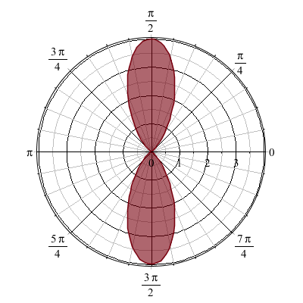
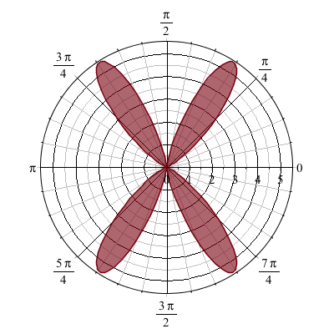
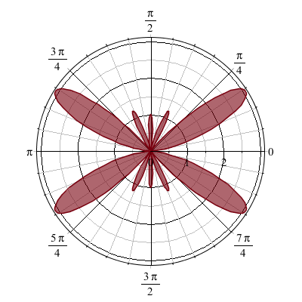
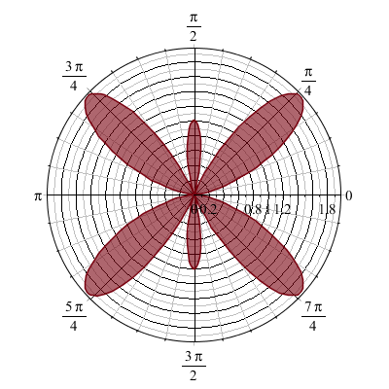
Alternative approach – linear center-fed antenna continued
kd=π 2π 3π 4π 5π

Slide 16
Dipole radiation in light scattering by small (dielectric) particles
E_{sc}
H_{sc}
E_{inc}
H_{inc}

Slide 17
Dipole radiation in light scattering by small (dielectric) particles
E_{sc}
H_{sc}
E_{inc}
H_{inc}

Slide 18
Estimation of scattering dipole moment:
Suppose the scattering particle is a dielectric sphere with permittivity ε and radius a:

Slide 19
Scattering by dielectric sphere with permittivity ε and radius a:
For E_{inc} polarized in scattering plane:
θ
θ

Slide 20
Scattering by dielectric sphere with permittivity ε and radius a:
For E_{inc} polarized perpendicular to scattering plane:
θ

Slide 21
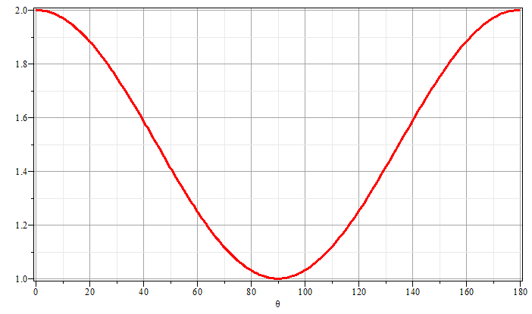
Scattering by dielectric sphere with permittivity ε and radius a:
θ
θ

