Slide 1
PHY 712 Electrodynamics
9-9:50 AM MWF Olin 103
Plan for Lecture 24:
Complete reading of Chap. 9 & 10
Superposition of radiation
Scattered radiation

Slide 2
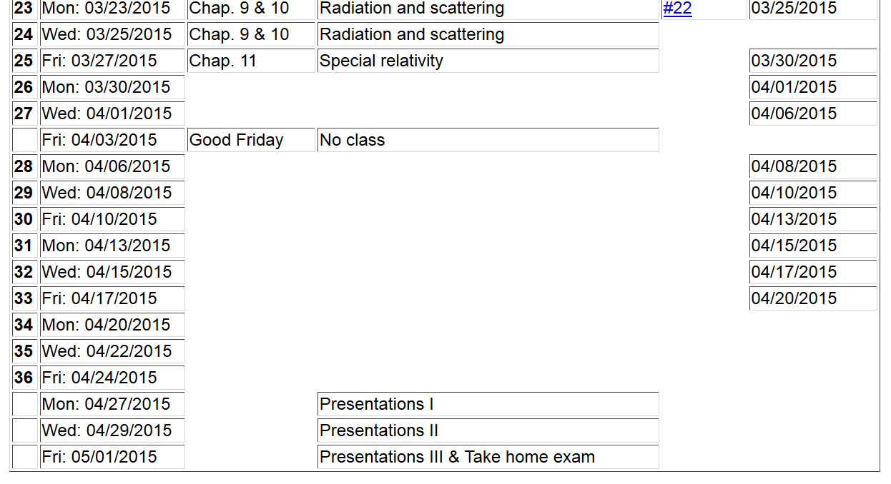

Slide 4
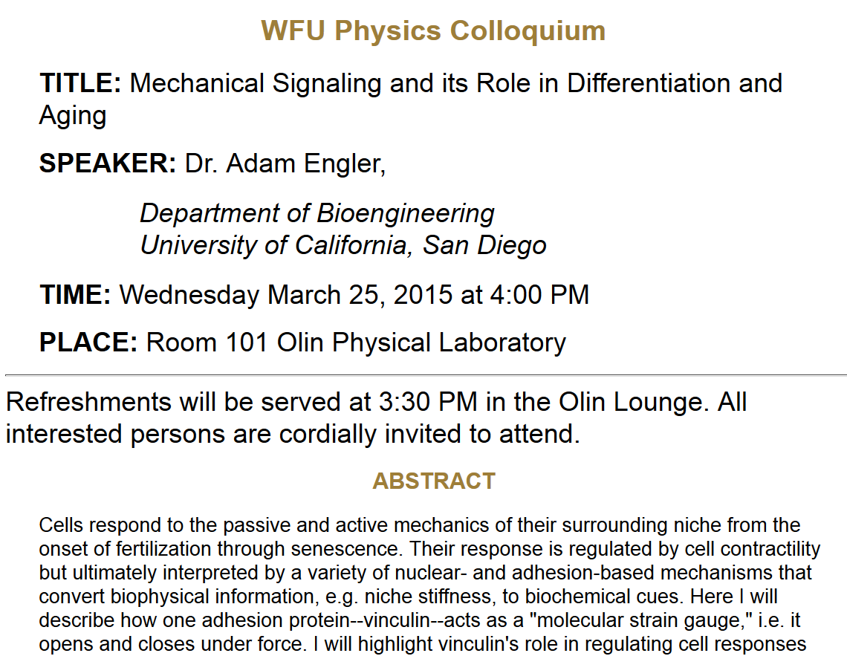

Slide 5
Electromagnetic waves from time harmonic sources – review:

Slide 6
Consider antenna source (center-fed)
Note – these notes differ from previous formulation d/2 ←→ d
r
z
d
θ
φ
y
d
x
6

Slide 7
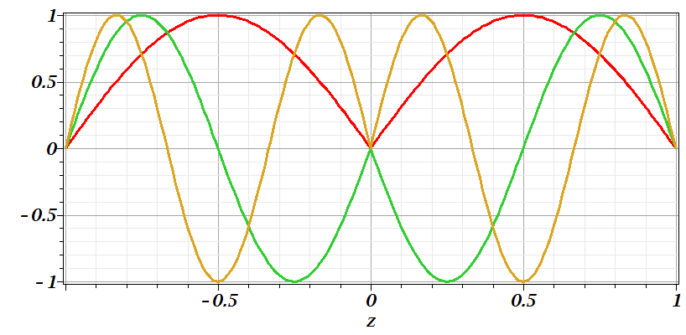
Consider antenna source -- continued
n=1
n=2
n=3

Slide 8
Consider antenna source -- continued

Slide 9
Consider antenna source -- continued

Slide 10
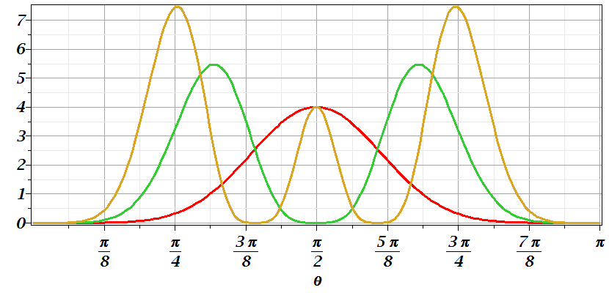
Consider antenna source -- continued
n=1
n=2
n=3

Slide 11
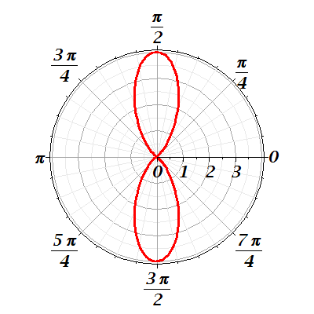
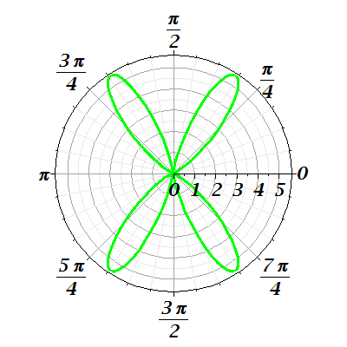
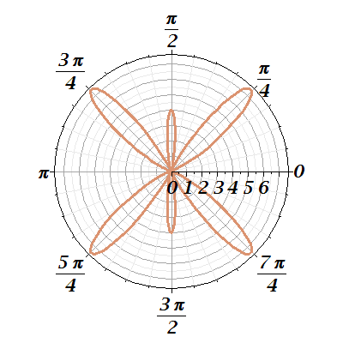
Consider antenna source -- continued
n=1
n=2
n=3

Slide 12
Radiation from antenna arrays
z
y
θ
φ
2d
x
a

Slide 13
Radiation from antenna arrays -- continued

Slide 14
Radiation from antenna arrays -- continued
N=2;a=d/2; φ=0
N=0
N=2;a=d; φ=0

Slide 15
Brief introduction to multipole expansion of electromagnetic fields (Chap. 9.7)

Slide 16
Multipole expansion of electromagnetic fields -- continued

Slide 17
Multipole expansion of electromagnetic fields -- continued
spherical Bessel function
spherical Bessel function

Slide 18
Multipole expansion of electromagnetic fields -- continued

Slide 19
Multipole expansion of electromagnetic fields -- continued

