Slide 1
PHY 712 Electrodynamics
9-9:50 AM MWF Olin 103
Plan for Lecture 26:
    Continue reading Chap. 11 –
    Theory of Special Relativity
      Lorentz transformation relations
      Electromagnetic field transformations
      Connection to Liénard-Wiechert potentials for constant velocity sources

Slide 2
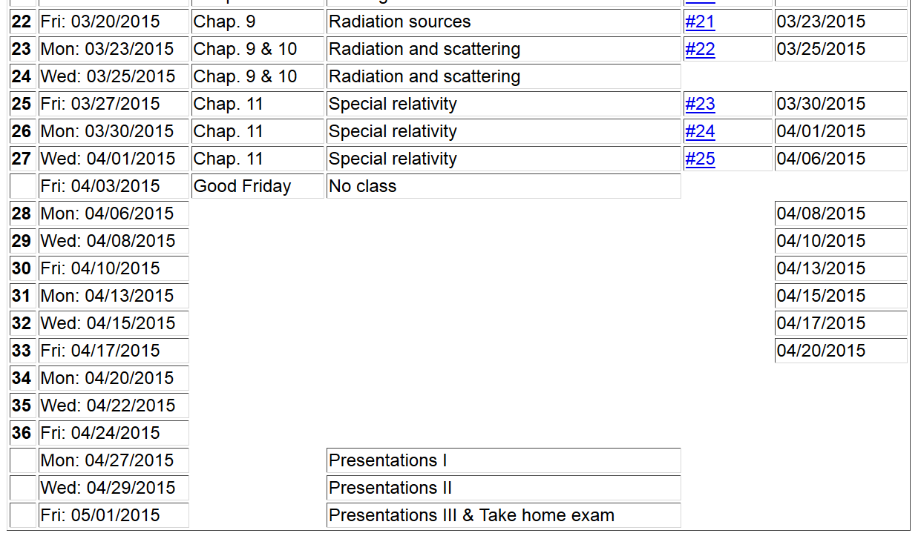

Slide 3
Lorentz transformations
y
y’
v
x
x’
y’
y
x’
x

Slide 4
Lorentz transformations -- continued

Slide 5
Special theory of relativity and Maxwell’s equations

Slide 6
More 4-vectors:

Slide 7
Lorentz transformations

Slide 8
4-vector relationships

Slide 9
Special theory of relativity and Maxwell’s equations

Slide 10
Electric and Magnetic field relationships

Slide 11
Field strength tensor
Transformation of field strength tensor

Slide 12
Inverse transformation of field strength tensor

Slide 13
Example:
y
y’
v
b
q
x
x’
z
z’

Slide 14
Example:
y
y’
v
b
q
x
x’
z
z’

Slide 15
Example:
y
y’
v
b
q
x
x’
z
z’
Expression in terms of consistent coordinates

Slide 16
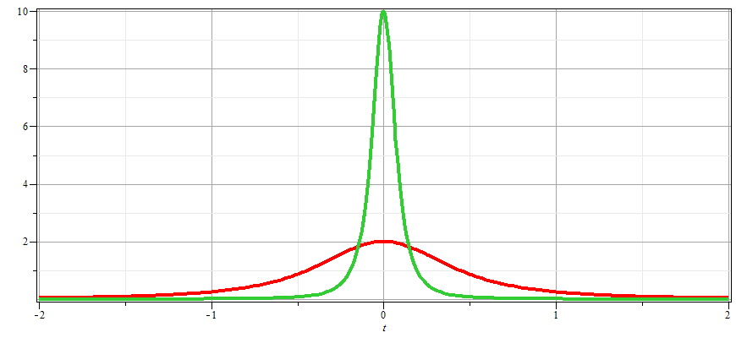
γ_{v}=10
γ_{v}=2

Slide 17
Examination of this system from the viewpoint of the
the Liènard-Wiechert potentials (temporarily keeping SI units

Slide 18
Examination of this system from the viewpoint of the
the Liènard-Wiechert potentials – continued (SI units)

Slide 19
Examination of this system from the viewpoint of the
the Liènard-Wiechert potentials – continued (SI units)

Slide 20
Examination of this system from the viewpoint of the
the Liènard-Wiechert potentials – continued (Gaussian units)

Slide 21
Examination of this system from the viewpoint of the
the Liènard-Wiechert potentials – continued (Gaussian units)

